Slide 1
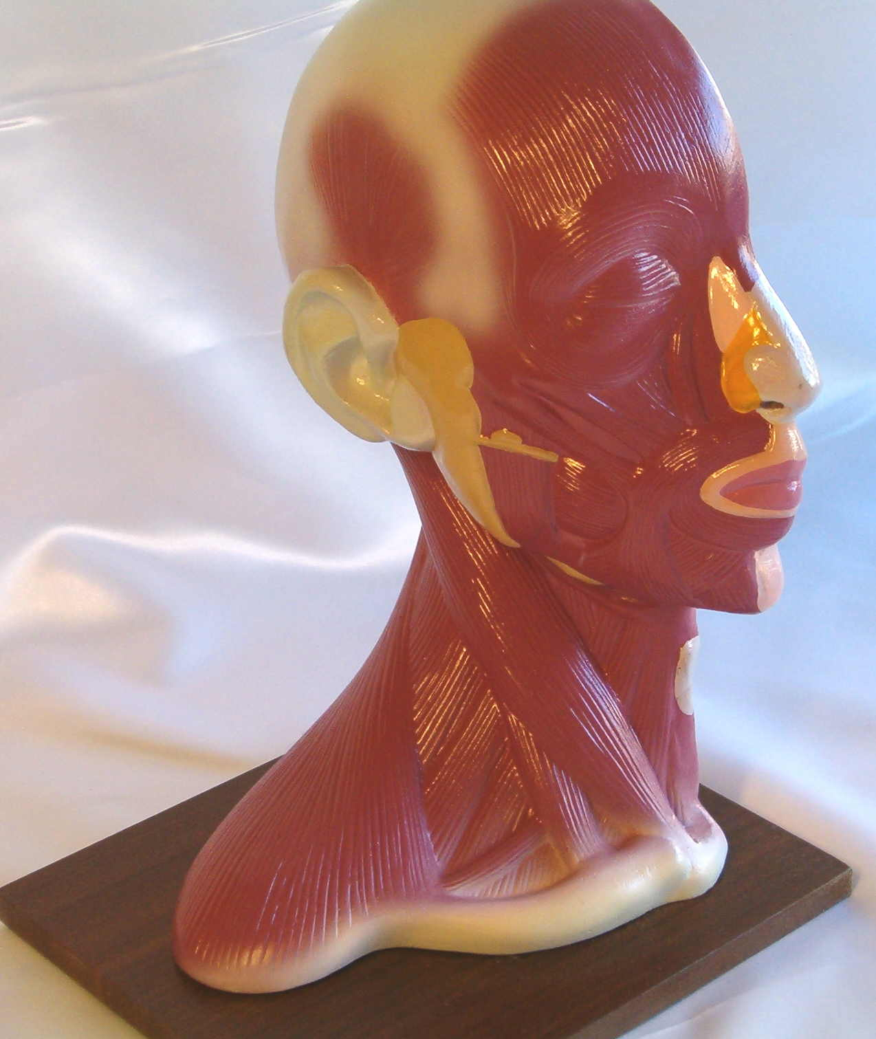
Use (overuse) of High end Technologies in IMRT/IGRT- Update

Slide 2
Over view of my talk
Uses of high end technology (IMRT/IGRT) in-
  Evidence in favor of IMRT/IGRT.
  Target volume delineation (contouring).
  Target volume doses-
    Treatment planning
    Replanning – Adaptive Radiotherapy (ART).
  Treatment Delivery (Setup errors).
  Clinical outcomes.

Slide 3
Aims of Intensity Modulation
Provide excellent locoregional control.
Sparing salivary function and dose to normal structures.
Chao et al- Green Journal, vol. 61, no. 3, pp. 275–280, 2001.
Lee et al- IJROBP, vol. 53, no. 1, pp. 12–22,2002.
Eisbruch et al- IJROBP, vol. 76, no. 5, pp. 1333–1338, 2010
Steep dose gradients between neighbouring disease and avoidance structures.
David L. Schwartz, Journal of Oncology Volume 2011, Article ID 690595

Slide 4
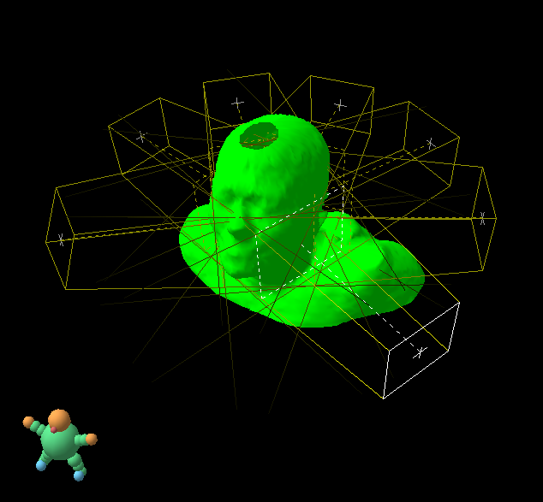
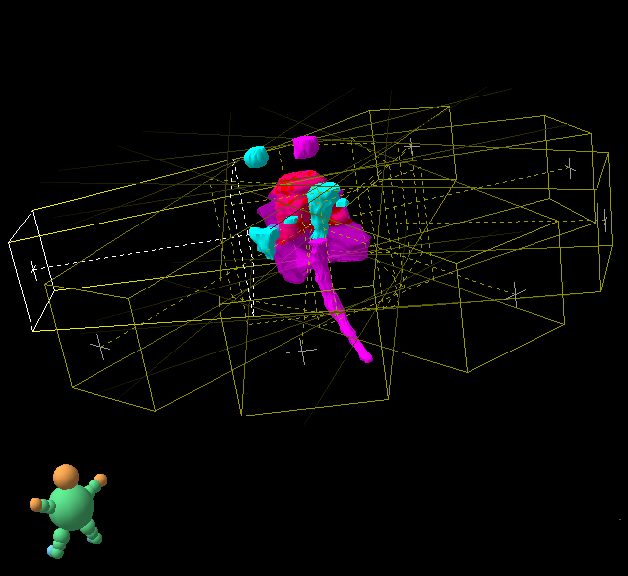
Head and neck (HN):
IMRT
GTV
brainstem
parotid
spinal cord
Limph
nodes
7 or more IMRT fields

Slide 5
The ability of IMRT to reduce treatment-induced toxic effects compared with non-IMRT treatment has been shown in three RCTs.
Two studies on breast cancer.
One study on nasopharyngeal cancer also showed an improved quality of life for patients who received IMRT.
The strongest endpoints, OS and disease specific survival, have not been investigated in RCTs.

Slide 6
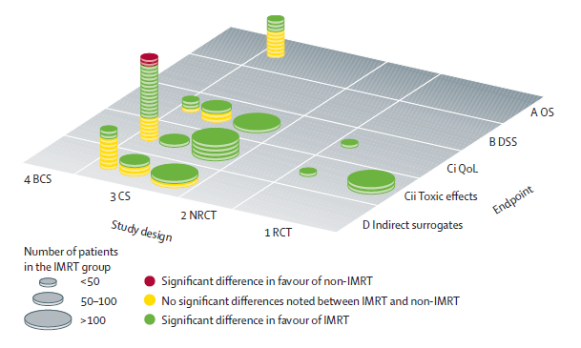
Recent Evidence
Recent randomized data (Level 1) from Europe demonstrated that IMRT reduces parotid toxicity, albeit with little benefit beyond this, relative to conventional therapy. (C. Nutting et al., Proc. ASCO 2009)
Liv Veldeman et alLancet Oncol 2008; 9: 367–375

Slide 7
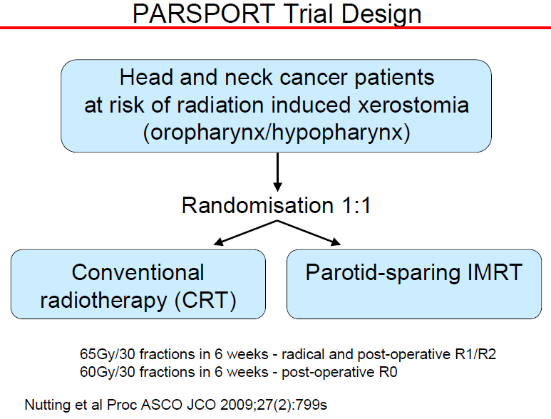

Slide 8
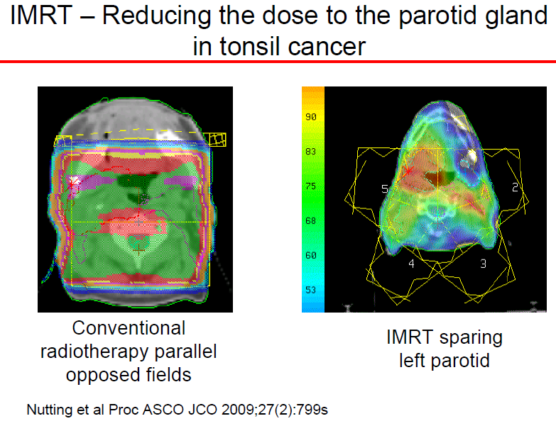

Slide 9
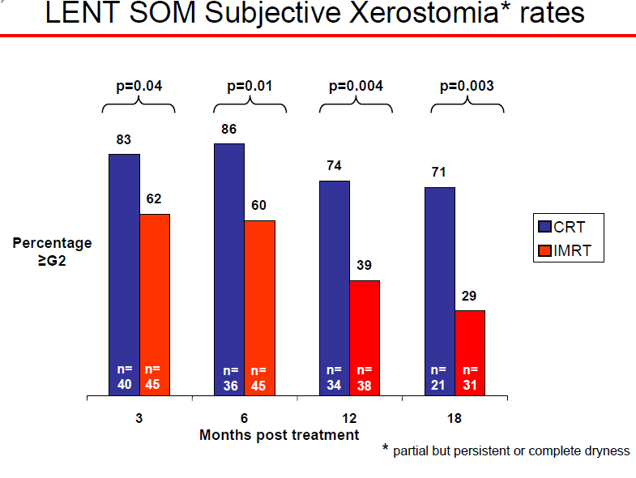
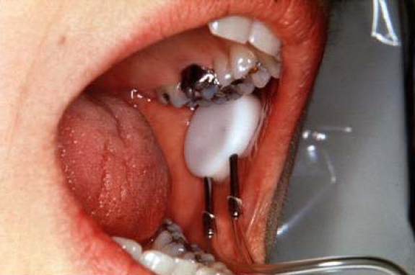

Slide 10
Over view of my talk
Uses of high end technology (IMRT/IGRT) in-
  Target volume delineation (contouring).
  Target volume doses-
    Treatment planning
    Replanning – Adaptive Radiotherapy (ART).
  Treatment Delivery (Setup errors).
  Clinical outcomes.

Slide 11
Use of IMRT with limited evidences

Slide 12
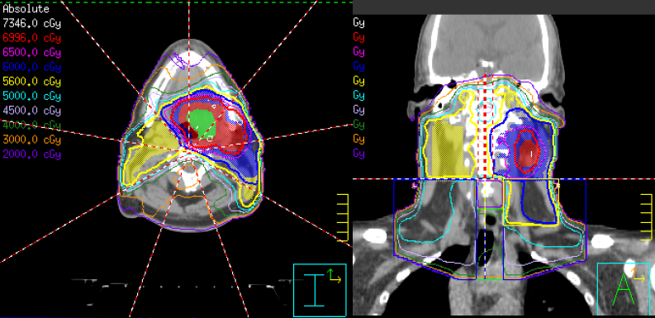
Dysphagia, aspiration and post radiotherapy salivary function are related to irradiated volumes for certain functional structures.
Eisbruch et al, IJROBP, vol. 45, no. 3, pp. 577–587, 1999.
Chao et al, IJROBP, vol. 49, no. 4, pp. 907–916, 2001.
Feng et al, IJROBP, vol. 68, no. 5, pp. 1289–1298, 2007.
Schwartz, IJROBP, 2011, article in press.

Slide 13

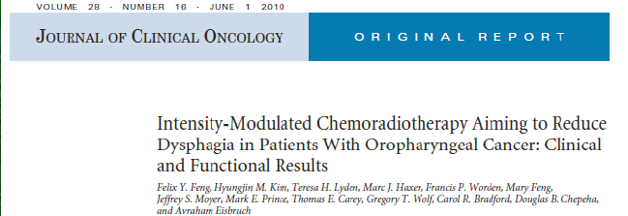
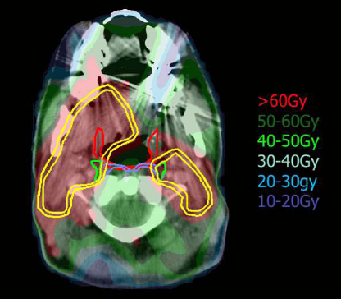
ADD CONCLUSION

Slide 14
IMRT with chemotherapy
Benefit in view of reduced toxicities
ADD

Slide 15
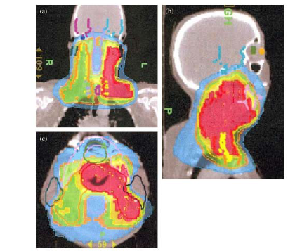
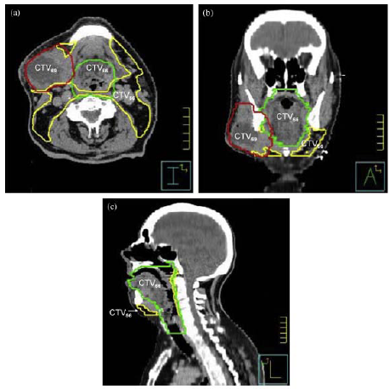
IMRT/IGRT for unknown primaries

Slide 16

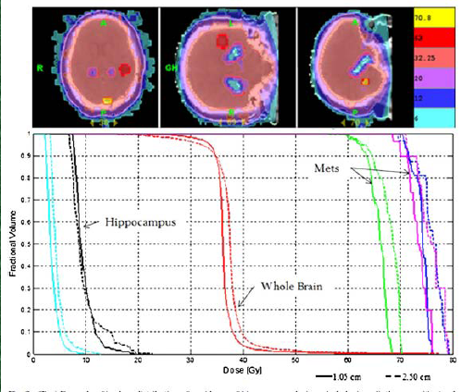
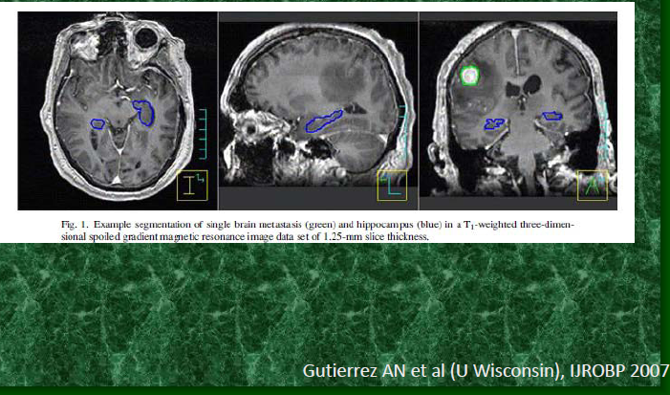
Memory loss preservation with IMRT
Cognitive functions are thought to reside in temporal lobes especially in the hippocampus.

Slide 17
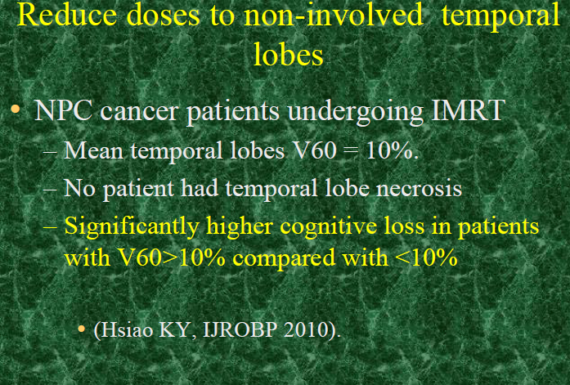

Slide 18
Overview of my talk
Uses of high end technology (IMRT/IGRT) in-
  Target volume delineation (contouring).
  Target volume doses-
    Treatment planning
    Replanning – Adaptive Radiotherapy (ART).
  Treatment Delivery (Setup errors).
  Clinical outcomes.

Slide 19
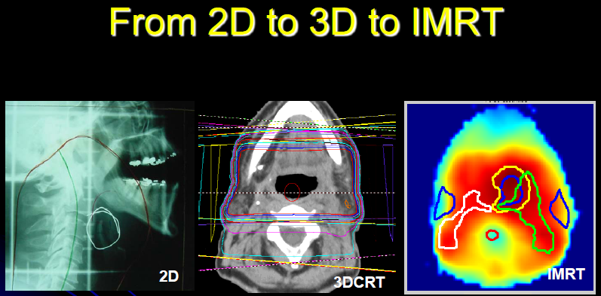
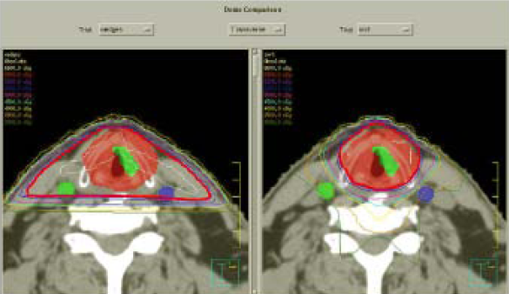

Slide 20
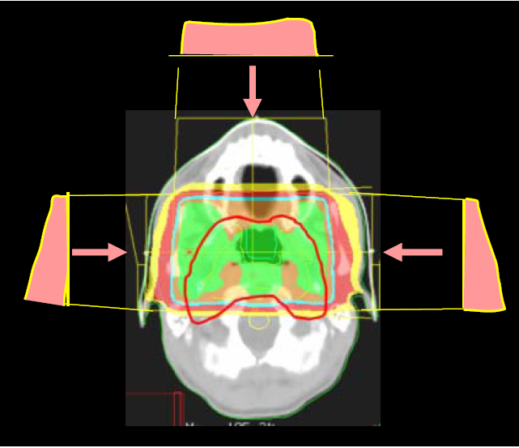
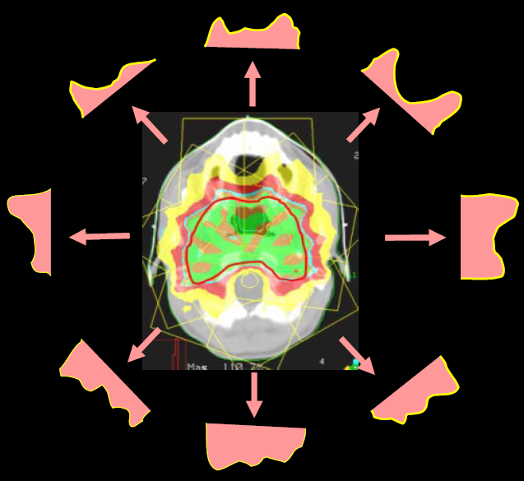

Slide 21
Dose conformity

Slide 22
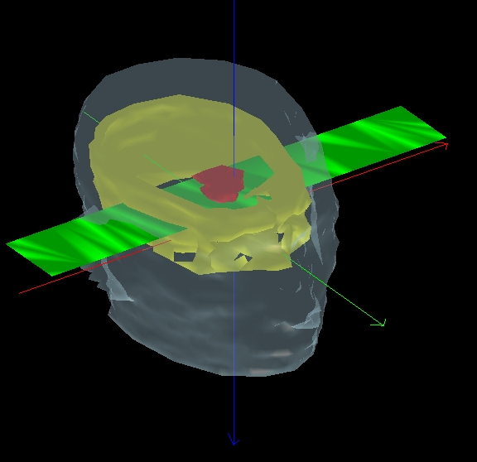
Photon Beam
Photon Beam
Target Volume
Target Volume

Slide 23
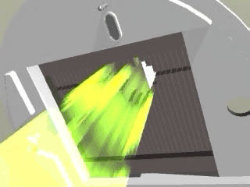
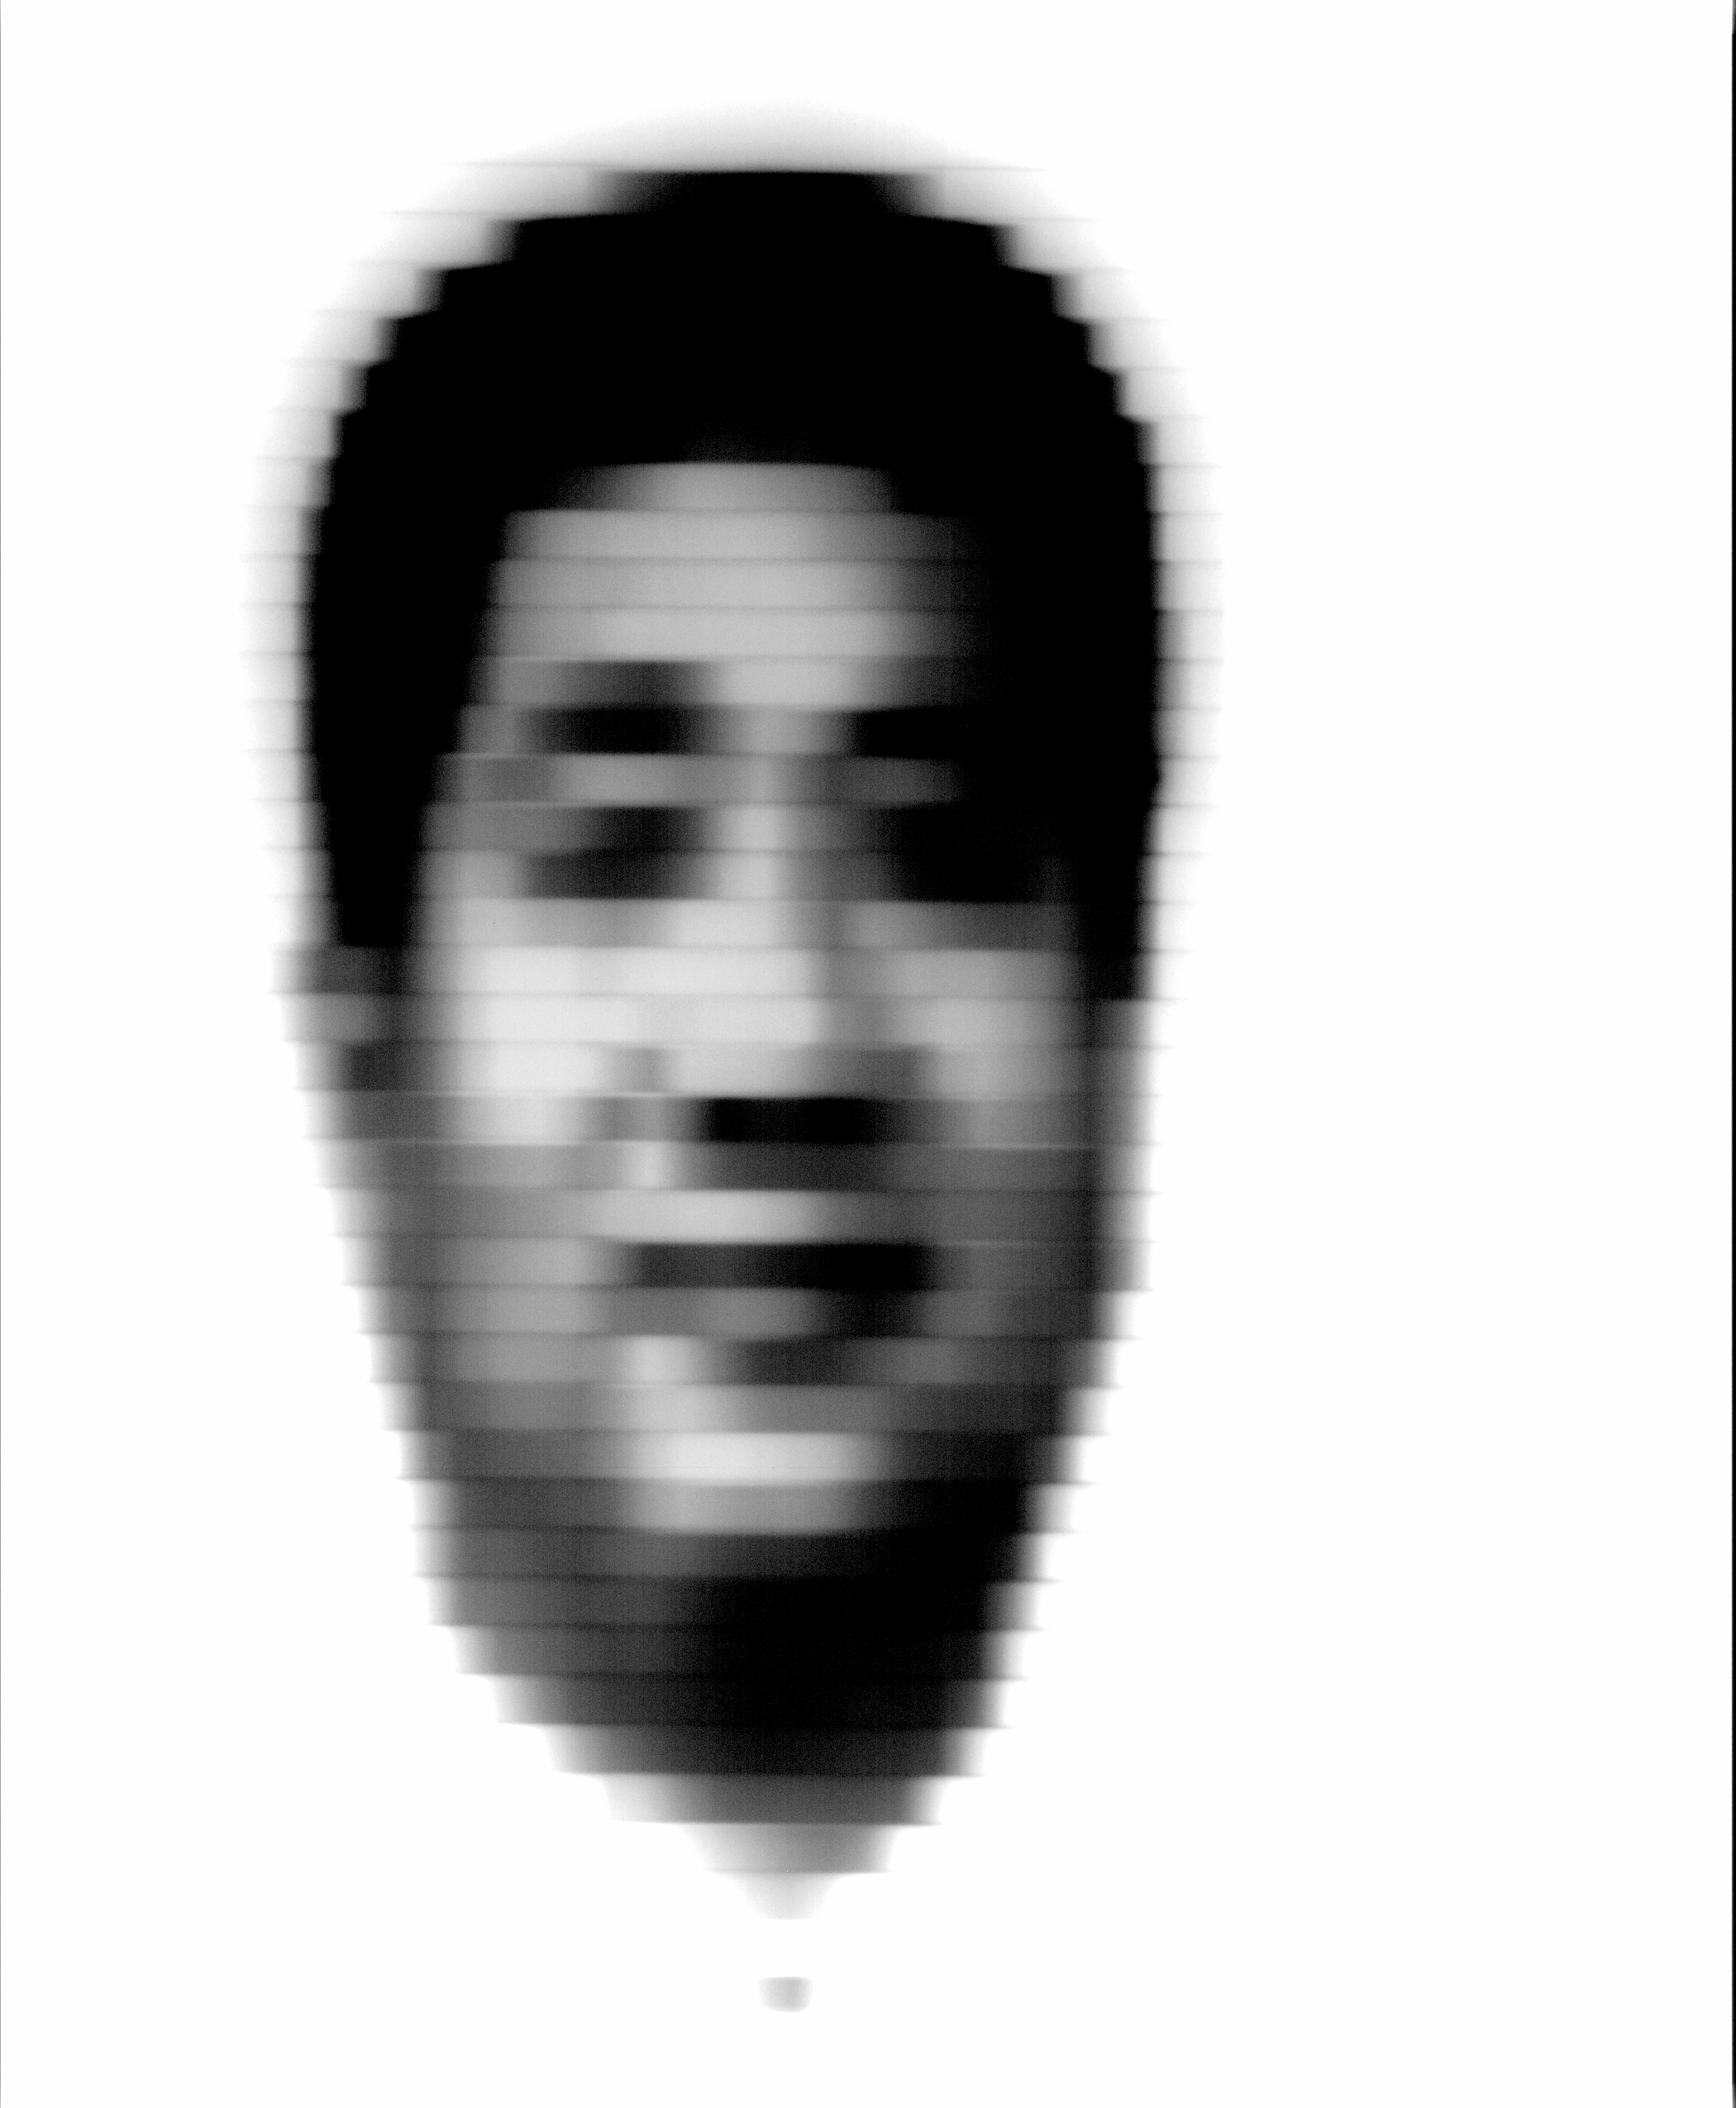
Sliding Windows technique

Slide 24
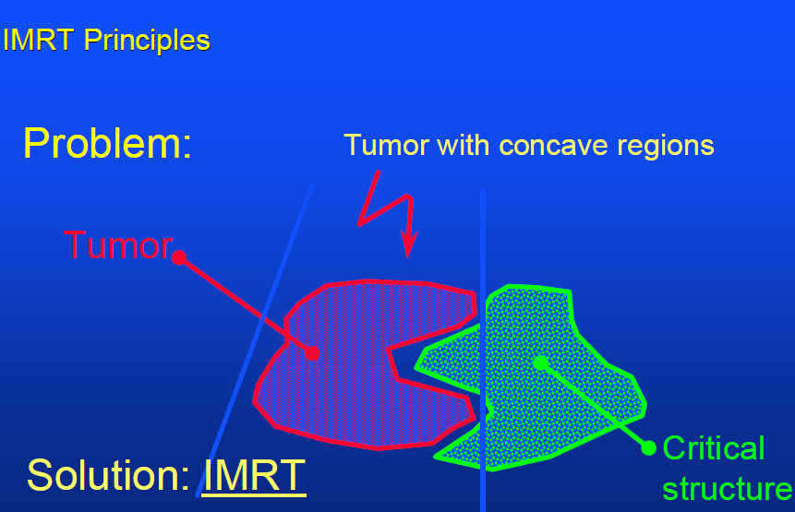

Slide 25
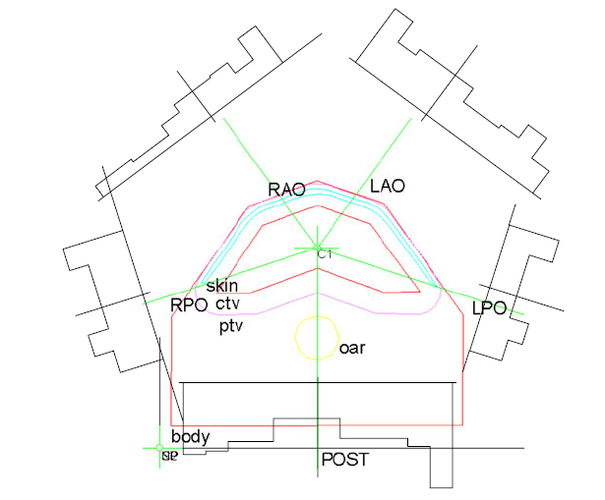

Slide 26
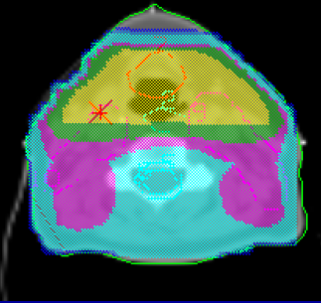
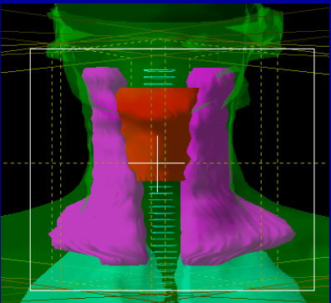
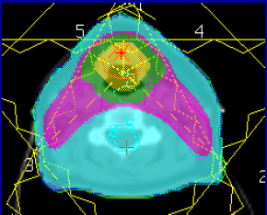
Conventional vs IMRT
Dose Distribution

Slide 27
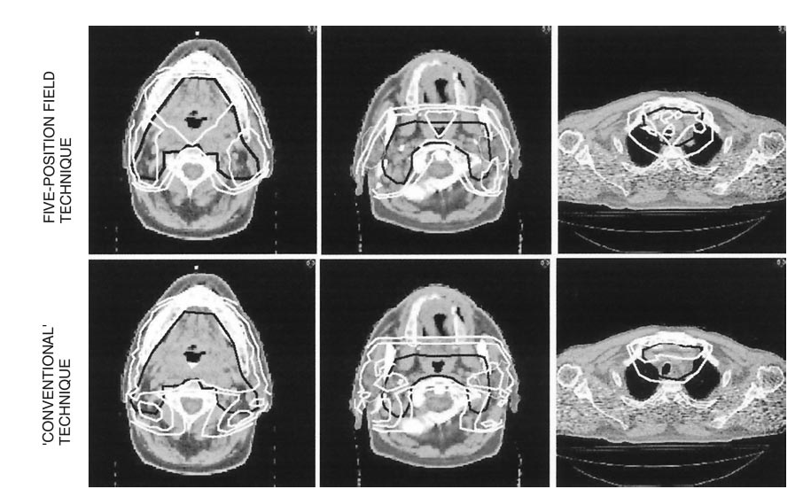

Slide 28
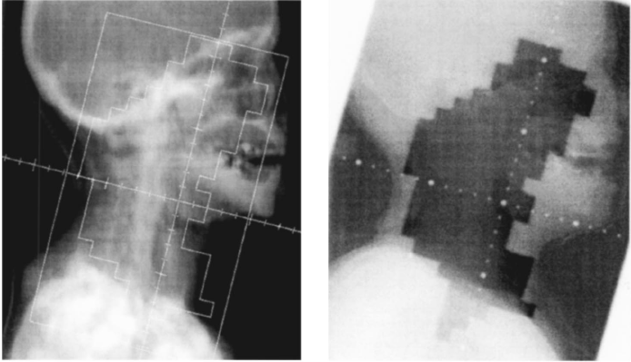

Slide 29
Electron Boost avoidance with
IMRT

Slide 30
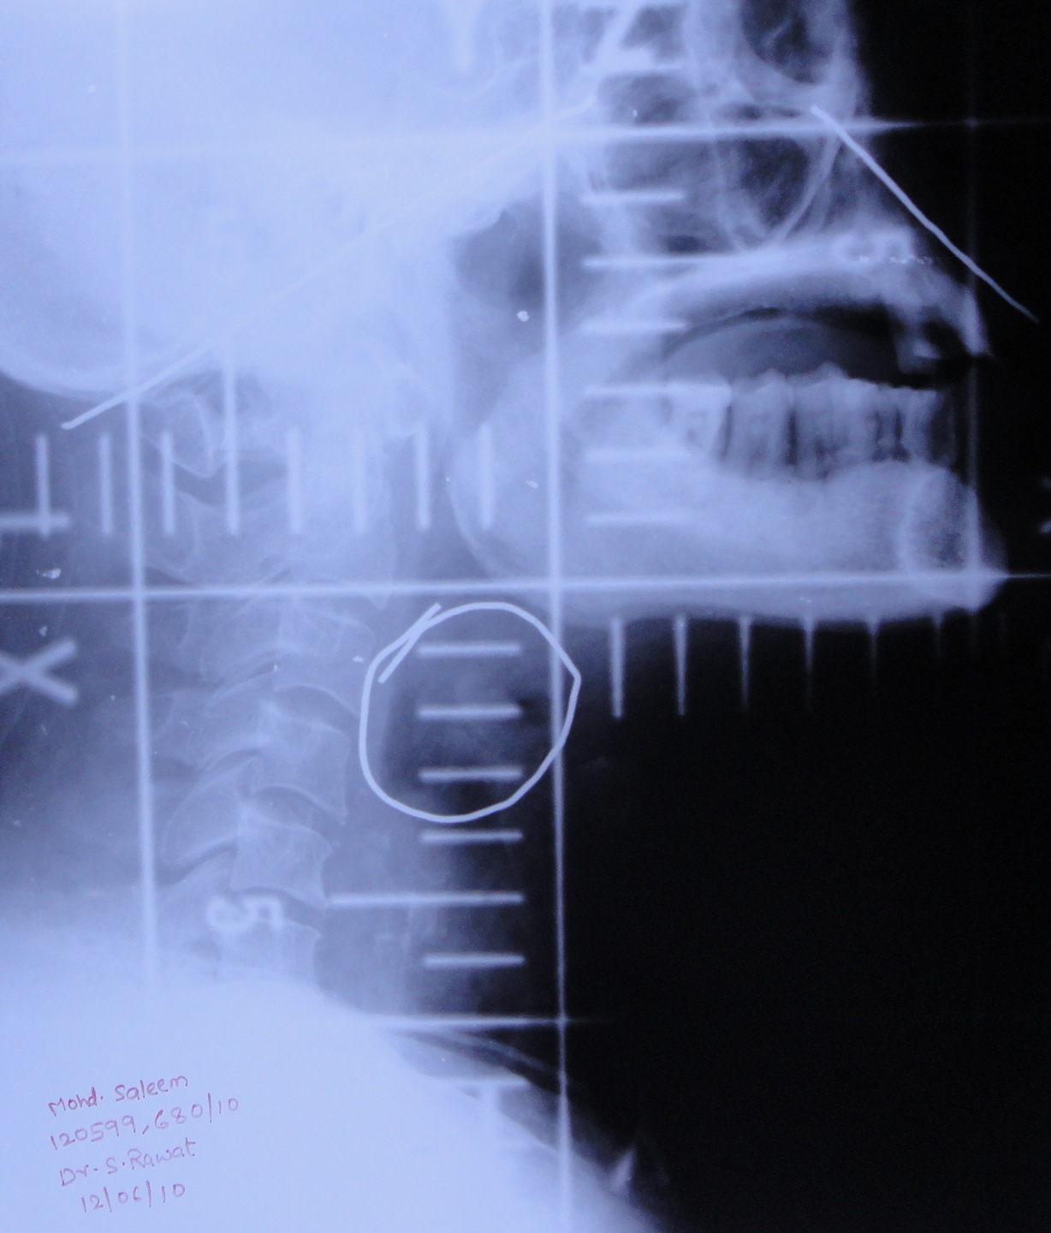
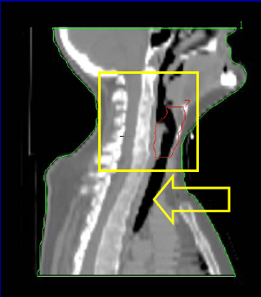
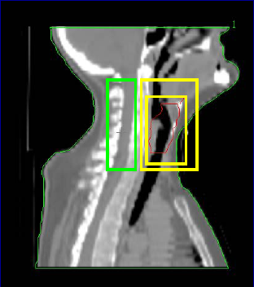
Conventional treatment technique
Phase I
Phase II

Slide 31
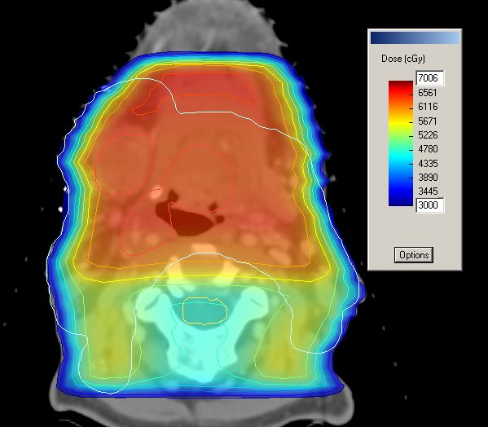
Electron boost
9 Mev Electron Boost Posterior Neck Nodes

Slide 33
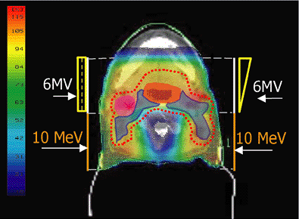
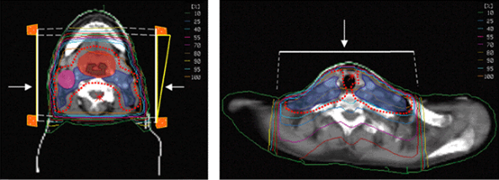
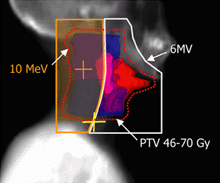

Slide 34
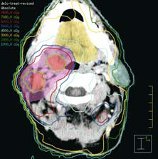

Slide 35
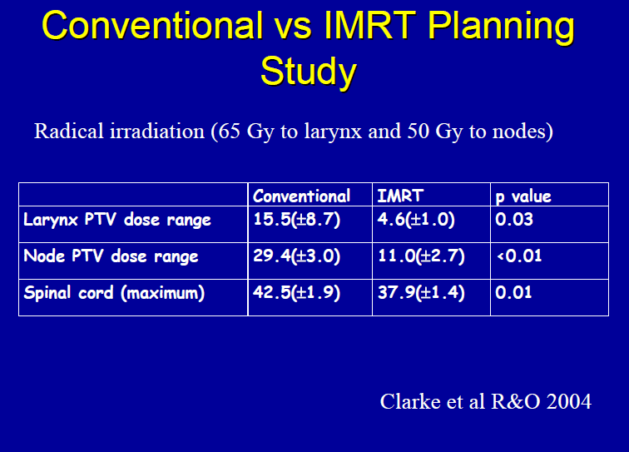

Slide 36
SIB

Slide 37
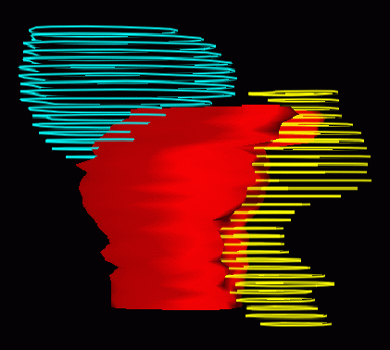
target

Slide 38
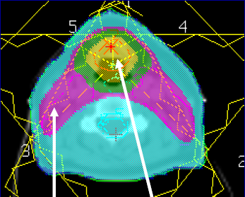
IMRT dose distribution
SIB
1.85Gy/#
2.25Gy/#
x 28#
Dose 51.8Gy and 63.0Gy

Slide 39
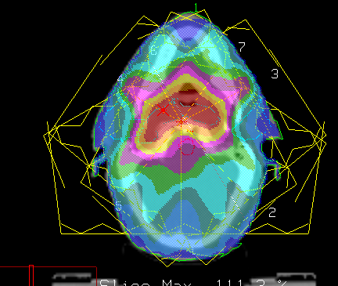
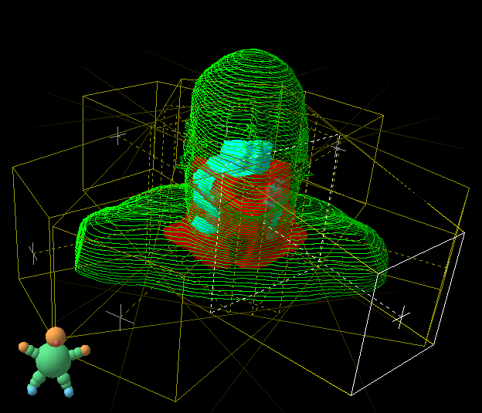


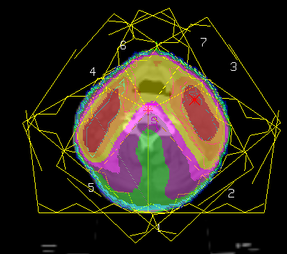
SIB in Nasopharynx carcinoma
GTV: 69.3 Gy/2.1Gy
CTV: 60 Gy/1.8 Gy
parotid
GTV
CTV
GTV
(positive nodes)

Slide 40
Differential dosages to different target volumes

Slide 41
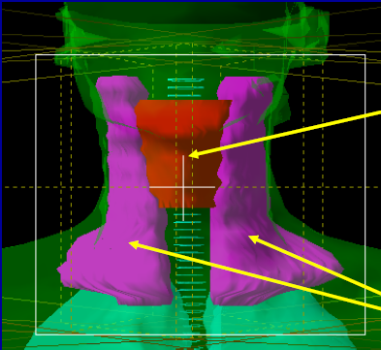
Differential dosages to different target volumes
PTV 1- Gross tumor + involved lymphnodes = Radical Dose of 70Gy/ 35#
PTV2- Elective nodal areas= Elective dose of 50Gy/ 25#

Slide 42
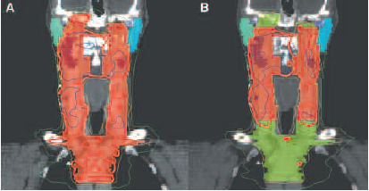
Differential dosages to different target volumes
60 Gy
50 Gy

Slide 43
Dose distribution depending upon planning characteristics

Slide 44
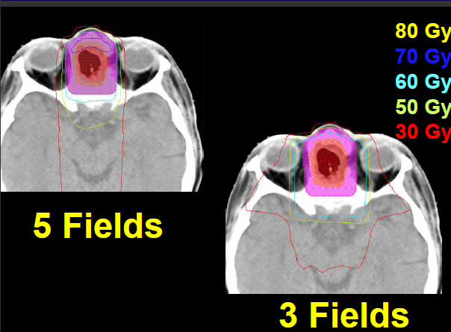
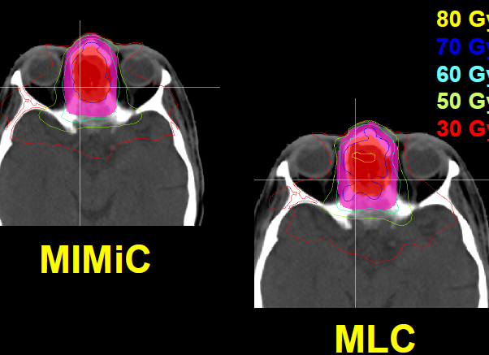

Slide 45
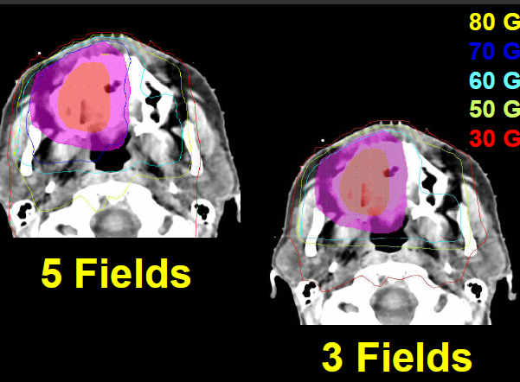
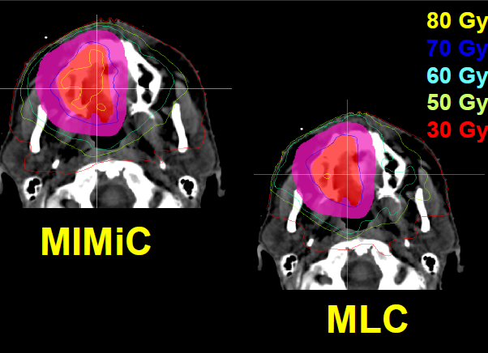

Slide 46



Slide 47
Overview of my talk
Uses of high end technology (IMRT/IGRT) in-
  Target volume delineation (contouring).
  Target volume doses-
    Treatment planning
    Replanning – Adaptive Radiotherapy (ART).
  Treatment Delivery (Setup errors).
  Clinical outcomes.

Slide 48
Unanswered questions
1 What are the characteristics and kinetics of setup errors in the H and N region?
2 How quickly and by how much can tumor and normal anatomy change during treatment?
3 What are the dosimetric consequences of anatomic changes and setup errors?
4 How can ART compensate for these uncertainties and reduce need for PTV expansions?
5 What are the most pressing (or most surmountable) hurdles impeding future widespread deployment of clinically meaningful H and N ART?

Slide 49
Rationale for ART
IMRT cannot compensate for changes in the location of disease and normal anatomy during treatment, leading to exposure of at-risk bystander tissues to higher-than-anticipated doses.
Lack of updated targeting during a course of therapy is a likely culprit responsible for continued issues with treatment toxicity during and following IMRT.

Slide 50

Average GTV decrease=
        2.5% per day
        55% after 45Gy
Average Parotid gland decrease=
        0.9% per day
        17.5% after 45Gy
Average SMG decrease=
        10 to 20% after 45Gy

Slide 51
From Schwartz paper
IMRT utilizes 3D anatomic
information extracted from imaging acquired several days
prior to treatment. It is recognized that the location, shape,
and size of disease and normal anatomy change significantly
due to daily positioning uncertainties and physiological
factors during a 6-7-week course of treatment. These changes
include regression of primary tumor and nodal disease,
alterations in normal glands and mucosa, resolution of
postoperative soft tissue effects, and alterations in body
habitus due to weight loss [4–8].

Slide 52
Adaptive radiotherapy (ART)
There are potential advantages to manual replanning of IMRT midway through treatment, but to date no prospective clinical study has been performed to demonstrate the clinical benefits and practicality of this approach.
In addition, the ideal timing for replanning remains an unresolved issue.
E. K. Hansen, M. K. Bucci, J. M. Quivey, V. Weinberg, and P.
Xia, IJROBP, vol. 64, no. 2, pp. 355–362, 2006.

Slide 53
Adaptive radiotherapy (ART)
Adaptive radiotherapy (ART) is an approach to correct for daily tumor and normal tissue variations through online or offline modification of original IMRT target volumes and plans.
It is a treatment strategy tightly linked to feedback based control theory.

Slide 54
ART has three basic components:
  (1) detection of changes,
  (2) method of intervention, and
  (3) management of overall clinical goals.
Ideally, direct staff input must be replaced by automated processes to make ART practical.

Slide 55
A prospective clinical trial testing the feasibility of an automated H and N ART delivery approach at M.D. Anderson Cancer Center is currently underway;
initial results –
1) highly precise treatment setup reproducibility with our CT-guided IGRT procedure once patients have acclimated to treatment.
2) has confirmed that standard 3-4mmPTV expansion margins are too generous to maintain parotid dose sparing if daily image guidance is employed.
3) the intent for ART is to recapitulate the treatment planning goals of the original IMRT plan as faithfully as possible, rather than to create novel planning guidelines.
4) By treatment completion, mean parotid shrinkage was 26%.
5) the median trigger point for the first adaptive replanning was the 16th treatment fraction (range: 2 to 28), at which point combined parotid volumes had shrunk by 15% and combined CTVs had shrunk by 4%.
6) This trial is the first prospective demonstration of the feasibility of adaptive head and neck radiotherapy. Significantly, initial results suggest that conventional IGRT alone does not provide meaningful dosimetric benefit if conventional PTV margins are used. One properly timed adaptive replan (ART1) appears to provide the most relevant dosimetric improvements.
J. C. O’Daniel, et al., IJROBP, vol. 69, no. 4, pp. 1290–1296, 2007.

Slide 56



An example of serial ART dose recalculation using a
daily CT image.
Improved contralateral parotid sparing and a lower total body dose.
a) Original plan b) 1st Replan c) 2nd Replan
(15th treatment fraction)
(25th treatment fraction)

Slide 57


Adaptive IMRT- Coronal reconstruction

Slide 58


Slide 59


Slide 60
Future Directions
The online approach can potentially provide greater treatment precision, at the cost of increased daily effort and treatment time.
Auto replanning.
Dose guided radiotherapy.

Slide 61
Conclusions
Feasible adaptive radiotherapy has long been a clinical goal.
Current adaptive radiotherapy strategies remain labour and resource intensive.
The optimal frequency and utilization as well as the ultimate clinical impact of ART remain undefined, and prospective clinical trials will be necessary to appropriately mould ART into a future treatment standard.

Slide 62


Slide 63


Slide 64


Slide 65


Slide 66


Slide 67


Slide 68


Slide 69


Slide 70


Slide 71


Slide 72
Treatment planning and contouring using advanced imaging
(fusion techniques)

Slide 73


Slide 74
Overview of my talk
Uses of high end technology (IMRT/IGRT) in-
  Target volume delineation (contouring).
  Target volume doses-
    Treatment planning
    Replanning – Adaptive Radiotherapy (ART).
  Treatment Delivery (Setup errors).
  Clinical outcomes.

Slide 75


Slide 76



Slide 77

Anatomic Uncertainties during treatment
Significant anatomic changes during their course of treatment, including shrinking primary tumors or nodal masses, resolving postsurgical edema, and weight loss.
GTV decreased throughout therapy at a median rate of 0.2 cc per treatment day (range, 0.01–1.95 cc/day). Lymph nodes lost volume at approximately the same rate of 1.7%-1.8% per treatment day.
Barker et al. observed that the median parotid volume loss was 0.2 cc/day or 0.6%/day of the initial volume. At the end of treatment, median parotid volume loss was 28.1%.
Barker et al. found that the median weight change from the start to completion of treatment was –7.1% (range, +5.2% to –13.0%) in their study.
Parotids migrated toward the patient center with a median total distance change of −5.26mm (0.00 to −16.35mm) and a median change rate of −0.22 mm/day.

Slide 78


H and N Setup Uncertainties
Baseline Anatomic Uncertainties-
  Displacement uncertainties of up to 2–6mm are generally observed indicating the effects of flexibility and rotation on position uncertainty.
MD Anderson has investigated internal systematic and random errors caused by swallowing . A total of 555 daily CTs were taken (30–33 images/patient).
These structures were found to move up to 1.6 cm during a treatment course relative to vertebral landmarks,most notably in the superiorinferior (SI) direction.

Slide 79


Slide 80


Slide 81
Present status of ART
Adaptive RT is a technological innovation.
May become the new treatment standard and eventually replace the classical treatment plan in the routine clinical practice.
However, adaptive RT remains extremely time-consuming and automation of the different processes involved will be required.
Further improvement in near real-time processes involving 3D CT image acquisition, automated segmentation, deformable registration, and modification of IMRT parameters, required.
Practical guidelines for identifying patients who would be best served with an adaptive treatment strategy still have to be defined.
Di Yan, Sem Rad Onc,;20,2, 79-83,2010

Slide 82
DGRT

Slide 83


Slide 84
Use of conformal therapy in Re irradiation/ Recurrence

Slide 85


Slide 86

Pyriform Fossa Re-irradiation

Slide 87





Brachytherapy

Slide 88
Balancing Quality (Safety), Efficiency and Innovation

Slide 89


Slide 90


Slide 91
Cautious use of IMRT

Slide 92


Slide 93


Slide 94

Hands-on experience confirms that IMRT continues to cause severe acute oral and pharyngeal side effects.
Treatment failures may also result from unanticipated tumor movement across critical regions of sharp dose gradient.
Chao et al- Green Journal, vol. 61, no. 3, pp. 275–280, 2001.
Lee et al- IJROBP, vol. 53, no. 1, pp. 12–22,2002.
Eisbruch et al- IJROBP, vol. 76, no. 5, pp. 1333–1338, 2010

Slide 95


Slide 96
IMRT negatives
Theoretical considerations-
  Increase in volume of exposure and total body dose- radiation induced secondary cancers.
Practical considerations-
  (in) voluntary movements- setup errors
  Tight margins, and
  Misses due to steep dose gradients.
  Target volume imaging uncertainities.
Cost considerations-
  Space, time, rupees, man power, down time and repairs…………….
Emerging Solutions

Slide 97
Conclusions
Level 1 Evidence of IMRT /IGRT is clearly for parotid sparing only without reduction in any other toxicity.
No level 1 evidence for usage of IMRT/IGRT for better DFS or OS.
Electron boost avoidance, use of SIB with improved dose conformities and re-irradiation are definite practical add ons of IMRT/IGRT.
ART is a technological innovation which can be a new standard of care for modern radiotherapy delivery.

