Slide 1
Dr. Vivek Bansal
Director-Radiation Oncology
HCG Cancer Center
Ahmedabad
Radiotherapy in Carcinoma
Prostate - Clinical perspective

Slide 2
RADIATION ONCOLOGY
Integral Part of Modern Management of Cancer patients

Slide 3
1965 - 2007
CLINICAL PROGRESS
Improved assessment
Treatment Selection
Control of reactions
Concept of the Oncological team

Slide 4
Management of Cancer
Quantity of life
Quality of life
Conservation of Organ, Function & Cosmesis

Slide 5
The Goal
Optimal Dose Delivery
…With Minimum Acute And Long Term Toxicity
Notes:
Let us have quick view on the Anatomy of Prostate
It is wall nut shaped organ
Located below the Urinary Bladder in front of the Rectum surrounding the Urethra
IT IS The close proximity of Bladder & Rectum acts as dose limiting factor in conventional radiotherapy

Slide 6
SCHEMA
NCCN GUIDELINES- INDICATIONS OF RT IN CA. PROSTATE STAGEWISE
BRACHTHERAPY
IMRT
IGRT
POST OP & PALLIATIVE RT
CYBERKNIFE
HYPOFRACTIONATION RATIONALE

Slide 7
RISK GROUPS
–Low Risk
•PSA ≤10 and
•Biopsy Gleason ≤6 and
•T1c or T2a
–Intermediate Risk
•PSA > 10 –20 or
•Biopsy Gleason 7 or
•T2b-T2c
–High Risk–bone scan; CT/MRI pelvis
•PSA > 20 or
•Biopsy Gleason 8 –10 or
•T3or higher

Slide 8
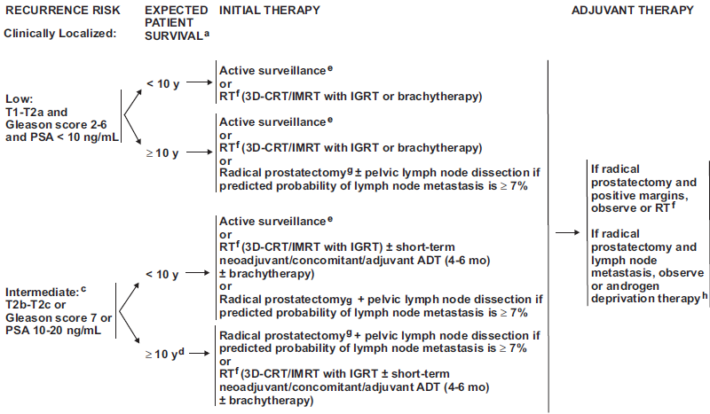

Slide 9
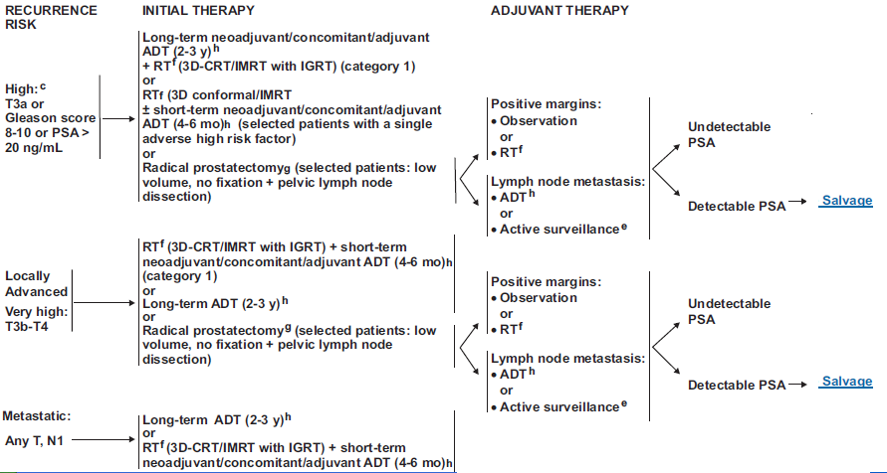

Slide 10
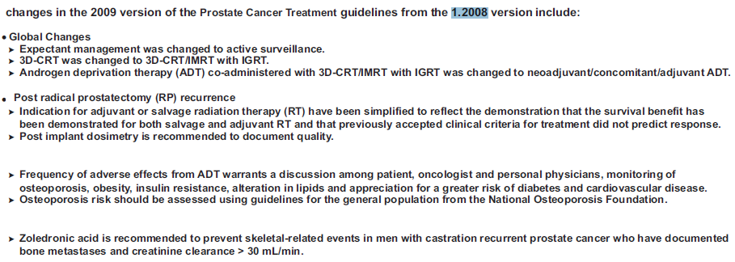
2012
2011

Slide 11
Treatment Strategies
Active Surveillance is an option for patients with nonaggressive Carcinoma.
The outcome of early prostate Ca. is good irrespective of the modality chosen. The results of 7 year FBR is >75% for any modality in many studies on review of literature.
For locally advanced high risk prostate cancer Radiotherapy with androgen ablation is the mainstay of treatment though survival remains dismal.

Slide 12
Radiation Therapy
Externally
  Linear Accelerator, Cobalt
  Tomotherapy, Cyber knife
  Particle therapy
Internally
  Brachytherapy
    Using sealed radioactive sources

Slide 13
Brachytherapy in Ca.Prostate
Permanent Interstitial Implants
  Iodine 125
  Palladium 103
High Dose Rate (HDR)
  Iridium 192

Slide 14
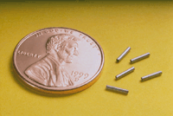
Permanent Seed Implants
It is a form of Low Dose Rate (LDR) brachytherapy
I-125 for slow growing low risk tumours
Pd-103 for fast growing high risk tumours.
Tiny seeds (1mm x 5mm) are inserted into the prostate

Slide 15
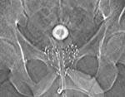
Permanent Seed Implants
These tiny seeds (1mm x 5mm) are inserted into the prostate under transrectal USG guidance with pre planned CT/USG based mapped 3D information using square grid template under anesthesia with Mick’s applicator

Slide 16
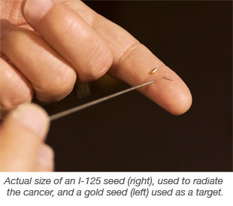
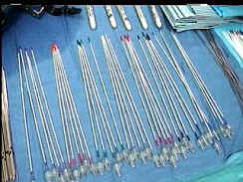
PERMANENT IMPLANT

Slide 17
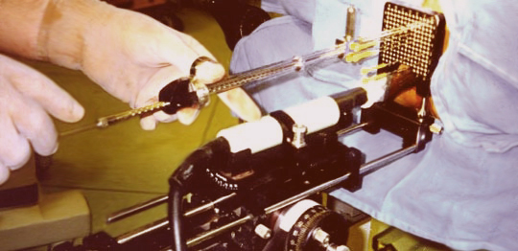
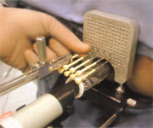
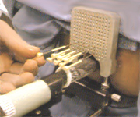
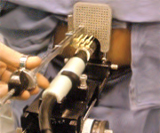
Permanent seed implant

Slide 18
Permanent Seed Implants
It may be used alone or in combination with external therapy
Disadvantages :
  Inability to modify dose distribution
  Inability to treat extra-capsular extension
  _ Radiation safety relating to seeds migration in urine, ejaculate or lungs and exposure to personnel
  High cost of seeds

Slide 19
Role of HDR Brachytherapy
Localized disease :
  Ex.RT + Brachy or Monotherapy is adequate
Advanced disease :
  Requires high doses
  Can well be delivered by conformal HDR brachytherapy
  With additional advantages like steep dose gradient & optimization

Slide 20
HDR Brachytherapy
Use of highly radioactive source like Iridium – 192
Sent through the needles / flexible tubes which is pre-inserted into the tissue or cavity encompassing the tumour
Short treatment time (few minutes)

Slide 21
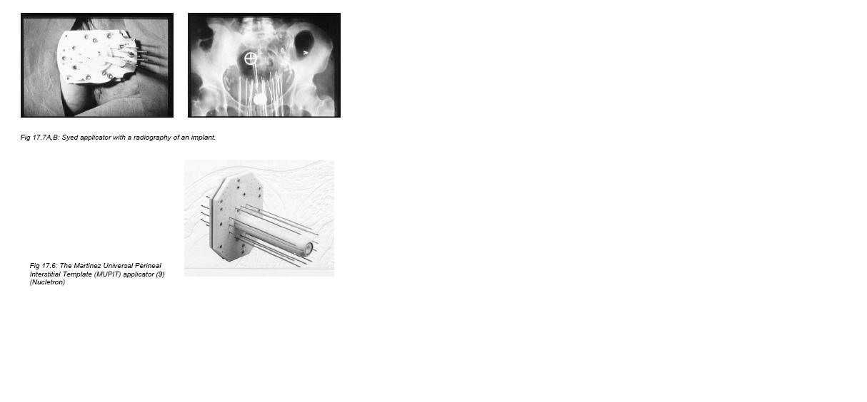
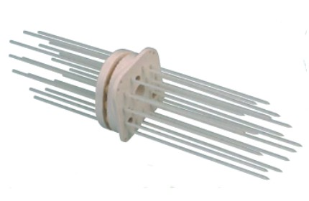
Martinez Template
Syed Template

Slide 22
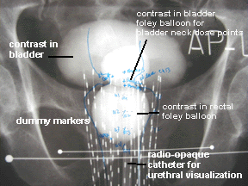
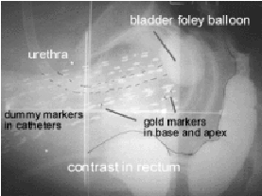
HDR Brachytherapy
AP view
LAT view

Slide 23
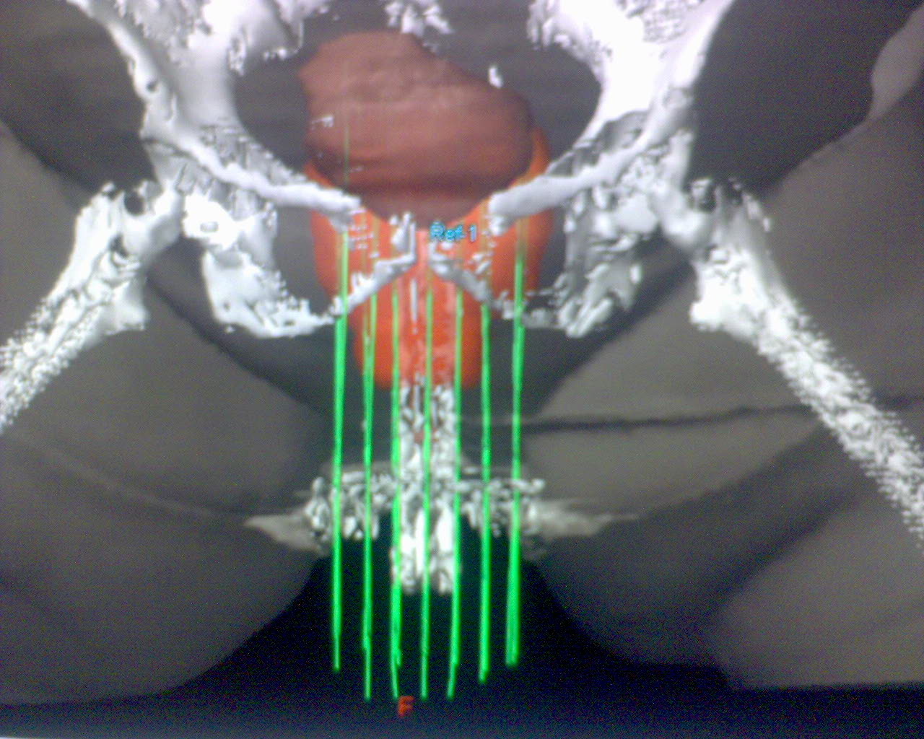
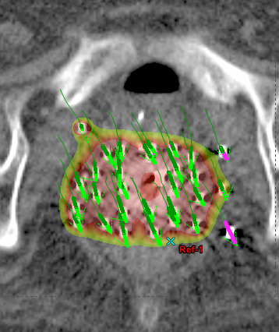
3D Conformal Brachytherapy
3D reconstruction
Isodose

Slide 24
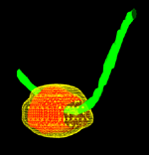
HDR Brachytherapy
3D view

Slide 25
External Radiotherapy Techniques
  2D (Conventional)
  3DCRT (3 Dimensional Conformal RadioTherapy)
  IMRT (Intensity Modulated RadioTherapy)
  Image Guided Radiotherapy (IGRT)
  Palliative Radiotherapy.

Slide 26
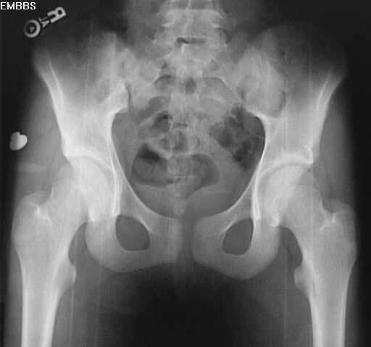
Conventional RT
Typical 4 field Box – 46 Gy
Boost to 70 Gy by shrinking field technique
Dose escalation above 70 Gy is not possible – limiting factor ‘Normal tissue toxicity’

Slide 27
Improved Outcome with
Dose Escalation
Better Biochemical and Biopsy proven tumour control
References :
  Zelefsky MD : IJROBP41 ; 491 – 500 1999
  Pullock A : JCO. 18; 3904 – 3911, 2000
  Hanks GE : IJROBP 46; 823-832,2000

Slide 28
Dose volume relationship

Slide 29
3D Conformal Radiation Therapy
An attempt to shape high dose volume of radiation to the tumor while minimizing the dose to surrounding normal critical structures

Slide 30
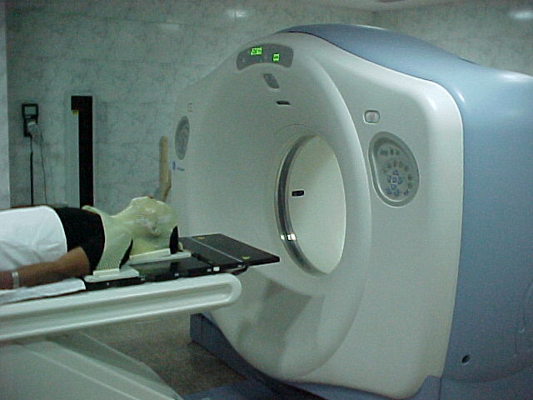
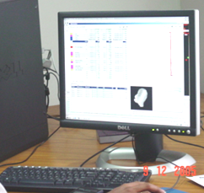
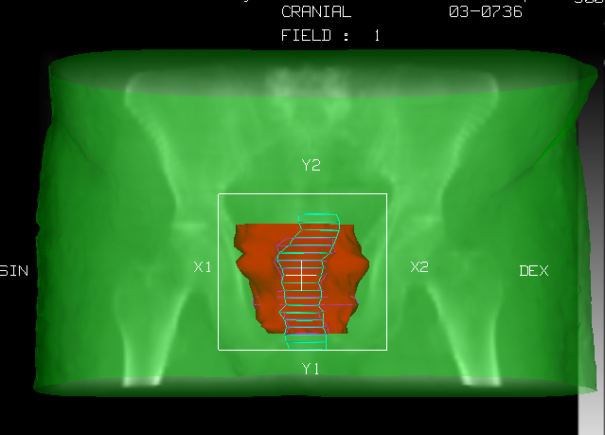
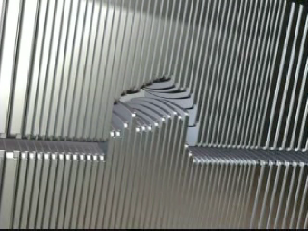
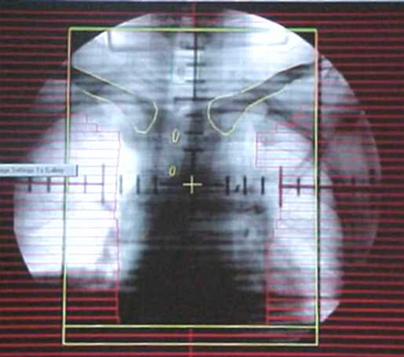
Making conformal Therapy a reality
Multi slice CT scan

Slide 31
Beams Eye View

Slide 32
Problems with 3DCRT

Slide 33
CONVENTIONAL
3D-CRT
IMRT
(Intensity Modulated Radio Therapy)
Paradigm shift

Slide 34
IMRT – a high tech art in medicine
PLAY OF POWERFUL HARDWARE AND SOFTWARE IN THE HAND OF CLINICANS AND PHYSICISTS.

Slide 35
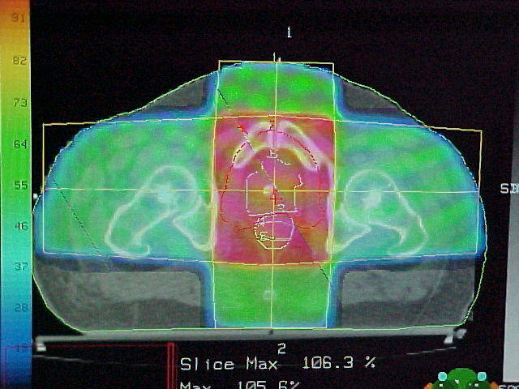
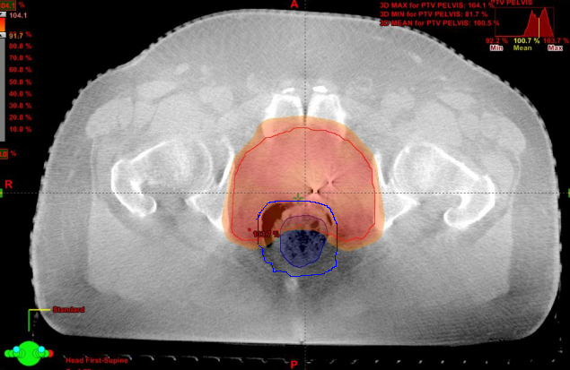
What is different about IMRT
Uniformity in dose distribution – mantra for Conventional therapy
‘Dose painting / sculpting’ using
non-uniform dose patterns
is the power of IMRT

Slide 36
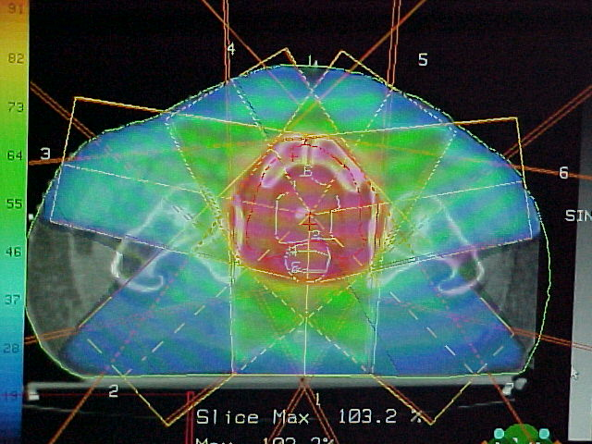
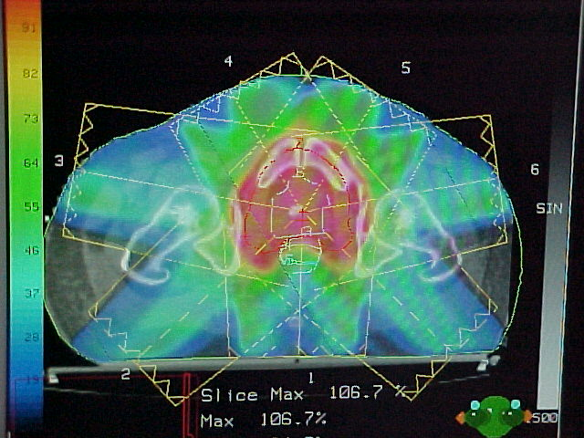
IMRT for Prostate
Concave shaped distribution
Enables Dose Escalation
Better patient compliance
2D
3DCRT
IMRT
Notes:
IMRT can generate concave shaped dose distribution which conforms low dose to Rectum
IMRT enables physicians to Escalate Doses with better patient compliance

Slide 37
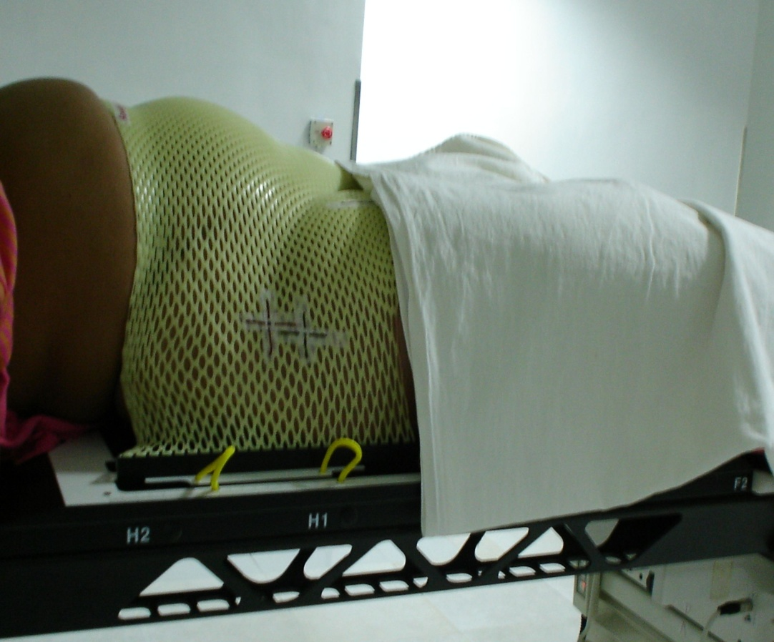
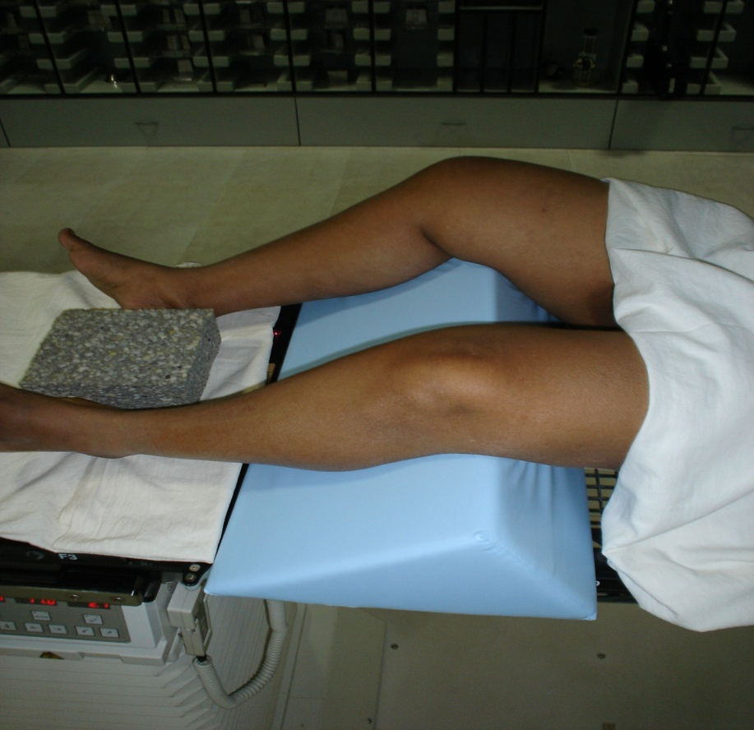
Immobilization

Slide 38
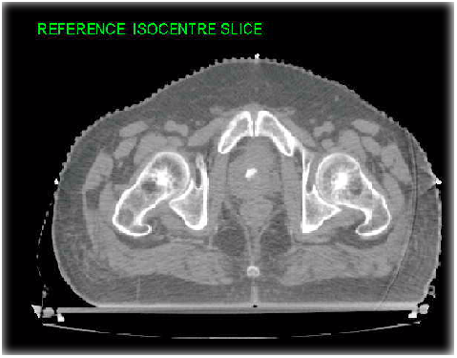
CT Imaging
Whole Pelvis
Slice thickness 3mm or 5mm
Patient aligned to the fiducials & laser marks
IV contrast to enhance target & critical organs
DICOM images transferred thro’ network
Fiducial
Notes:
Third Step is CT Imaging is done for whole of Pelvis, with 5mm slice thickness Patients is first allined to the fiducials & Laser marks. IV Contrast is also given to enhance Target & Critical organs. Once the scvanning is over the DICOM images are transferred thro network to the Treatment Planning System.

Slide 39
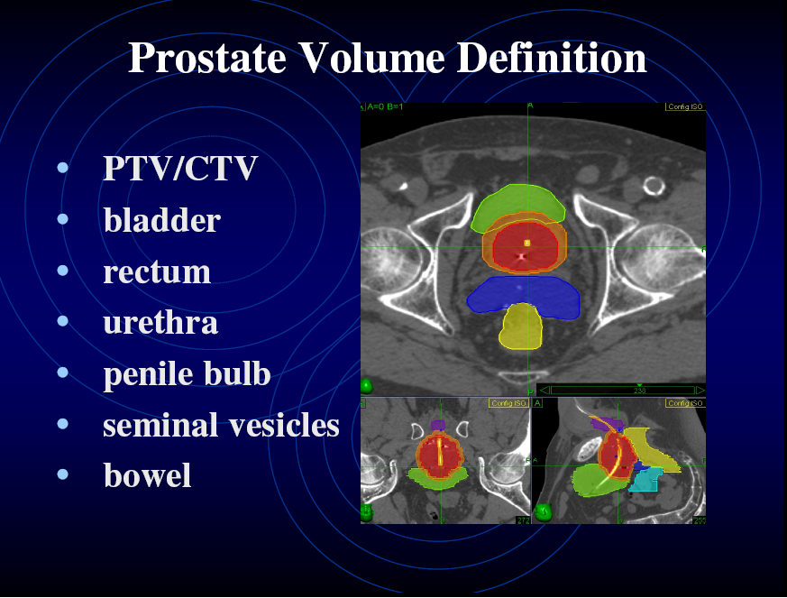

Slide 40
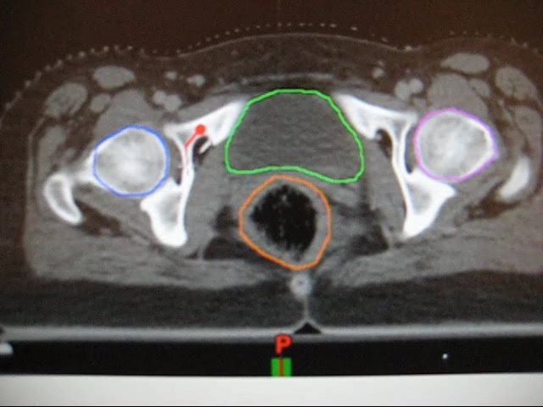
CONTOURING TUMOUR TARGETS

Slide 41
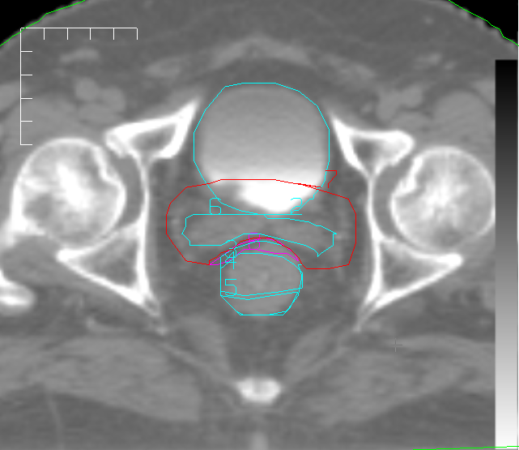
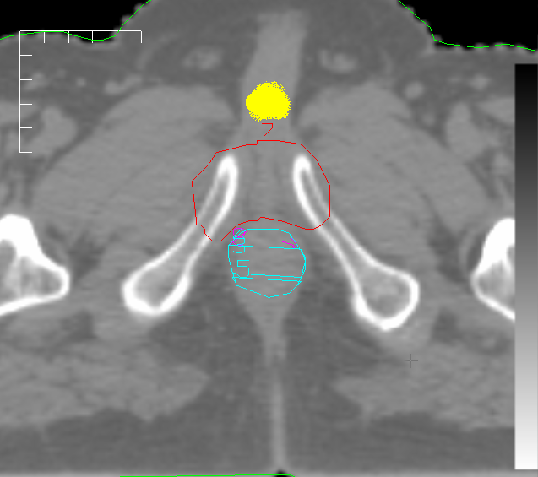
Contouring

Slide 42
Optimization Dose and Dose Volume constraints for 81 Gy Prostate IMRT Plan
Structure 81 Gy Plan
PTV – rectum overlap Prescription dose = 100
Minimum dose = 98%, penalty = 50
Maximum dose = 102%, penalty = 50
PTV + rectum overlap Prescription dose = 95%
Minimum dose = 93 %, penalty = 10
Maximum dose = 96 %, penalty = 20
Rectal wall Maximum dose = 95%, penalty = 20
70% of rectal volume receives < 40%
Maximum dose, penalty = 20
Bladder wall Maximum dose = 98%, penalty = 35
70% of bladder volume receives < 40 %
Maximum dose, penalty = 20

Slide 43
Treatment Planning
Inverse Planning IMRT
CadPlan – Helios
6 MV Photons
7 fields, Coplanar
DMLC technique
Dose constraints to
PTV and other structures
Tight constraints for Rectum e.g., < 40% dose to
70% rectal volume
Notes:
The next step is Treatment Planning which is done using inverse planning Method. In Cadplan the inverse planning software the helios is used for generating IMRT plans
6 Mv photons with 7 coplanar fields are used for treating the Prostate with DMLC technique.
Dose constrains are defined for PTV and other structures. Rectum has given tight dose constrains of less than 40 % of dose to 70 % rectal volume

Slide 44
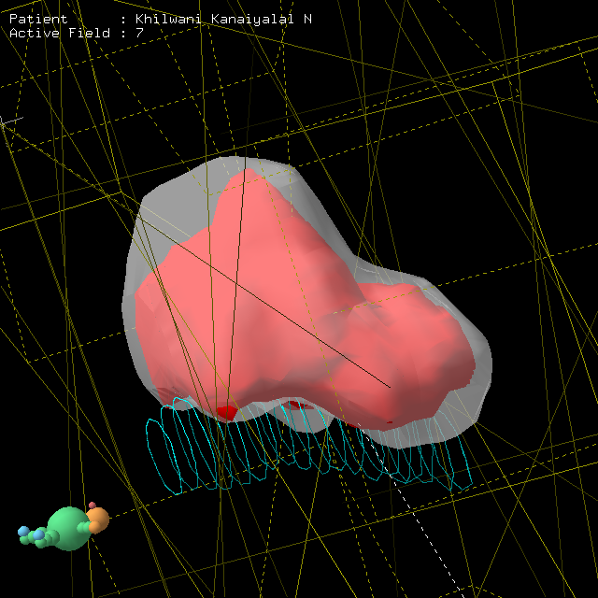
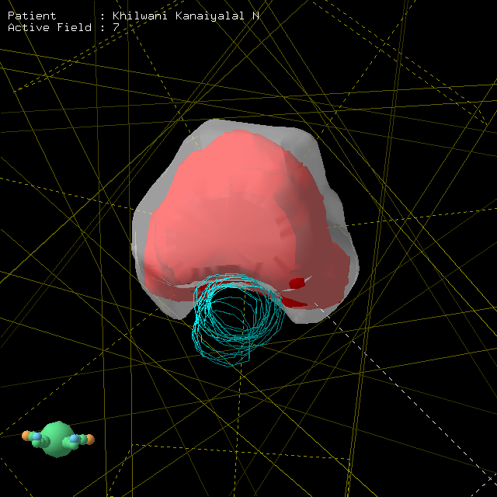
3D VIEW

Slide 45
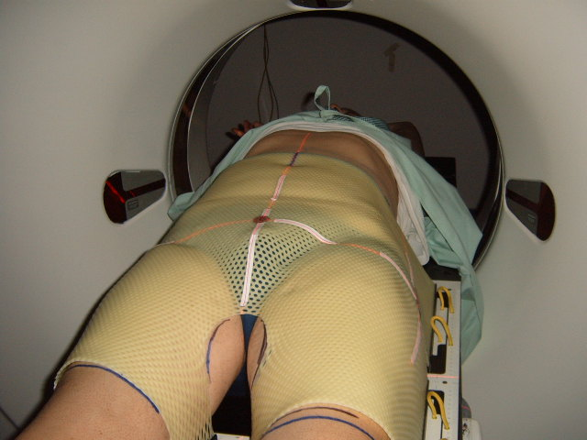
ISOCENTER TRANSFER

Slide 46
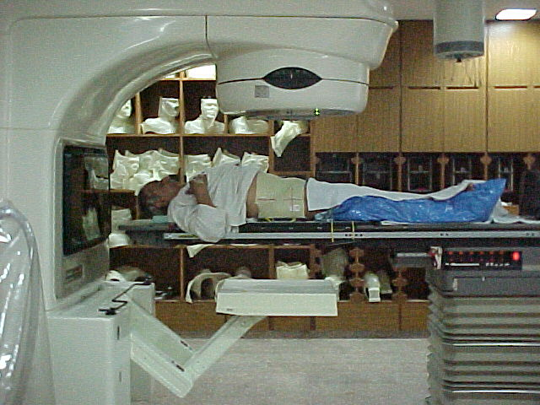
Treatment set-up on LA

Slide 47
IMRT Vs 3DCRT
RTOG study - Late Rectal Toxicity for 81 Gy
Grade IMRT 3DCRT P Value
Gr. I 8% 6% 0.8
Gr. II 0.5% 13% 0.001
Gr. III 0.5% 2% 0.4
Gr. IV 0% 0%
2 yrs. Actuarial rate of Gr. II rectal bleeding was 2% for IMRT and 10 % for 3DCRT (P < 0.001) .
Dose escalation to 86.4 Gy has now started where no difference in acute rectal toxicity has been observed.

Slide 48
IMRT Success Depends on
Proper case selection
Taking adequate care during Immobilization
Proper Target Volume Delineation
Good physics backup for planning and QA
Perfect reproducibility of setup

Slide 49
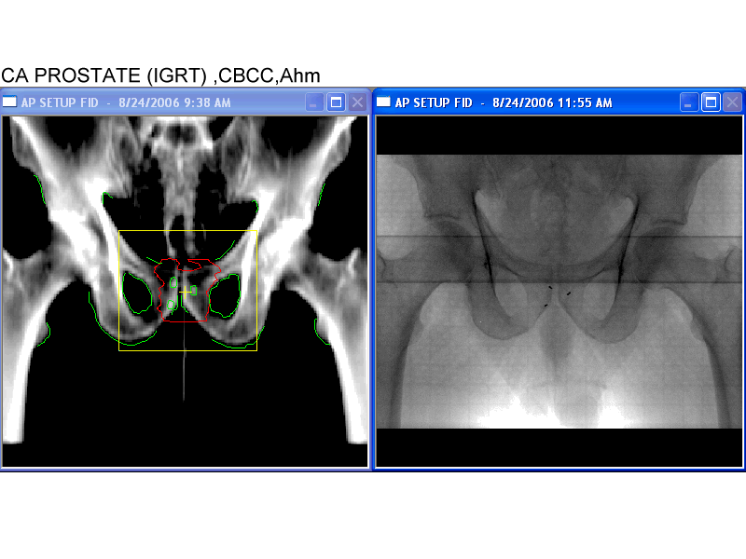
IS THE PLANNED TREATMENT ACTUALLY DELIVERED ?

Slide 50
Have we won the Race ?
Reduced Margins
Setup Errors
Geometric Miss
Locoregional Failures

Slide 51
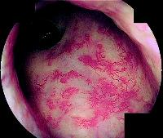
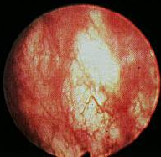
Geometric miss
Treatment Failures Unwanted complications
Proctitis
proctitis
cystitis

Slide 52
Setup Errors
It is therefore important
  to quantify patient set up errors
  possibly improve the set-up accuracy

Slide 53
Image Guided Radiotherapy (IGRT)
For better precision ideally tumor needs to be localized on daily basis before every fraction of radiation.
The technology and process that allows for this daily tumor localization is known as IGRT.

Slide 54
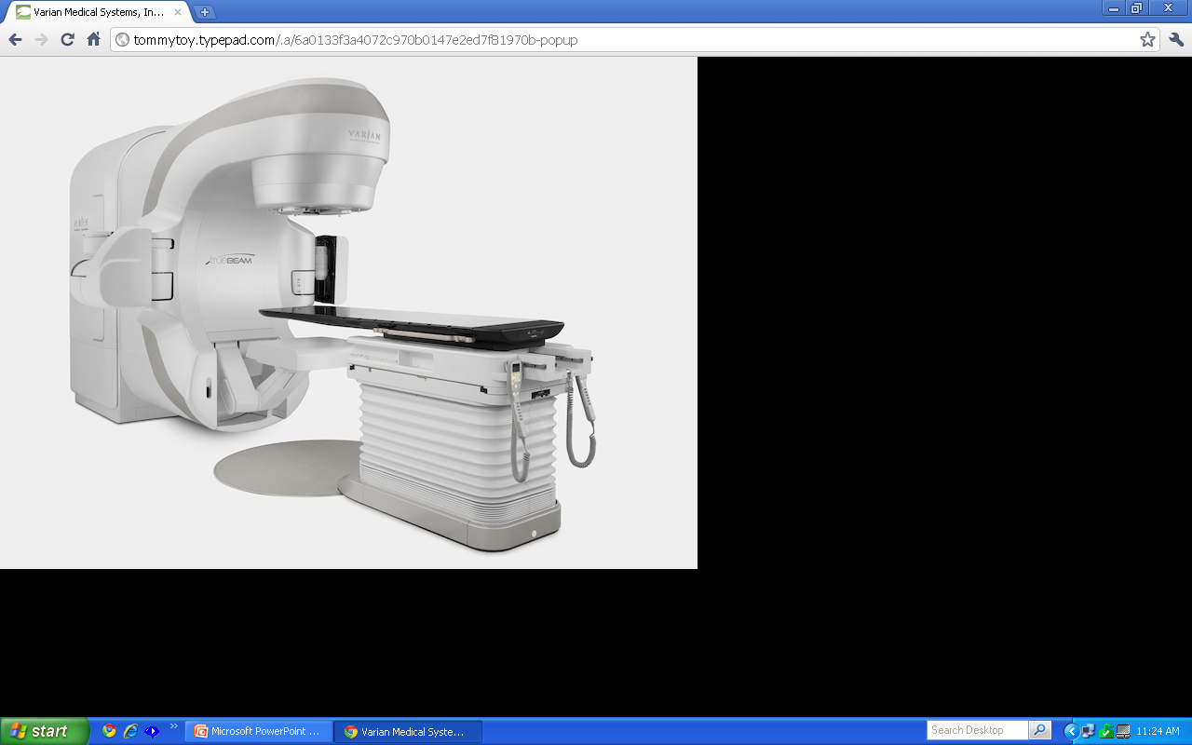
One stop solution
Image Guided Radiotherapy (IGRT)
TRUEBEAM- A MASTERPIECE

Slide 55
On Board Imaging (OBI)
3 Imaging Modes
Radiographic
Fluoroscopy
Cone Beam CT

Slide 56
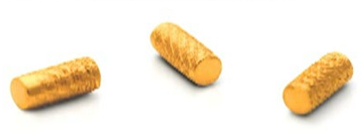
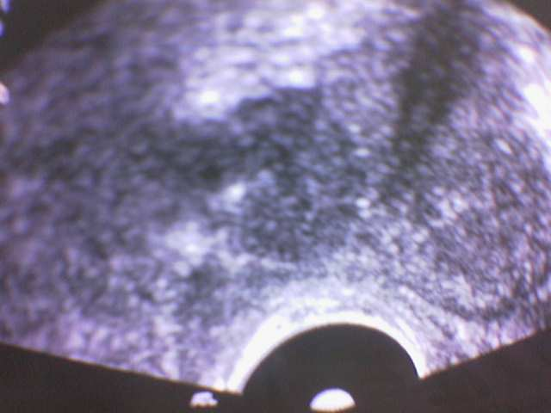
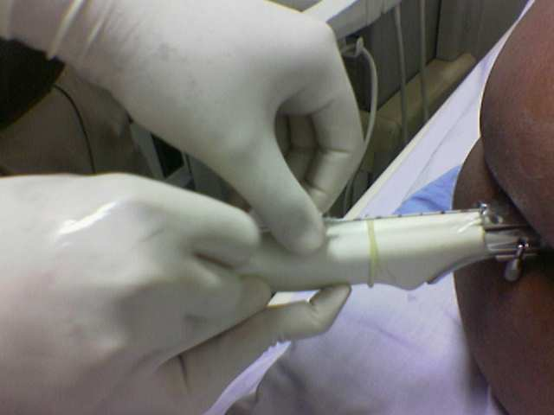
Marker implantation – Ca. Prostate
Gold marker size 1.2 x 3 mm
Team work –Radiation oncologist
Urologist and Radiologist
Transrectal sonography
Asses tumor size and location

Slide 57
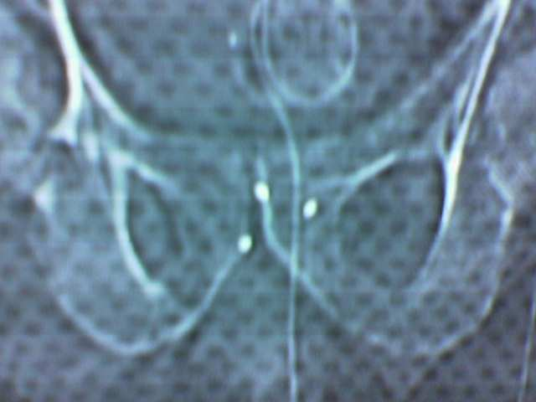
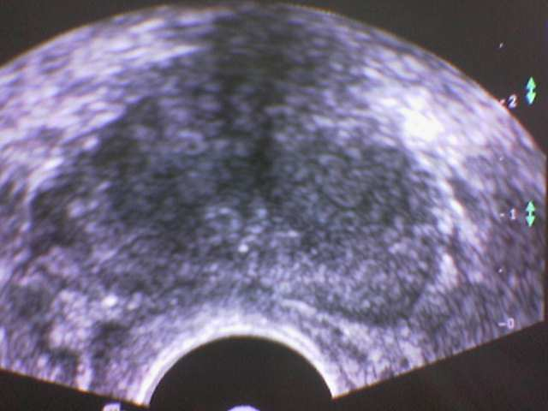
Verification of marker placement
Fluoroscopy
TRUS

Slide 58
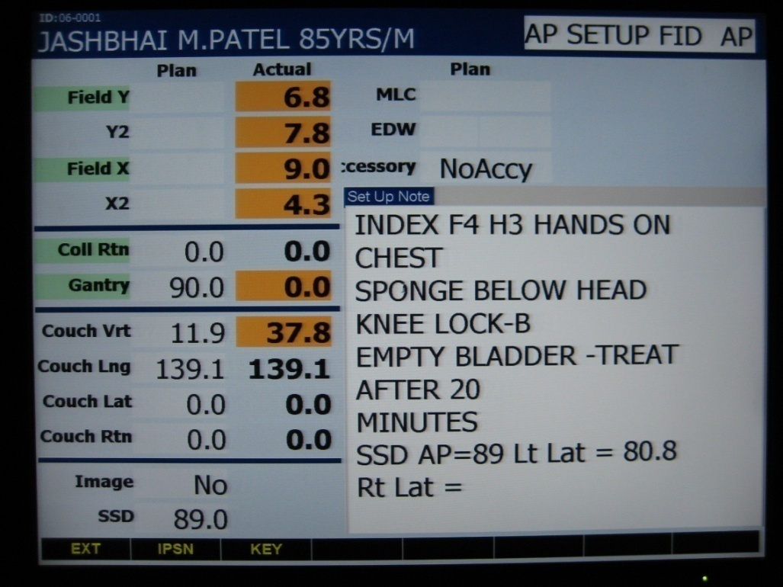
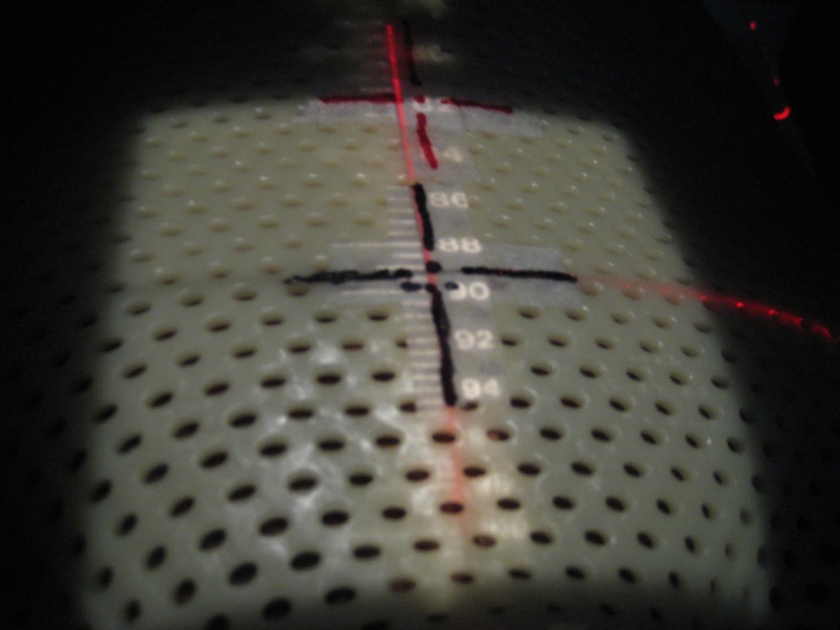
Treatment
Patient’s set-up using lasers & external markings

Slide 59


AP and Lateral KV images using OBI-2D Match
AP KV imaging
Lat KV imaging

Slide 60

AP and Lateral images were compared with the OBI software via direct overlay with DRR.
Manual matching was performed by Radiation Oncologist on implanted markers or on bony landmarks

Slide 61


Slide 62

CBCT-3D Matching
CBCT images matched with reference CT
- First 3 days (with 3D correction)
- Once weekly

Slide 63
Why CBCT?
    3D matching and thereafter corrects errors if any
    Evaluation of radiation response
    Monitoring contour changes and location of critical structures during XRT
    Localizing target position (if marker seeds not used)

Slide 64


Matched CBCT and Ref CT images

Slide 65


Changing dose distribution with Gas

Slide 66





Slide 68


81 Gy in 45 fractions

Slide 69

Precision vs. accuracy
IMRT (precise) vs. IGRT (accurate)

Slide 70


Slide 71
Role of Post.Op. RT & salvage RT
Safe option in patients with
  Extensive extra-capsular disease
  Positive margins
  Seminal vesicle involvement
  Key to Optimal outcome is to start RT if PSA
  level is rising more than 0.2 ng/ml in three
  serial measurements

Slide 72

Role of Radiation in Bony metastasis

Slide 73
AIM OF TREATMENT
Avoid futile therapies that result in toxicity.
Therapies should be directed at
Preventing or relieving symptoms-pain
Maximize functional integrity.
Cost effective

Slide 74
Median survival in Bony Mets.
Breast cancer
Bone mets alone - 20 months
Bone +liver mets - 3 months
Prostate cancer - 20 months
Lung cancer - 3 months

Slide 75



Dose distribution

Slide 76


Disseminated metastasis
Hemi body irradiation
UHBI
LHBI

Slide 77
Cost effectiveness-hospice
XRT : 30 Gy/10 # or 20 Gy/5#
Cost
XRT- $1200 to 2500
Analgesics - $9000 to $36000
Macklis,et.al.
ASTRO 2005

Slide 78


Radiotherapy: The Technology Conundrum
3D CRT
SRS/SRT
IMRT/IMRS
IGRT
CART
Proton Beam RT
Robotic RT
BIO-ART

Slide 79

True Beam
Image with confidence. Treat with confidence.

Slide 80

Image Quality

Slide 81
Truebeam –how is it different?
First fully-integrated radiotherapy system designed to treat a moving target with speed and precision.
It combines imaging, beam delivery and sophisticated RapidArc technology to accurately and precisely target tumors with great speed.
With dose delivery rates that are 40 to 140 percent higher TrueBeam can complete a treatment significantly faster

Slide 82
Truebeam –What to expect
Hypofractionated treatments for sites like prostate,lung and breast which can reduce the total duration from weeks to week.
SRS and SBRT treatments with RAPIDARC can be over in few seconds thereby adding to patient comfort with precision.
Better clinical outcomes with IGRT by virtue of reduced toxicity, uninterrupted treatment and dose escalation .

Slide 83


Slide 84
What is a CyberKnife?
The CyberKnife is a frameless robotic radiosurgery system to deliver hypofractionated treatment.
Small linear particle accelerator producing 6 MV beam.
Robotic arm which allows the energy to be directed at any part of the body from any direction.
Image guidance system.
Couch having six degrees freedom of movement.

Slide 85

What Sets the CyberKnife Apart
Noncoplanar beams (~ 120robot beam delivery points -called nodes)
As the treatment progresses, the robot walks through a set of nodes in sequence. This is referred to as a path.
Uses image guidance software to track and continually adjust treatment for any patient or tumor movement. This sets it far ahead of other similar treatments.
It allows patients to breathe normally and relax comfortably during treatment.

Slide 86



Slide 87
Stereotactic Radiation Surgery: Pancreas
Patient of Carcinoma Pancreas with local infiltration-Inoperable/surgery not feasible
Conventional option:
    Radio-Chemotherapy
    Clinical trial
    Poor GC – Best supportive care

Slide 88
Internal fiducial gold seeds or Coils (Viscicoil©)
Fiducial gold seed markers with applicators
Notes:
88

Slide 89

Notes:
89

Slide 90



Before, 3 mo., 6 mo.
AFTER CK
Notes:
90
Size no change in CT scan, but PET scan showed………

Slide 91



Changing Technology Impacts Every Sphere of Life

Slide 92

Developing Countries – Changing Perceptions
On the verge of major expansions
Opportunities galore
Increasing challenges

Slide 93

THANK YOU!

