Slide 1
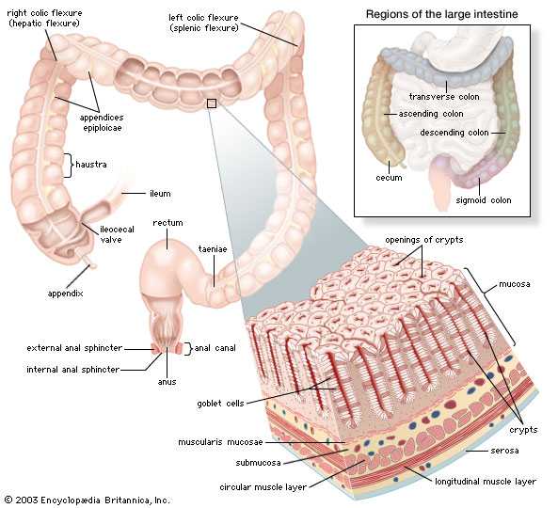
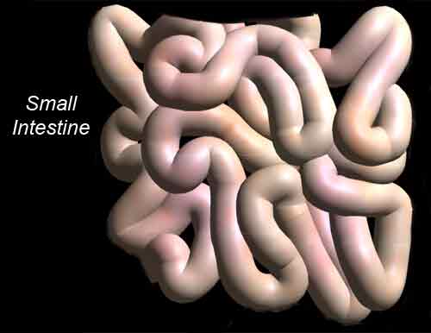
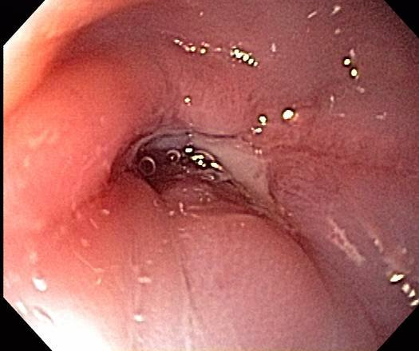
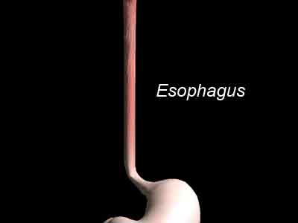
Radiation in GI Cancer-Improving outcomes & Reducing Toxicity
Dr Vivek Bansal
Director- Radiation oncology
HCG-Medisurge Hospital
SOLA-ROAD,Ahmedabad.

Slide 2
SCHEMA
Problems with conventional Radiation
Need to improve Therapeutic index
What has changed in last decade in delivery of Radiation to reduce toxicity
Evidence as of today site wise .
What future holds for us and concerns

Slide 3
TUMOR VRS NORMAL TISSUES-
DOSE CONSTRAINTS
  Squamous cell Carcinoma – 50-70 Gy
  Adenocarcinoma - 45 - 70 Gy
  Normal tissue Tolerances
    liver - 30 Gy
    kidney – <15 Gy
    Spinal cord – 46 Gy
    Spleen – 15-20 Gy
    Bowel - < 45 Gy
    This differential has to be achieved

Slide 4
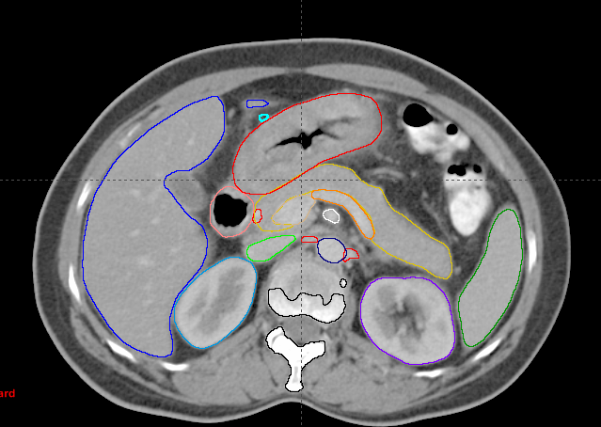
2D(Conventional) Treatment is less forgiving
No Respect to Normal tissues
( AP/PA portal)
Limitation of 2 dimensional conventional RT: -
Further dose escalation not feasible .
Tumour control and survival static for many years.

Slide 5
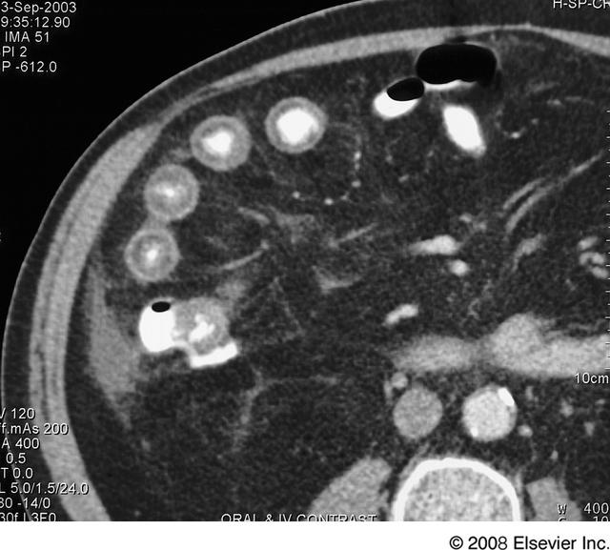
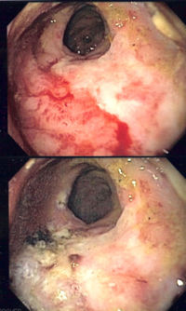
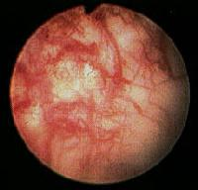
Problems with concurrent chemotherapy+ conventional radiotherapy
cystitis
Proctitis
RADIATION ENTERITIS
Mucosal ulceration ,‘Ribbon’ or toothpaste bowel
Stenosis, adhesion and/ or fistula
Thickening of lbowel folds

Slide 6
Improving Therapeutic Index
Reducing acute dose limiting toxicities allows effective dose intensification of RT
Where as Reducing late adverse effects can improve patients long term functioning and quality of life.

Slide 7
Dose volume relationship

Slide 8


Changing Technology Impacts Every Sphere of Life
USHERING IN ERA OF CONFORMAL
RADIOTHERAPY –A PARADIGM SHIFT

Slide 9
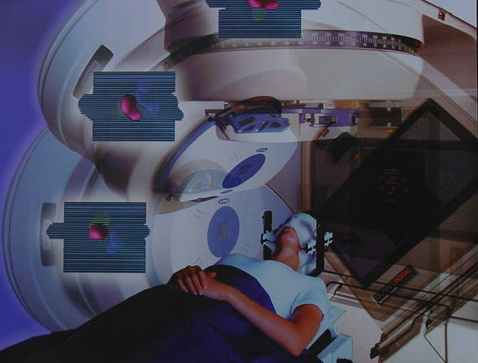
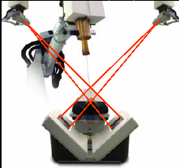
Changing face of Conformal Radiotherapy: The Technology Conundrum
3D CRT
SRS/SRT
IMRT/IMRS
IGRT
CART
Proton Beam RT
Robotic RT
BIO-ART

Slide 10
Imaging-role
Tumor imaging is an essential component to develop an optimal treatment plan
  Multimodality imaging has improved the accuracy and efficacy of planning, delivery and verification of radiotherapy
Imaging is also required to assess response to the treatment and to monitor complications

Slide 11
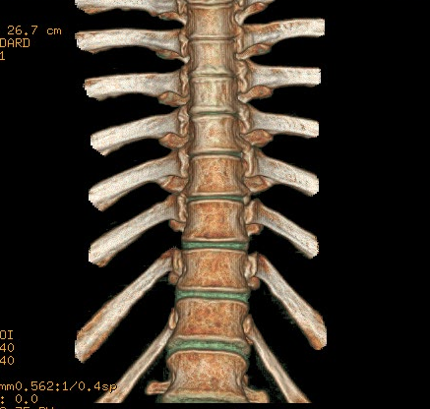
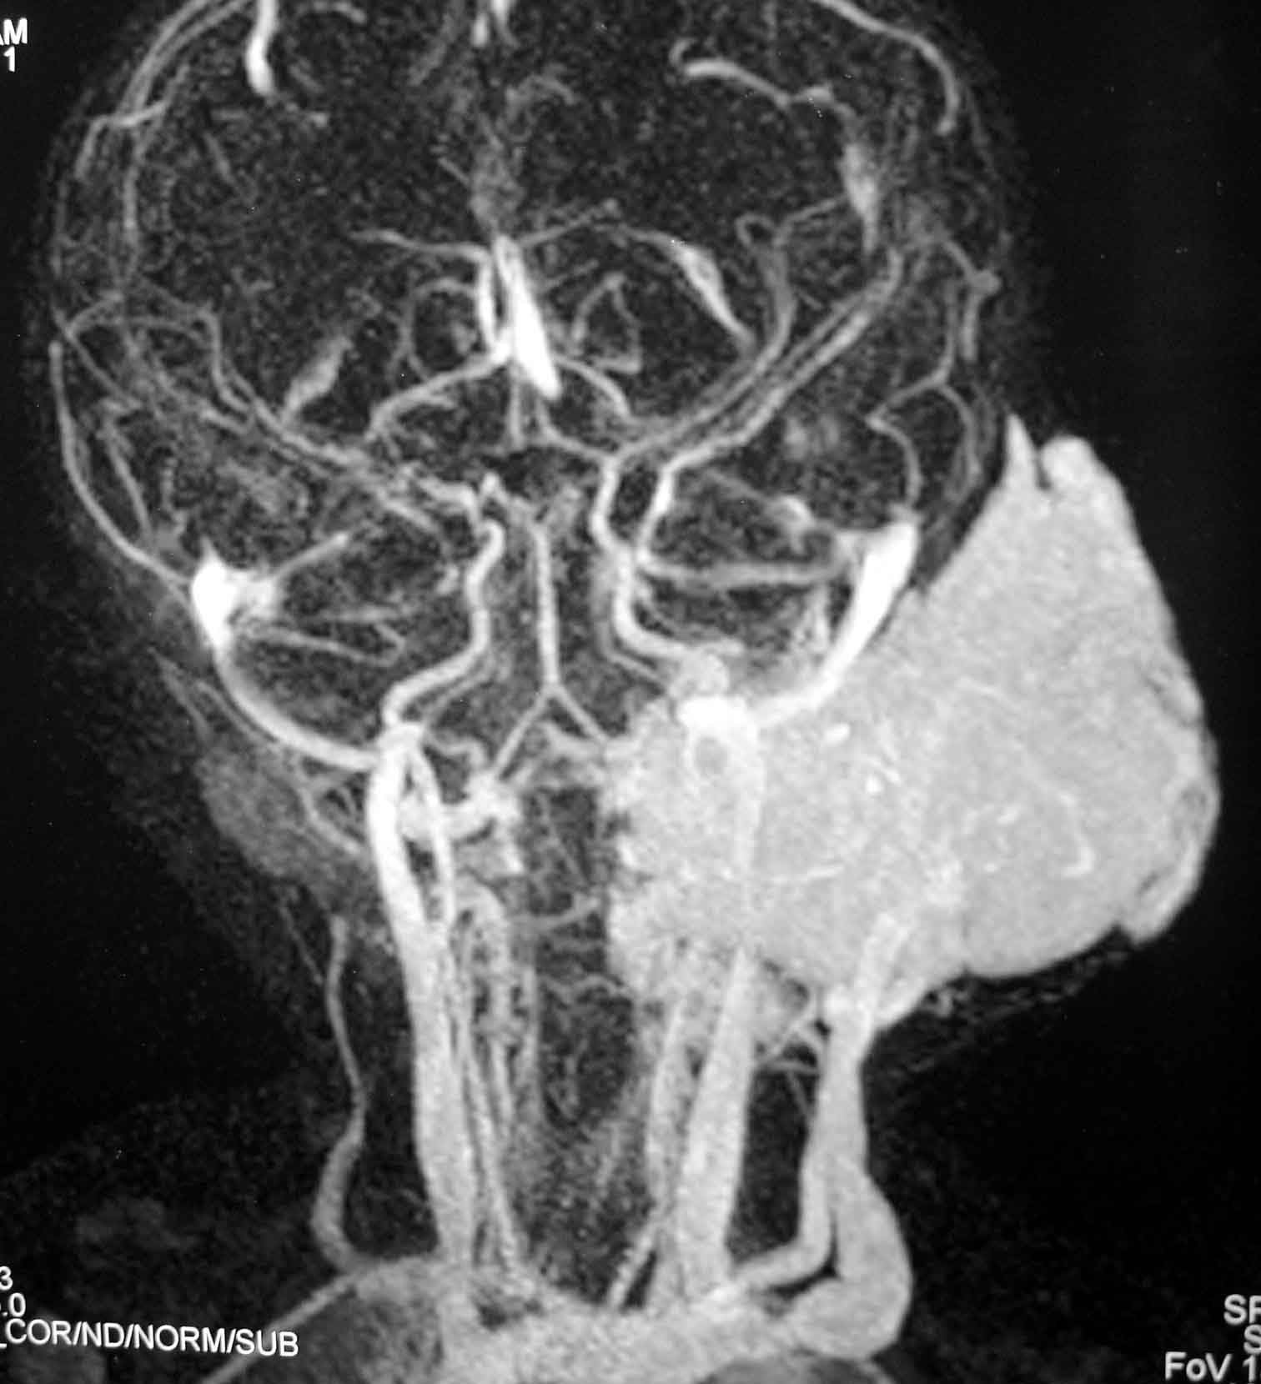
Volumetric
Shaded surface display (SSD)
Maximum intensity projection (MIP)

Slide 12
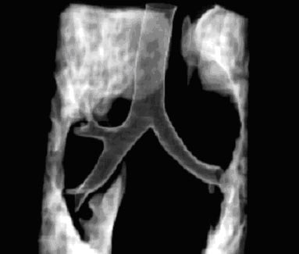
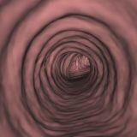
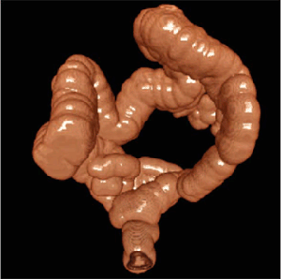
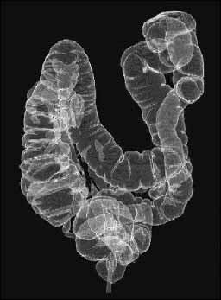
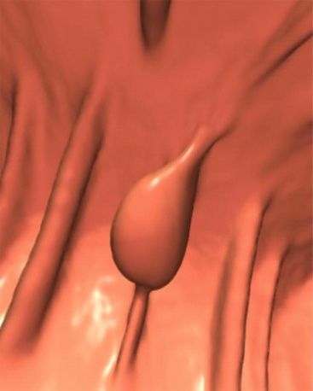
CT: Image Depiction

Slide 13
PET-CT Scan
FDG PET improved oncological management:
  Improved detection of disease localization &staging
  Monitoring chemo- and radiation therapy
  D.D. recurrence/residual tumor or necrosis
  Assistance with biopsy guidance* and RTP.
  - Avoidance of surgery or less extensive surgery
Post-C/T
early
Post-R/T
> 4 Ms
Staging
Restaging
Rec. RD or Nec.
Biospy
Diagnosis
Unknown primary
Prognosis

Slide 14
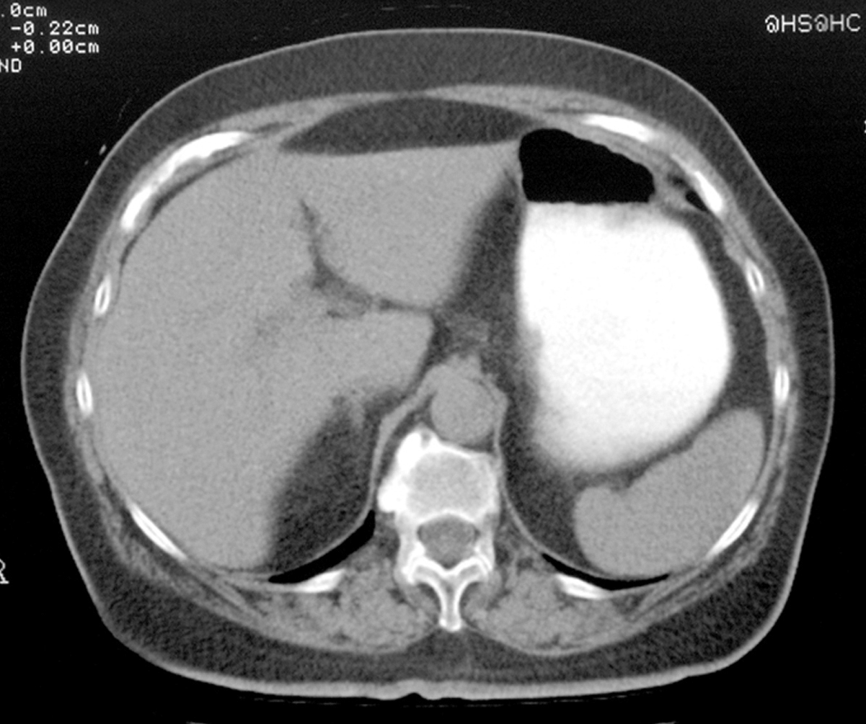
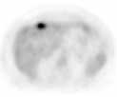
Enhanced Detection
73 year old woman s/p resection for colon cancer, rising CEA level and negative CT

Slide 15
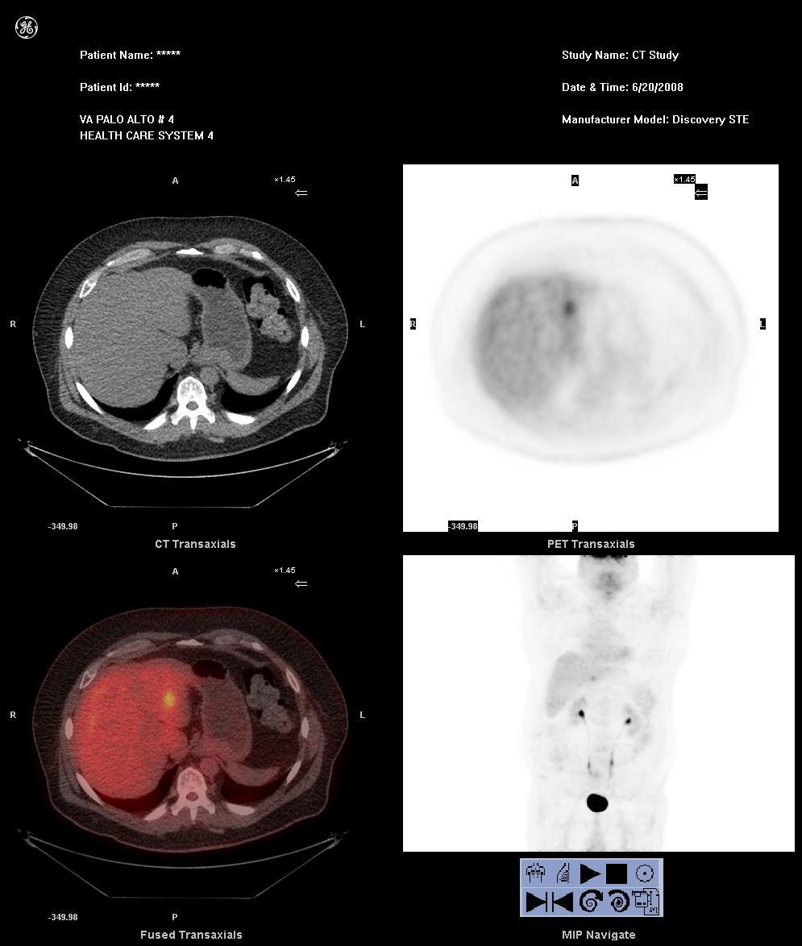
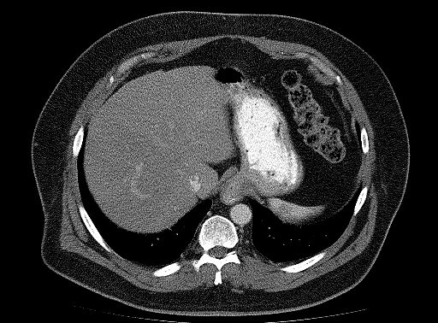
Enhanced Detection

Slide 16
Aim of PET-CT based planning
Identification & Rx of active tumor tissues
Possible tumor dose escalation & improve control
Sparing of surrounding critical structures better

Slide 17
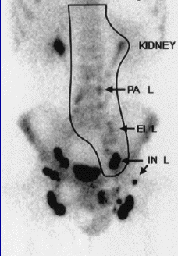
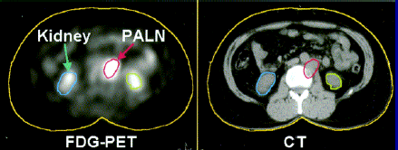
PET positive lesion included in GTV

Slide 18
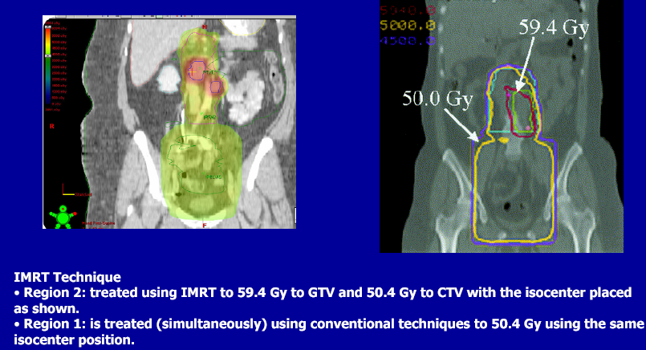
Composite IMRT plan (dose distribution for PA node)

Slide 19
OESOPHAGUS

Slide 20
IMRT in Carcinoma Oesophagus

Slide 21
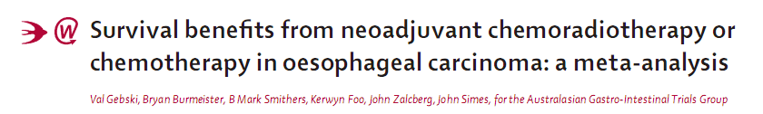
Lancet Oncol 2007; 8: 22634

Slide 22
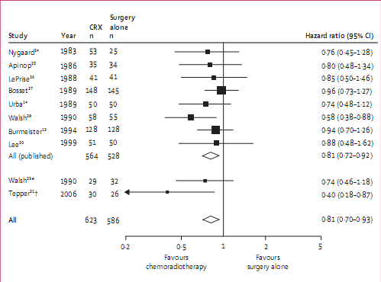
Meta-analysis: 18 Trials
10 trials of Neo-adjuvant RT+CCT (1983-2006)
Surgery
Vs
Surgery Alone
    13% survival benefit for the chemoradiotherapy studies

Slide 23
Lessons learnt in Ca.Oesophagus
Intergroup (INT) 0123/Radiation Therapy Oncology Group (RTOG) 94-05 study
Escalating the dose to 64.8 Gy was not beneficial.
(did not improve survival or locoregional control) .
Guidelines favour preopCT+RT > surgery in T2+
Disease of squamous cell Ca of Oesophagus.

Slide 24
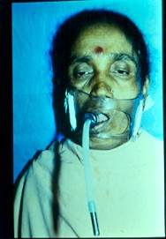
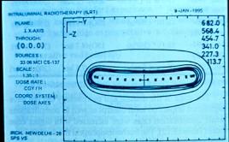
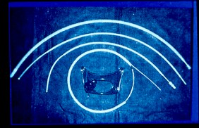
BRACHYTHERAPY

Slide 25
Stomach

Slide 26
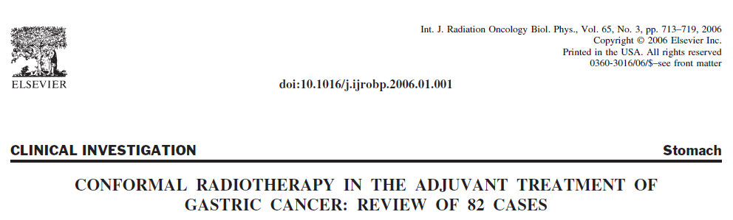
82 patients with resected gastric or (GEJ) adenocarcinoma
Stage IB to IV (M0)
45 Gy in 25 fractions using a 5-field conformal technique.
Chemotherapy was in accordance with the Intergroup 0116 study.
INT 0116 was planned using a two-dimensional planning technique

Slide 27
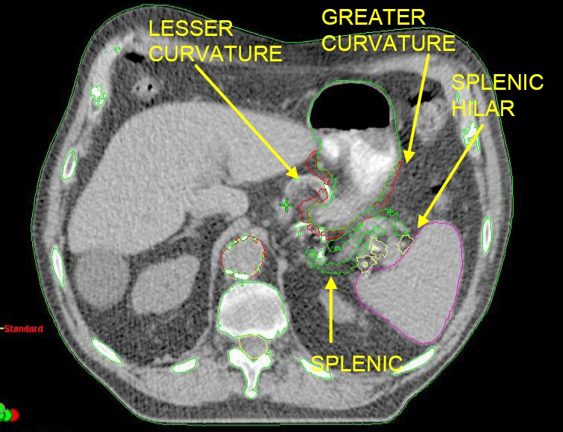
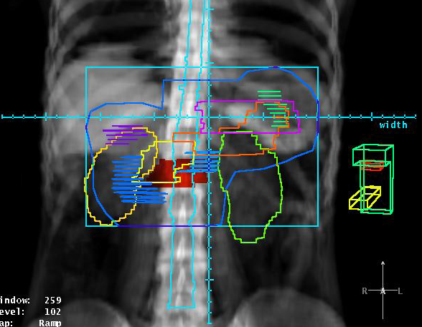
Grade 3 or greater acute toxicity was noted in 57% of patients (upper gastrointestinal tract 34%, hematologic 33%).

Slide 28
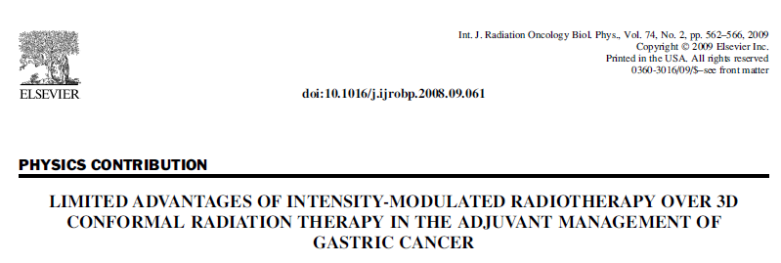
Results:
Comparison of the clinical target volumes revealed satisfactory coverage by the 95% isodose envelope using either IMRT or 3D conformal therapy.

Slide 29
Pancreas
Van der Geld Y.
Evaluation of four-dimensional computed-tomography-based intensity modulated and respiratory-gated radiotherapy techniques for pancreatic carcinoma.
Int J Radiat Oncol Biol Phys 2008;72: 1215–1220.
Landry JC.
Treatment of pancreatic cancer tumors with intensity-modulated radiation therapy using the volume at risk approach: Employing dose-volume histogram and normal tissue complication probability to evaluate small bowel toxicity.
Med Dosim 2002;27:121–129.
Milano M.
Intensity-modulated radiotherapy in treatment of pancreatic and bile duct malignancies: Toxicity and clinical outcome.
Int J Radiat Oncol Biol Phys 2004;59:445–453.
Ben-Josef E.
Intensity modulated radiotherapy and concurrent capecitabine for pancreatic cancer.
Int J Radiat Oncol Biol Phys 2004;59:454–459.

Slide 30
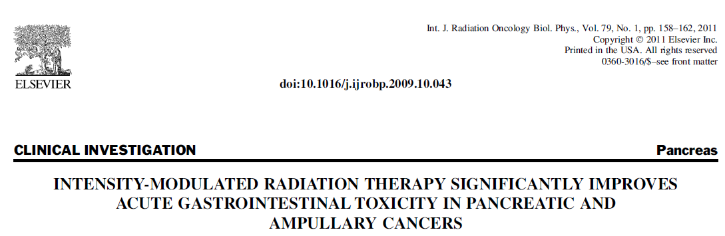
46 patients with pancreatic/ampullary cancer -concurrent chemoradiation
5-fluorouracil -Radiation Therapy Oncology Group (RTOG) 97-04.
Rates of acute gastrointestinal (GI) toxicity for this series of IMRT
treated patients were compared with those from RTOG 97-04 (where all
patients were treated with 3D conformal techniques).
Conclusions:
IMRT is associated with a statistically significant decrease in acute upper and lower GI toxicity among patients treated with CRT for pancreatic/ampullary cancers. Grade 3–4 nausea and vomiting (0% vs. 11%, p = 0.024) and diarrhea (3% vs. 18%, p = 0.017).

Slide 31
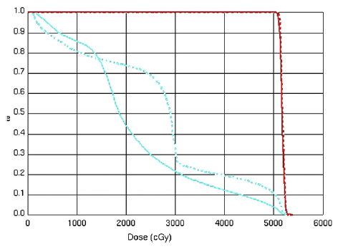
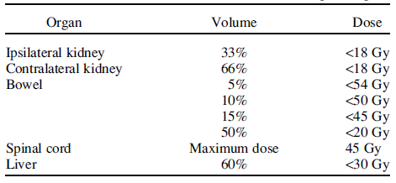
IMRT in Carcinoma Pancreas
The improved tolerability of treatment not only can improve patients’ quality of life but also may allow for radiation dose escalation and
Intensification of chemotherapy regimens

Slide 32
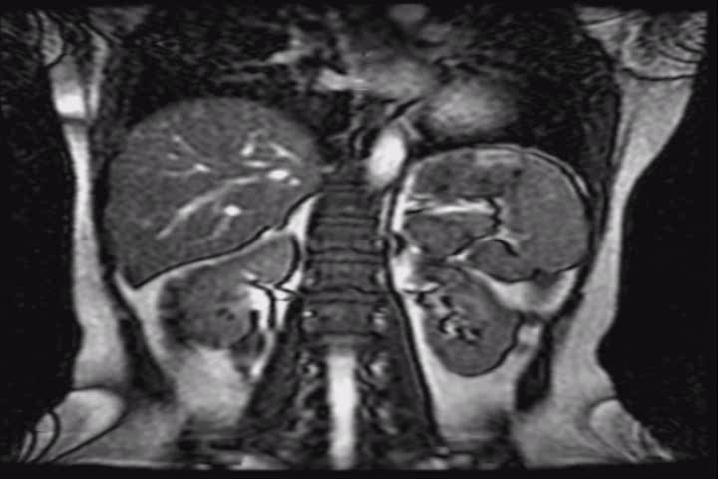

Slide 33
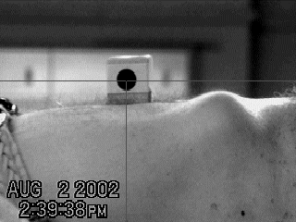
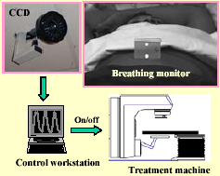
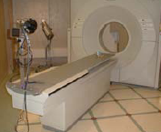
Respiratory Gating System:
Varian Real-time Position Management (RPM)
Components:
Reflective external Marker placed on abdomen or chest
Infrared illuminator/CCD camera
Workstation to process signals & generate trigger for CT/simulator/ linac

Slide 34
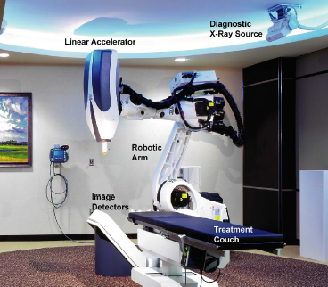
Cyberknife in Inoperable Carcinoma Pancreas

Slide 35
Stereotactic Radiation Surgery: Pancreas
Patient of Carcinoma Pancreas with local infiltration-Inoperable/surgery not feasible
Conventional option:
    Radio-Chemotherapy
    Clinical trial
    Poor GC – Best supportive care

Slide 36
Internal fiducial gold seeds or Coils (Viscicoil©)
Fiducial gold seed markers with applicators
Notes:
36

Slide 37
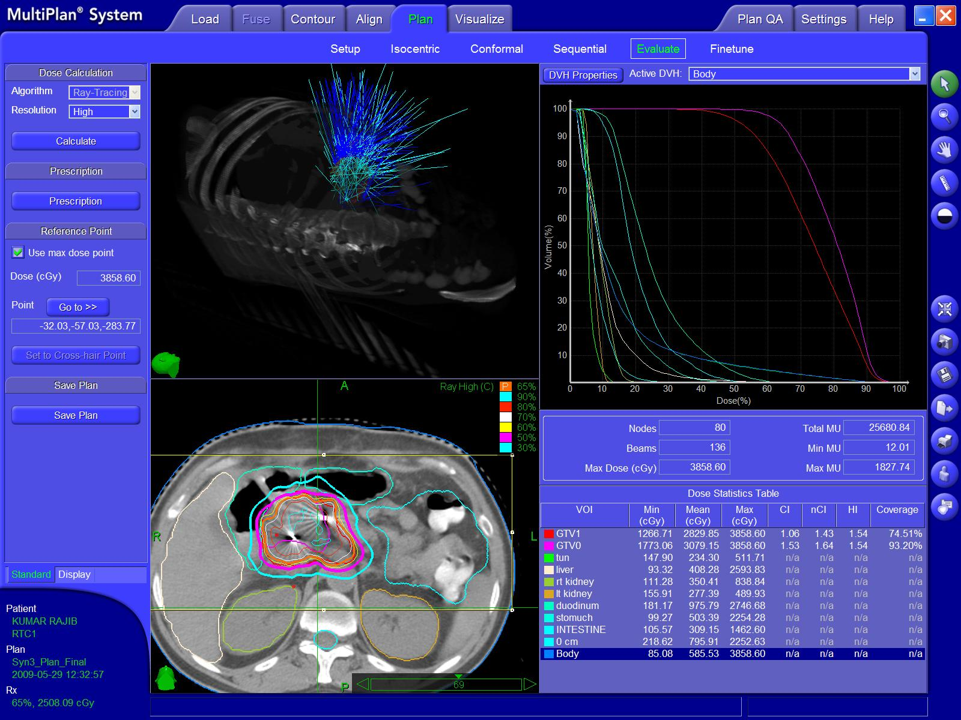
Notes:
37

Slide 38
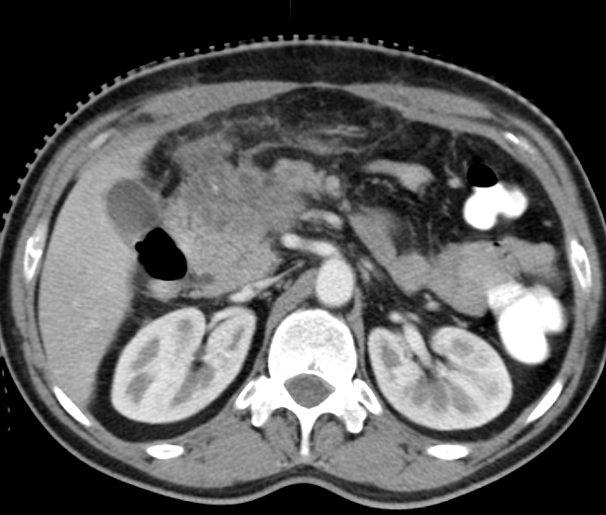
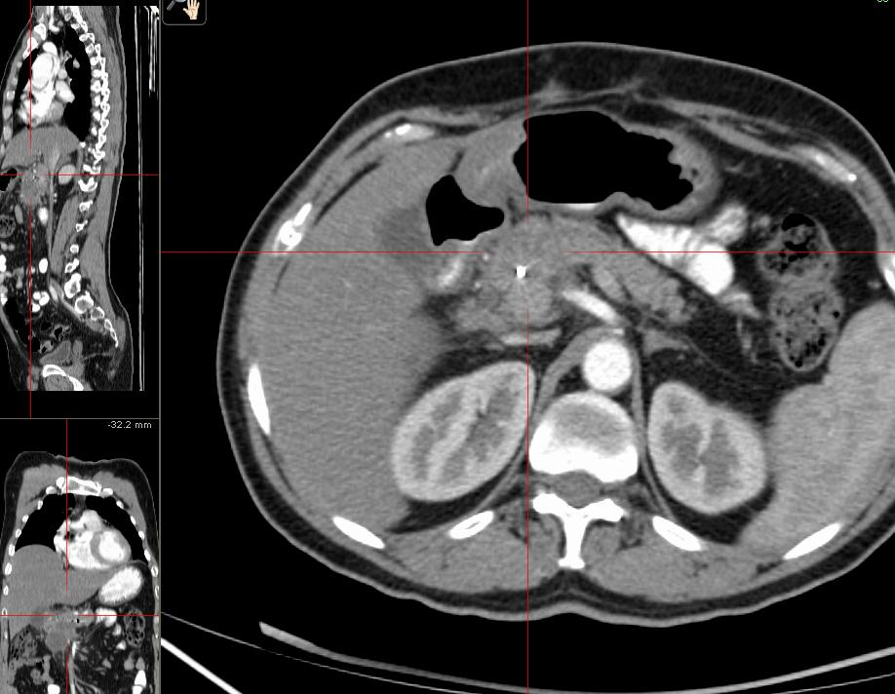
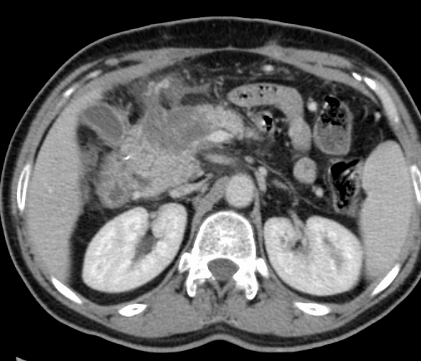
Before, 3 mo., 6 mo.
AFTER CK
Notes:
38
Size no change in CT scan, but PET scan showed………

Slide 39
Results SBRT-Pancreas
Pancreas
Koong et al, 2004 n=16
    25 Gy SRS boost after CCT & IMRT
    Gr. 3 toxicity: 2 patients
    Local progression control: 15/16
    No effect on OS

Slide 40
Gallbladder and Extrahepatic Bile Duct CA
Management of disease is complex: Surgery is main stay but often not possible in advanced stage
Limited data on optimal therapeutic approach
Morbid patient population due to jaundice/pruritus
Palliative setting : biliary drainage, stenting+adjuvant therapy

Slide 41
Intra luminal Biliary Brachytherapy protocol
Unresectable PBC with biliary obstruction causing jaundice
Percutaneous/Endoscopic transhepatic biliary drainage (PTBD/EBD)
Ir-192 Intraluminal brachytherapy
Self expandable metallic stenting
Chemotherapy

Slide 42
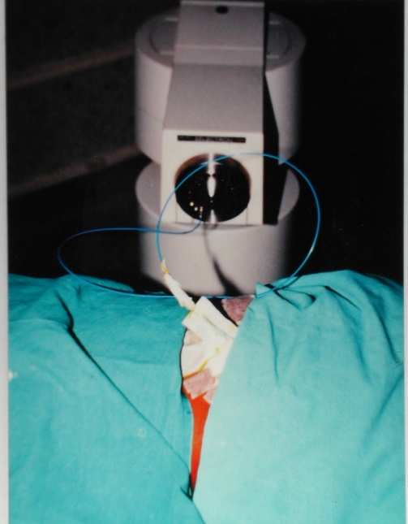
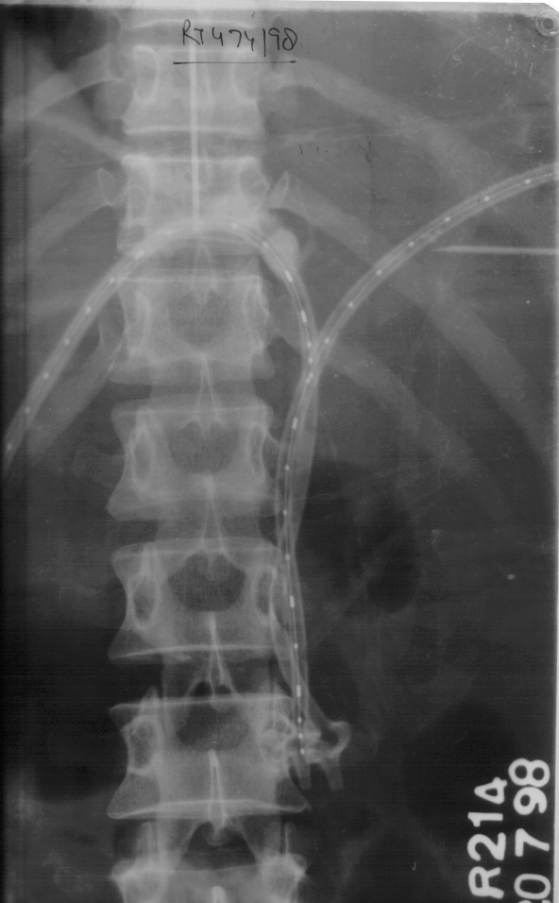
Intraluminal Brachytherapy
- Improved QOL due to prolonged jaundice free survival
- Brachytherapy appears to prolong stent patency and decrease stent block as high dose radiation in & around the bile duct

Slide 43
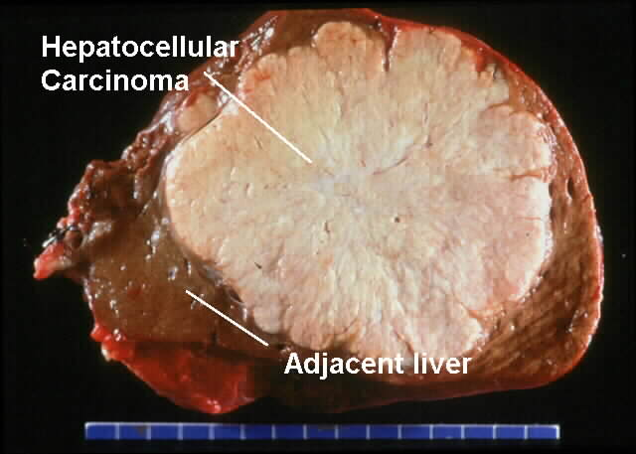
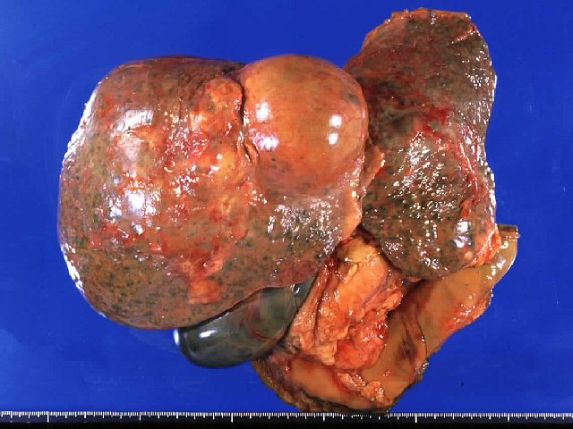
HEPATOCELLULAR CARCINOMA
The traditional curative treatment modalities used in this disease are resection or transplantation
However less than 20% of patients with HCC are candidates for resection or transplantation.
O

Slide 44
Radiation in HCC
Indications
Large unresectable HCC
Symptomatic portal vein thrombosis
Symptomatic jaundice
Part of combined modality treatment
Notes:
44

Slide 45
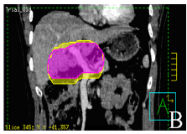
Advances in our understanding of ;
Partial liver tolerance of RT
Diagnostic imaging
Radiation planning
Techniques to account for respiratory motion of the liver
Techniques to target the tumor with image-guided RT
Availability of stereotactic RT and particle therapy have permitted us to escalate the doses of RT to focal HCC without dose-limiting toxicity

Slide 46
Charged-Particle Irradiation using Proton & Carbon ion therapy

Slide 47



Slide 48
Charged-Particle Irradiation
The largest experience with proton RT for HCC comes from Tsukuba, Japan.
Between November 1985 and July 1998, 162 patients with unresectable HCCs were treated with proton beam therapy with or without transarterial embolization and percutaneous ethanol injection.

Slide 49
Charged-Particle Irradiation
The median dose was 72 Gy in 16 fractions over 29 days.
Patients had few acute reactions to treatment and rare late sequelae.
The 5-year local control rate was 87%, and the 5-year overall survival rate was 23.5%.

Slide 50


72.6GyE/22 fr.
Before treatment
normal liver
enlargement
(functional recovery)
Tumor shrinkage
(just like surgery)
4 years after
Notes:
50

Slide 51
Rectum
Callister M.
IMRT reduces the dose to small bowel and other pelvic in the preoperative treatment of
rectal cancer.
Int J Radiat Oncol Biol Phys 2006;66:S290.
Engels B
Preoperative helical tomotherapy and megavoltage computed tomography for rectal
cancer: Impact on the irradiated volume of small bowel.
Int J Radiat Oncol Biol Phys 2009;74:1476–1480.
Guerrero Urbano MT
Intensity modulated radiotherapy in patients with locally advanced rectal cancer reduces volume of bowel treated to high dose levels.
Int J Radiat Oncol Biol Phys 2006;65:907–916.

Slide 54

A retrospective review -Clinic Arizona -92 patients recd 50 Gy.
61 recd 3DCRT and 31 recd IMRT with chemo.
Data regarding- Patient and tumor characteristics/ treatment
Acute toxicity according to the CTCAEv 3.0
Tumor response, and
Perioperative morbidity were collected.

Slide 55

Acute GI Effects>=2 Diarrhea Enteritis
3DCRT 48% 30%
IMRT 23% 10%
P Value 0.02 0.015
IMRT for rectal cancer in our practice is associated with a clinically significant decrease in acute GI toxicity compared with traditional techniques.
These clinical results confirm the findings of dosimetric studies that show the potential for IMRT to reduce bowel exposure compared with CRT

Slide 56
Anal Canal

Slide 57

60 patients, treated with conventional radiation techniques (C-RT), were used as controls, and 62 consecutive patients were treated with 3D-CRT.
Conclusion: The use of 3D-CRT allows patients with anal canal cancer to complete radiation and chemotherapy without interruption for toxicity, with significant improvements in LC, FFR, and OS.

Slide 58

Brachytherapy
in Anal Cancers

Slide 59


Interstitial brachytherapy
“O” type template

Slide 60

Interstitial brachytherapy
Martinez Universal Perineal Implant Template
(MUPIT)

Slide 61


IJROBP, 62, 2, 479-485, 2005 (France)
N = 69 pts (T_{is}, T₁)
Radiotherapy : 66
  Brachytherapy : 8
  Ext. RT+ BCT : 38
  Ext. RT alone : 20
CR at end of RT : 98%
Local failure : 7
Salvaged by APR : 6 / 7
Radiotherapy
(Ext. RT + BCT)
An effective option
for Anal cancers
5 yr. OS 94%
5 yr. DFS 89%

Slide 62



Stereotactic Body Radiation Therapy
(Stereotactic Ablative Radiotherapy)
Critical structures
Image-guided
Ablative dose
GTV

Slide 63

Rationale for SBRT & Scope
Ablative doses provides similar outcomes for the lesion for which surgical approaches are standard of care
Scope :
lung/ thorax
Prostate
Thyroid
Pancreas
Liver
Colon
Adrenal
………………..
SBRT technical brief ; AHRQ Publication No. 10(11)-EHC058-EF May 2011

Slide 64
SBRT TREATMENT PROTOCOL AND DOSES
Liver
Hepatoma : 5 - 8 Gy x 3-4 fr
Metastasis : 6 - 9 Gy x 3-5 fr
Pancreatic Cancers : 6 - 8 Gy x 3-5 fr
Recc. Rectal Cancers : 5 - 7 Gy x 5 fr
Metastatic disease:
Kidney : 8 Gy x 4 fr
Adrenal : 10 Gy x 3 fr
Blomgren et al
Notes:
Various schedules recommended by Stockholm Group. Most of these are palliative situations and not in a radical setting

Slide 65






IA
IB
IC
II B
II C
IIA
IA. Seg VIII metastasis IB. SBRT dose distribution IC. Complete response 3 mths
IIA. Seg IV metastasis II B. SBRT dose distribution IIC .Complete response 3 mths

Slide 66


RT NO.12-0379
PRE SBRT SCAN
1 MONTH POST SBRT

Slide 67






INDIA at a Glance…..
Total Area : 3,287,263 sq km
Total Population (X1000) : 1,21,01,93,422
Official languages : 14
Life Expectancy : 64.7 years
Rural/urban population : 70/30
Literacy Rate : 59%
MAJOR MORTALITY : INFECTIOUS DISEASES
Infant Mort. Rate : 54.6 deaths /1000live birth

Slide 68
The Global Burden of Cancer
Million
* WHO Projection

Slide 69


Problems of Resource Limited Settings:
Patient Related
Poverty
Malnutrition
Illiteracy
Funding
Infrastructure
Manpower
Standardization
Poverty is a Carcinogen.
Do we care ?
37% of the deaths from cancer attributed to Poverty
(Between 27 and 64 Years of age)
ACS , Cancer Facts and Figures 2011
Lung cancer: Indian demographics
Indian J Chest Dis Allied Sci. 2004 Oct;46(4):269-81.

Slide 70


Problems of Resource Limited Settings:
Provider Related
Poverty
Malnutrition
Illiteracy
Funding
Infrastructure
Manpower
Standardization
2000
2010
Radiotherapy units per million population:
India/Pakistan 0.3
Bangladesh 0.1
USA 8.3
Dismal for Simulators / TPS
Lancet Oncology(5)2004;695-8

Slide 71

The Unique Paradox:
Problems of Resource Limited Settings
Lost between
Basic deficiencies &
Technical advancements

Slide 72
High-cost Technology in Radiation Oncology: A value judgment
Hi-LET
IMRT+Hi-LET
IGRT
IMRT
IMAT
SiMAT
3D-CRT
KV: Kilovoltage X-rays
MV: Megavoltage X-rays
3D-CRT: 3D-Conformal Radiotherapy
SiMAT: Simplified Intensity Modulated Arc Therapy
IMAT: Intensity Modulated Arc Therapy (X-rays)
IMRT: Intensity Modulated Radiotherapy (X-rays)
IGRT: Image Guided Radiotherapy (Tomo etc.)
Hi-LET: High LET radiation (Charged particles)
IMRT+Hi-LET: Combination
Cost-Benefit Ratio
MV
KV

Slide 73
Optimization of Treatment
Good Nutritional Support.
Avoidance of Treatment Breaks
Integration of Chemotherapy
Altered fractionation & abbreviated schedules
Integration of high-precision techniques

Slide 74

THANK YOU!

Slide 75




CT: Image Depiction

Slide 76
Why PET-CT ?
• Metabolic information (molecular imaging)
• Safe, non-invasive procedure
• Single test for the entire body
• Earlier detection, Precise staging
• Monitoring response to chemo/radiotherapy
• Avoidance of surgery or less extensive surgery
• Lowering the overall cost of care

Slide 78
Unfavorable characteristics
T4 tumors
AFP level > 1,000 ng/mL
total tumor diameter > 8 cm
Vascular invasion
poorly differentiated histologic grade
Older individuals
Notes:
78

Slide 79
HCC has traditionally been considered a radioresistant tumor.
This historical view was related to the fact that only low doses were used originally to treat HCC to avoid hepatic toxicity.
Conventional RT to the entire liver has a high risk of potentially fatal radiation-induced liver disease (RILD).
Observed when doses to the entire liver exceed 30 Gy.

Slide 80


The development of three-dimensional (3D) conformal RT has enabled high-dose RT to be directed to the tumor while sparing the non–tumor-bearing surrounding liver parenchyma from these high doses.

Slide 81


Newer imaging modalities and more refined imaging protocols have improved our ability to delineate tumors on the basis of their contrast uptake characteristics.

Slide 82
Results of External-Beam RT
Promising clinical data from various studies suggest that HCCs are indeed radiosensitive,
with sustained local control rates ranging from 71% to 100% after 30 to 90 Gy, delivered over 1 to 8 weeks.
The large range of objective response rates (48%–91%) and survival rates (42%–94% at 1 year and 6%–19% at 5 years).

Slide 83

Proton beam / heavy ion therapy:
its application for organ preservation
^{１}H
・Hepatocellular carcinoma (HCC)
・Pediatric tumors
^{１２}Ｃ
・Bone and soft tissue sarcoma
Conclusions
Particle beam therapy using proton / carbon beam
・ better survival rate
・ significantly better quality of life
than conventional treatment modalities.
Notes:
83

Slide 84
Charged-Particle Irradiation
More recently, Kawashima et al. reported a 66% overall survival rate at 2 years among 30 patients treated on a phase 2 protocol with 72 CGE in 20 fractions over 5 weeks.
These results indicate that proton beam therapy is safe and efficacious in the treatment of HCC and the results compare favorably to other curative treatments.

Slide 85
Charged-Particle Irradiation
Furthermore, it is repeatable and minimally influenced by tumor size, tumor location, arterial anatomy of feeding vessels, presence of vascular invasion, and coexistence of intercurrent medical disease.

Slide 86
CHILD-PUGH SCORE
score | Bilirubin (mg/dl) | Albumin (g/dl) | Prothrombin time (sec) | Hepatic encephalopathy (grade) | Ascites
1 | <2 | > 3.5 | < 4 | None | None
2 | 2 – 3 | 2.8 – 3.5 | 4 – 6 | 1 – 2 | Mild (detectable)
3 | >3 | < 2.8 | > 6 | 3 - 4 | Severe (tense)
Child-Pugh class : A, 5-6; B, 7-9; C, >9

Slide 87
DuthoyW,
Clinical implementation of intensity-modulated arc therapy (IMAT) for rectal
cancer.
Int J Radiat Oncol Biol Phys 2004;60:794–806.
Nuyttens JJ
The influence of small bowel motion on both a conventional three-field and intensity
modulated radiation therapy (IMRT) for rectal cancer.
Cancer Radiother 2004;8:297–304.
Arbea L
Intensitymodulated radiation therapy (IMRT) vs. 3D conformal radiotherapy
(3DCRT) in locally advanced rectal cancer (LARC): Dosimetric comparison and clinical implications.
Radiat Oncol 2010;5:17.
Tho LM
Acute small bowel toxicity and preoperative chemoradiotherapy for rectal cancer: Investigating
dose-volume relationships and role for inverse planning. Int J Radiat Oncol Biol Phys 2006;66:505–513.

Slide 88


Treatment regimen
After target coverage and homogeneity, IMRT optimization were prioritized for dose reduction to the small bowel followed by bladder and femora.
Limited volumes of small bowel volume were allowed to exceed 45 Gy if adjacent to the boost volume, but not to exceed 50 Gy.
In addition to maximum dose, multiple dose–volume parameters were specified for the small bowel volume, ranging from 15 to 40 Gy to reduce mean bowel exposure to as low as achievable.
The maximum bladder dose was kept from exceeding 50 Gy, and V40 was kept less than 40% or lower if possible.
The proximal femora were constrained from receiving more than 40 Gy.
The dose fractionation for IMRT patients was similar to that for CRT patients except that often the GTV boost (to 50 Gy) was delivered concurrently with the 45 Gy to the pelvis.

Slide 89
RT/CT IN RECTAL CANCERS

Slide 92
Pre-operative

Slide 93
Mortality, morbidity, toxicity, and function
Treatment mortality - A meta-analysis of 13 randomized, controlled trials of radiotherapy (excluding the Swedish trial) found no difference in mortality, but subgroup analysis suggested that mortality was greater when the dose was higher than 30 Gy .
Complication rates were higher after radiotherapy plus surgery than after surgery alone: 57% versus 42%,
Camma C,et al. Preoperative radiotherapy for resectable rectal cancer. JAMA 2000;284:1008–15.
Complications associated with adjuvant therapy:
-acute severe or life-threatening diarrhea (25%)
-chronic bowel injury (25%)
-long term quality of life changes: increased BM/day (median 7 with chemoRT vs.
surgery alone),
-occasional incontinence (39% vs. 7%)

Slide 94

43 patients
IMRT and concurrent chemotherapy
IMRT was prescribed as follows:
T2N0: 42 Gy, 1.5 Gy/fraction (fx) to elective nodal planning target volume (PTV) and 50.4 Gy, 1.8 Gy/fx to anal tumor PTV;
T3-4N0-3: 45 Gy, 1.5 Gy/fx to elective nodal PTV, and 54 Gy, 1.8 Gy/fx to the anal tumor and metastatic nodal PTV >3 cm with 50.4 Gy, 1.68 Gy/fx to nodal PTVs #3 cm in
size.

Slide 95

Results:
Median age was 58 years;
Median follow-up was 24 months (range, 0.6–43.5 months).
Sixty percent completed chemoradiation without treatment interruption
median duration of treatment interruption was 2 days (range, 2–24 days).
Two-year local control, overall survival, colostomy-free survival, and metastasis-free survival were 95%, 94%, 90%, and 92%, respectively
Acute Grade 3+ toxicity included:
hematologic - 51%
Dermatologic- 10%
gastrointestinal - 7%
genitourinary - 7%.
Conclusions - local control and colostomy-free survival in this series is very encouraging
especially in light of the 33% of patients who were immunocompromised (21% HIV-positive and 12% on chronic immunosuppression), a putative risk factor for decreased local control and greater toxicity.
Awaiting the longterm patterns of failure and late morbidity results of RTOG 0529 to validate this DP-IMRTapproach before it is adapted as standard of care.

Slide 96
Patient Selection Criteria
Indications
Brachytherapy alone:
  Effective in controlling very small lesions
  Painful reactions in 50%, late necrosis in 10-15%
  Usually not used as sole treatment modality
Boost following concomitant Chemoradiotherapy, usually after 40-45 Gy of Ext. RT
Located within 8 cm of anal verge
Tumor size preferably not more than 6 cm
Thickness preferably less than 3 cm
Less than half of the lumen infiltration

Slide 97
Summary ⎯
FDG PET improved oncological management:
  Improved detection of disease localization
  Monitoring chemo- and radiation therapy
  D.D. recurrence/residual tumor or necrosis
  Assistance with biopsy guidance* and RTP.
Post-C/T
early
Post-R/T
> 4 Ms
Staging
Restaging
Rec. RD or Nec.
Biospy
Diagnosis
Unknown primary
Prognosis

Slide 98

Nearly doubles the incidence of second cancers at 10 years

Slide 99
Concurrent chemoradiotherapy – Increasing Role
Concurrent Chemoradiotherapy
higher incidence of acute and late complication compared with RT alone.
Especially with conventional Radiotherapy

Slide 100
Treatment regimen
All patients received 5-fluorouracil (5-FU)–based concurrent CRT therapy with either capecitabine (750–825 mg/m2, divided in twice-daily doses and given Monday through Friday with radiation treatment) or infusional 5-FU (250 mg/m2 daily throughout radiation
treatments).
The majority of patients received one to two cycles of gemcitabine (1000 mg/m2 weekly for 3 to 7 weeks) before beginning concurrent CRT in a schema similar to the recently reported adjuvant pancreas trial, RTOG 97-04. Patients received further treatment with gemcitabine after completing concurrent CRT at the discretion of the treating medical oncologist.
Median radiation dose was 50.4 Gy given in 28 1.8-Gy fractions; patients with unresectable disease (n = 15) or positive margins (n = 8) received higher doses (54–59.4 Gy).

Slide 101
BRACHYTHERAPY

Slide 102
ISODOSE DISTRIBUTION

Slide 103
Limitation of 2 dimensional conventional RT: -
Further dose escalation not feasible .
Large amount of normal tissue irradiated leading to high late radiation morbidity &QOL
Tumour control and survival static for many years.

Slide 104
Biologically Guided Radiotherapy:
Theragnostics
Bentzen proposed
‘‘Theragnostic’’: use of molecular imaging to prescribe the distribution of radiation doses in 4 dimensions
  Tumor burden / clonogenic density
  Hypoxia
  Proliferation targeted
  Receptor expression (EGFR) etc
Integration of these tracers could be used to ‘‘paint’’ or ‘‘sculpt’’ the dose in various sub volumes by IMRT/IGRT
PET signal intensity can be used to prescribe the dose, leading to the evolution of the concept of dose painting into “dose painting by numbers”
104

Slide 105






Volume rendered (VRT)
3D model with various degree of opacification
Uses opacity transfer function from fixed observer viewpoint
Color coding

Slide 106
RT – 3D Conformal
Methods
25 Pts, Child-Pugh A/B, small HCC
Ineligible for curative therapies
66 Gy in 2 Gy Fx
Results
1 yr Local Control: 78% (92% tumor response)
Grade 4 toxicities in 22% of Child-Pugh B pts only, (already had Grade 3)
French RTF1 prospective phase 2 trial (IJROBP, 2006)
    Investigated high-dose RT for unresectable cirrhotic patients
Notes:
106

Slide 107




Why Brachytherapy … Anal Cancers
Changing concepts in Anal cancer management
From APR to functional organ preservation
Favorable outcomes with Chemoradiotherapy
  Loco-regional control
  Sphincter preservation
Radiation dose response relationship – tumor & normal tissues
  Use of additional boost
  External radiotherapy or brachytherapy

Slide 108



Slide 109
METABOLLICALLY AIMED RADIOTHERAPY
MART
PET GUIDED
IMRT/TOMOTHERAPY
IMPROVED TUMOR/NON TUMOR RADIATION DOSE
HYPO-FRACTIONATION
30-40 → 5-10 fractions

Slide 110
Solution
Treat only high risk area with minimal damage of normal cells
Tremendous advancement in the field of Radiation Oncology
IG-IMRT
IG-Brachytherapy
Proton therapy
Use of CT/MR
Conformal therapy
Brachytherapy
SRT/SRS
IMRT

Slide 111
Chemical/Biologic Modifiers
Prolonged maintenance on high doses of chemotherapy
Pre-existing inflammatory bowel disease
Prior pelvic surgery
Pelvic inflammatory disease
Diabetes have demonstrated increased risk of GI toxicity .

Slide 112

Ca Colon with rising CEA

Slide 113

Interventional Radiology
Palliation and supportive
Catheter drainage
  Abscess, effusion
  PTBD, nephrostomy, gastrostomy
  Can be used for brachytherapy
Recanalisation & stenting
  Airway, GI tract, biliary
Pain management
  Neurolysis
  Vertebroplasty

Slide 114

RESIDUAL DISEASE
HD POST THERAPY – RESIDUAL MASS
Notes:
114

Slide 115
PET-CT IN RT PLANNING
Change in treatment strategies : radical to palliative (15-26%)
Alteration in RT treatment portals : 10 - 20%
Therapeutic window for selective Dose Escalation
Impact on clinical outcome

Slide 116

Compared with the 50.4 Gy 2D-CRT plan, the 64.8 Gy SIB-IMRT produced significant dose reductions to all critical structures (heart, lung, liver, and spinal cord).

Slide 117



Slide 118
Single-Dose Brachytherapy Versus Stent Placement
A total of 209 patients, were randomized to single-dose (12 Gy) brachytherapy or stent placement (Ultraflex).
Dysphagia improved more rapidly after stent placement than after brachytherapy, but long-term relief of dysphagia was better after brachytherapy.
Groups did not differ in persistent or recurrent dysphagia (P = .81) or in median survival (P = .23).
QOL scores were in favor of brachytherapy.
Total medical costs were also much the same for stent placement ($10,348) and brachytherapy ($10,247).

Slide 119


Slide 120


Slide 122


RT NO.12-0235
PRE SBRT SCAN
2 MONTHS POST SBRT

Slide 123
Why PET-CT?

Slide 124


Basic Principles in 3D Conformal External Radiation
PTV
GTV: or gross target volume
CTV: or clinical target volume
PTV: or planning target volume
IM for internal margin and SM for set-up margin

Slide 125


Slide 126




Interstitial brachytherapy
Syed Neblett template

Slide 127

Evolution
Surgical Techniques
Radiotherapy Equipment
Newer concepts: RT + CCT
Immunotherapy
HPV
Introduction Of PET-CT in overall planning

Slide 128

Real-Time
Tumor-tracking
System for
Gated
Radiotherapy
Highly Integrated System(4 x-rays
tubes, 4 Image Intensifiers)
Temporal Resolution: 30 fps
Spatial Targeting Precision;
1.5 mm@ 40mm/s

