Slide 1

DR VIVEK BANSAL
SENIOR CONSULTANT
DEPARTMENT OF RADIATION ONCOLOGY
RAJIV GANDHI CANCER INSTITUTE,
NEW DELHI vbansal280564@gmail.com
RECENT ADVANCES IN RADIATION THERAPY

Slide 2

Cancer Control
Ca a major global disease
Incidence : 8 millions
Prevalence : 25 millions
Mortality : 5 millions per year
Majority in Advanced stage
Outcome : Improving
Yet not satisfactory

Slide 3
Management of Cancer
Quantity of life
Quality of life
Focus on conservation, functional preservation and Cosmesis

Slide 4
1965 - 2007
CLINICAL PROGRESS
Improved assessment
Treatment Selection
Control of reactions

Slide 5
RADIATION ONCOLOGY
Integral Part of Modern Management of Cancer patients

Slide 6
ERAS OF EVOLUTION
Pre 1890 - Only Surgery
1895-1915 - Major breakthrough Radium
1915 -1935 -External Beam Therapy
1935-1980 – Megavoltage Cobalt Therapy
1981-2000 – Megavoltage Linac Therapy
2001-2007_- Precise Conformal Therapy

Slide 7
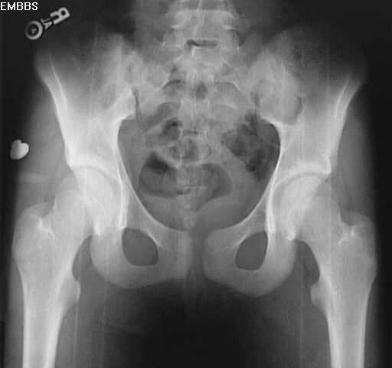
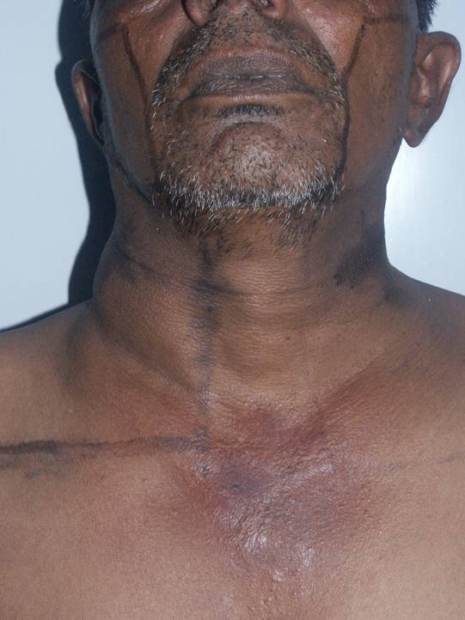
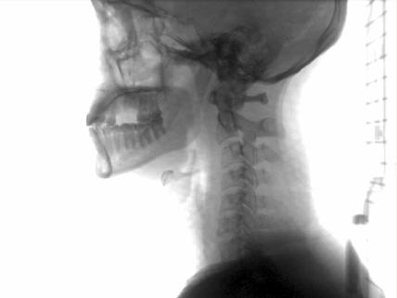
Conventional Radiotherapy
Manual
Conventional simulator
Simple treatment delivers uniform dose from 2-4 beam angles
Beam shape is rectangular or square
Beam hits healthy tissue as well as tumor
Doses have to be kept low to minimize harm to normal tissue
Notes:
There is little beam shaping; beam hits normal tissue as well as tumor.
Dose is uniform across field.
Doses kept relatively low to minimize harm to normal tissue.
Lower doses make it harder to eradicate tumor
Challenge: getting doses high enough to eradicate tumor without harming surrounding normal tissue

Slide 8
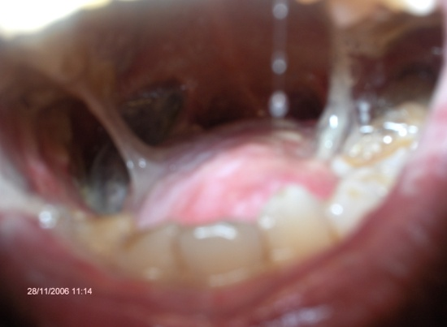
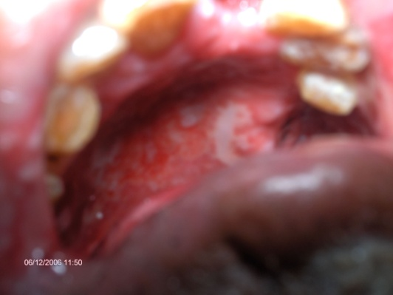
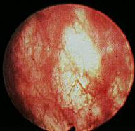
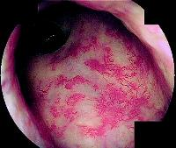
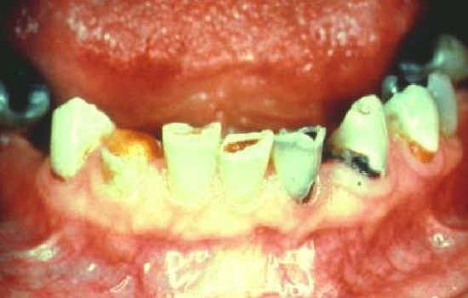
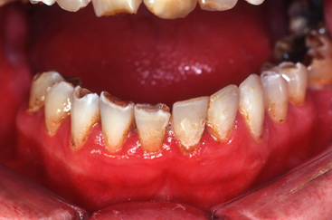
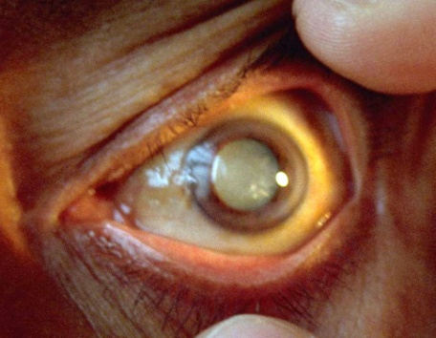

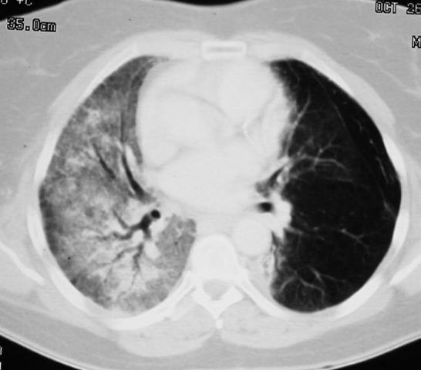
Problems with conventional Radiotherapy
Increased toxicity due to normal & critical tissue radiation
proctitis
Acute Mucositis
cystitis
xerostomia
fibrosis
Dental caries
cataract
Lung fibrosis

Slide 9
Concurrent chemo-radiation
Concurrent chemoradiotherapy is becoming more and more important in most of the malignancies.
Patients who receive concurrent Chemoradiotherapy have a significantly higher incidence of acute and late complication compared with RT alone.
Especially with conventional Radiotherapy
(Higher volume of irradiation)

Slide 10
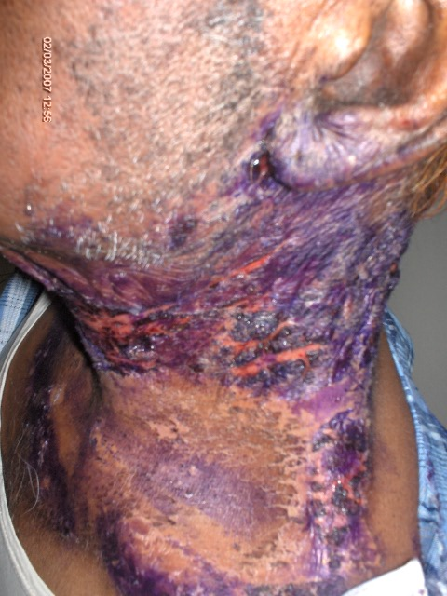
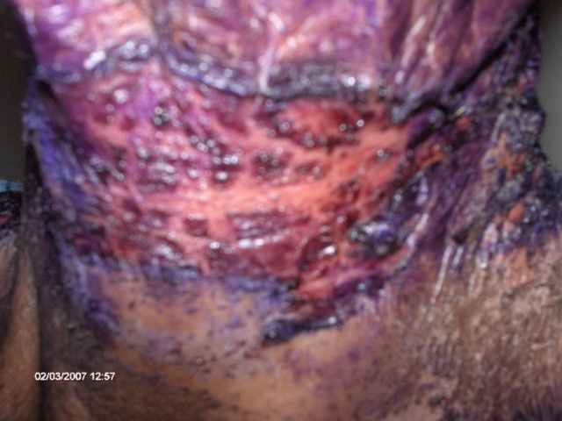
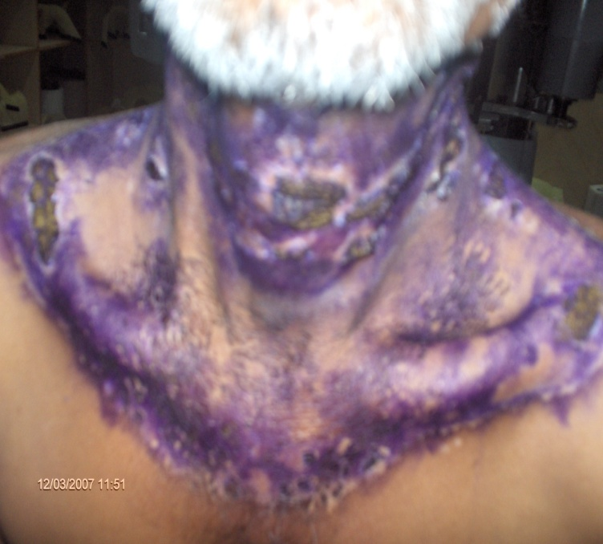
Problems with concurrent chemotherapy+conventional radiotherapy

Slide 11
Relevance of the morbidity
Physical
Psychological
Social
Financial

Slide 12
Dose volume relationship

Slide 13
Requirements for Better tumor control
Early staged Tumor
Combined modality wherever indicated
Techniques
Dose
Volume of normal/critical structures has to Reduce

Slide 14
How do we do it?
Treat only high risk area with minimal damage of normal cells
Conformal therapy (early 90’s)
Ushering in of a new era in the field of Radiation Oncology

Slide 15
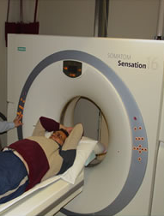
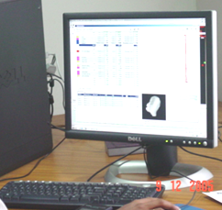
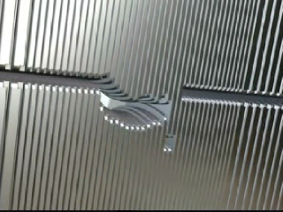
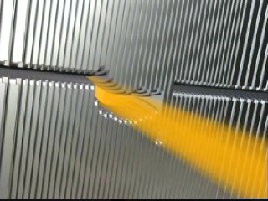
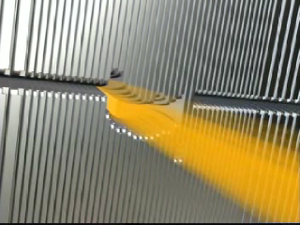
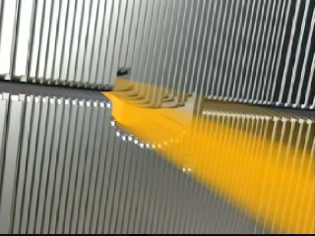
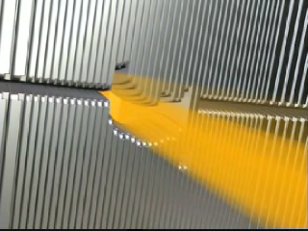
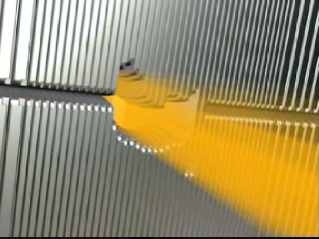
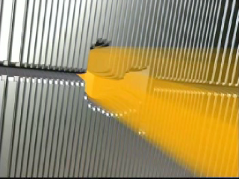
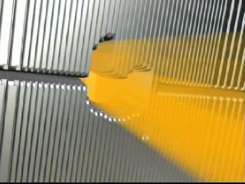
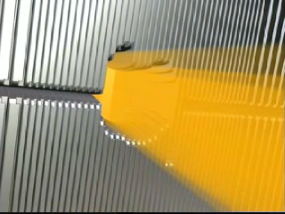
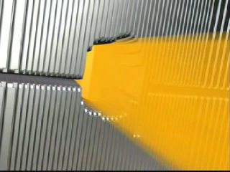
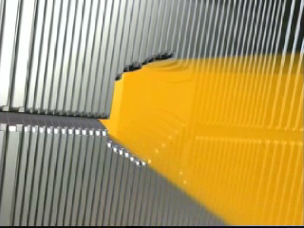
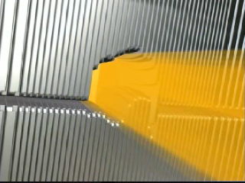
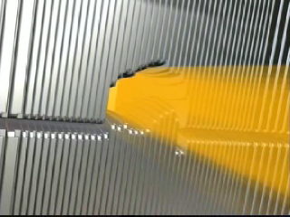
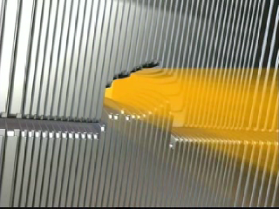
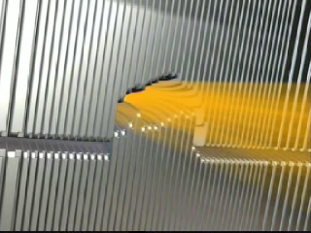
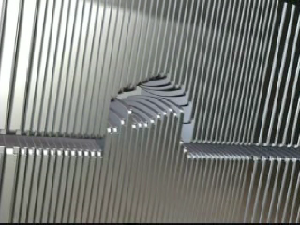
Conformal Therapy
Imaging modalities
      CT/MRI for planning purposes.
Advancements in computer technology
      Contouring, planning and evaluation of plans
Multi leaf collimators (MLC)
      A device which is fixed on modern Linear accelerators making three dimensional conformal radiotherapy (3D-CRT) and Intensity Modulated Radiotherapy (IMRT) treatments possible.

Slide 16
CONVENTIONAL
3D-CRT
IMRT
(Intensity Modulated Radio Therapy)
Paradigm shift

Slide 17
IMRT – a high tech art in medicine
PLAY OF POWERFUL HARDWARE AND SOFTWARE IN THE HAND OF CLINICANS AND PHYSICISTS.

Slide 18
IMRT Advantages
Normal Tissue avoidance (Reduced margins )
Improved target coverage
Dose Escalation with differential dose prescription

Slide 19
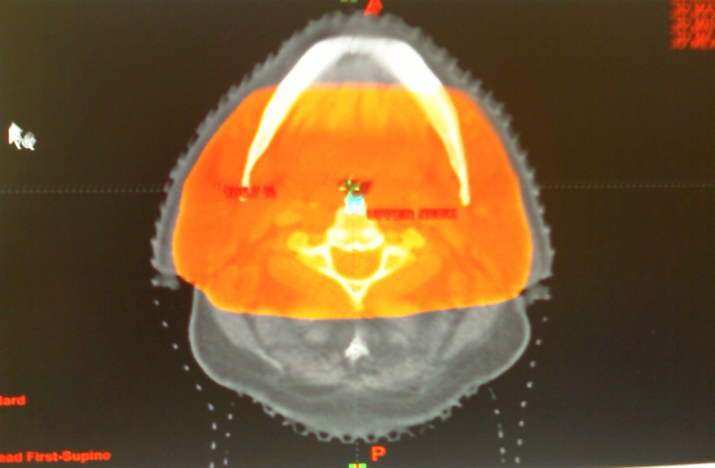
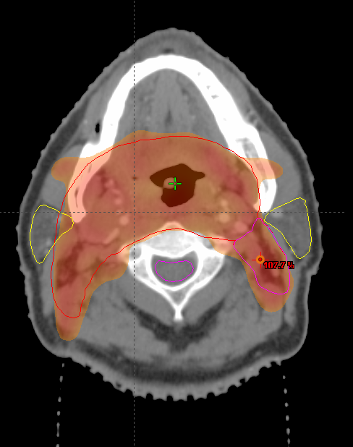
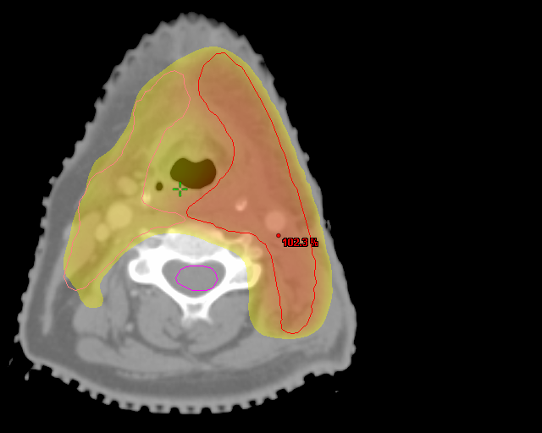
What is different about IMRT
Uniformity in dose distribution – mantra for Conventional therapy
‘Dose painting / sculpting’ using
non-uniform dose patterns
is the power of IMRT
Dose distribution at different levels

Slide 20
In most cases of H+N the only reason to use IMRT is to preserve salivary function

Slide 21
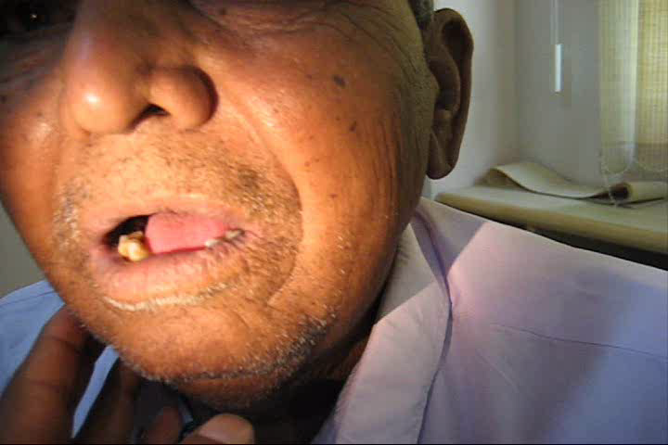
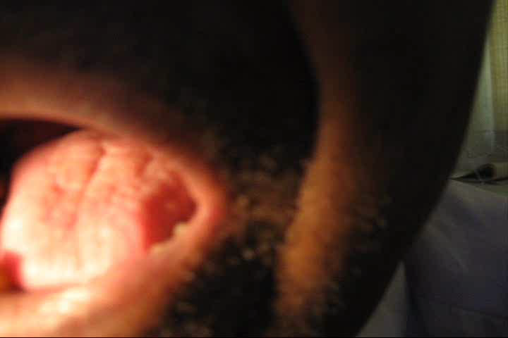
Problems with xerostomia
Difficulty in swallowing
Difficulty in speaking
Caries teeth

Slide 22
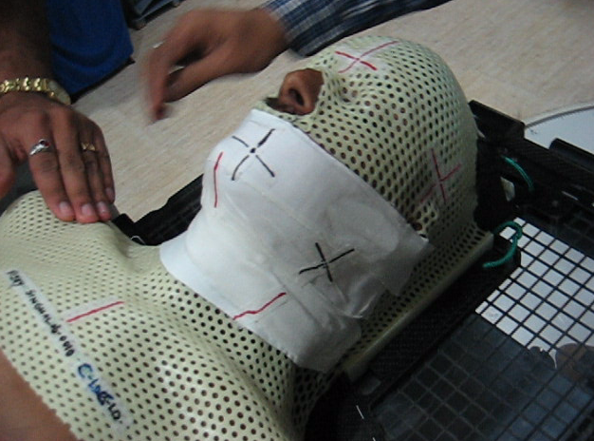
Immobilization-a vital step

Slide 23
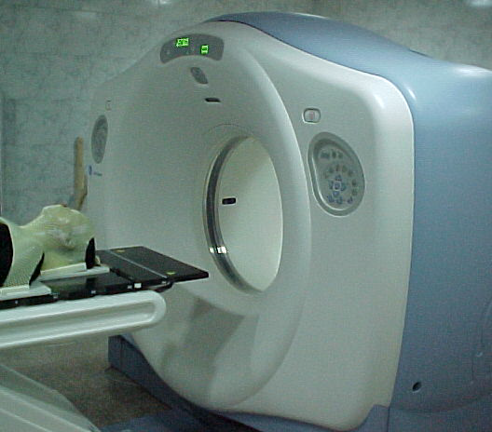
Making conformal Therapy a reality
Multi slice CT scan

Slide 24
CONTOURING NORMAL STRUCTURES

Slide 25
THE HEAD AND NECK IMRT ATLAS

Slide 26
WHAT & HOW TO SHOOT ?

Slide 27
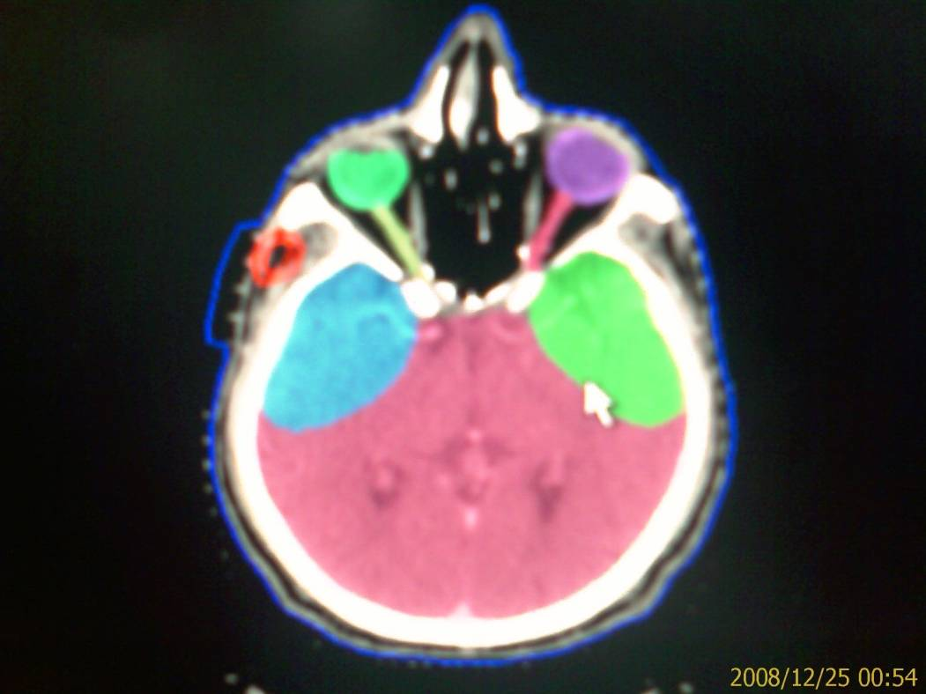
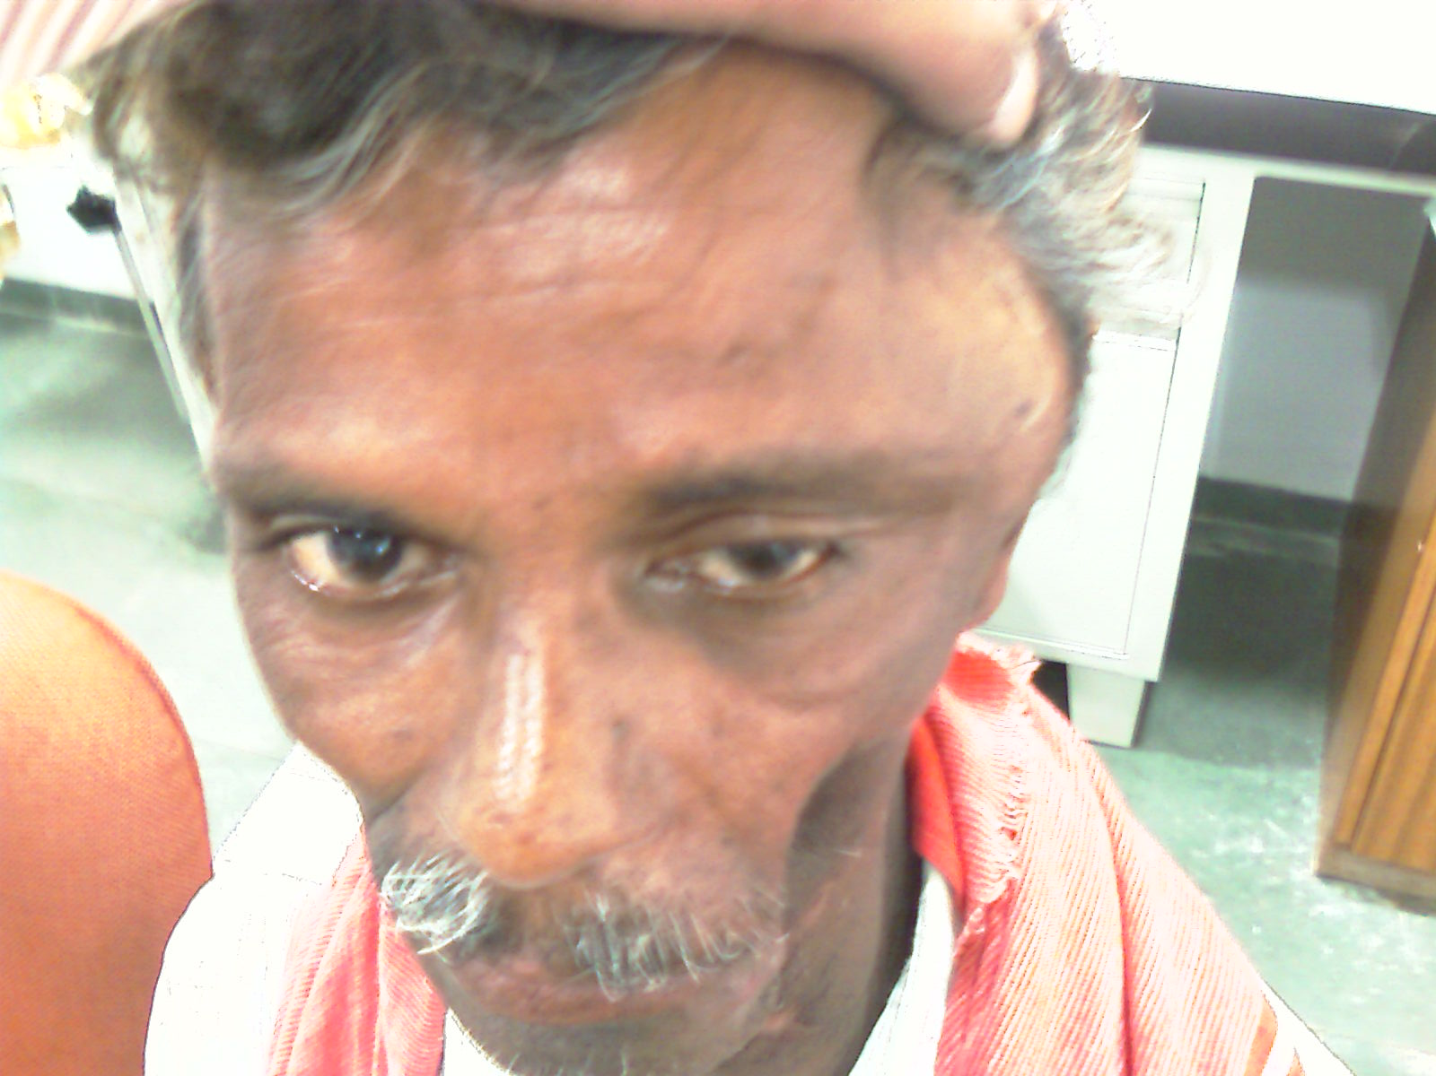
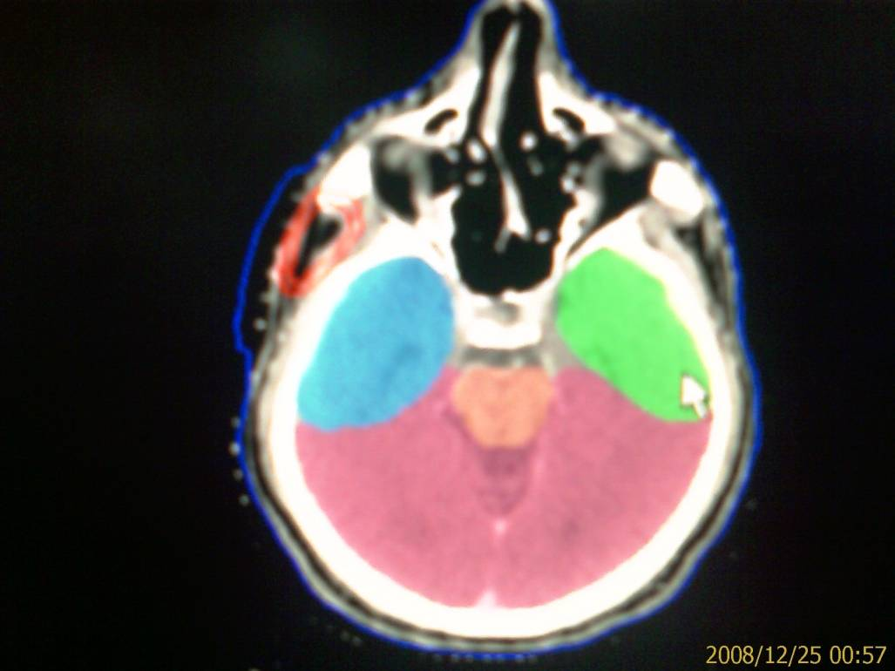
Uncovered ITF
Covered ITF
Unfortunate patient
ITF covered partly

Slide 28
Approaches to dose prescription
DIFFERENTIAL DOSE PRESCRIPTION
Gross disease volume (GTV) : 70Gy/35 @ 2Gy #
High risk subclinical disease CTV1 : 63Gy/35 @ 1.8Gy #
Lower risk elective targets CTV2 : 56Gy/35 @ 1.66Gy #

Slide 29
Quality Assessment of Treatment Plan
Target Coverage Goal :
> 95 % of the PTV receives the prescription dose

Slide 30
HOT SPOT- WHAT CAN IT DO ?

Slide 31
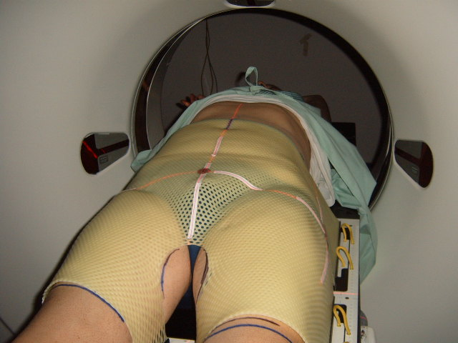
Pelvic Immobilization

Slide 32
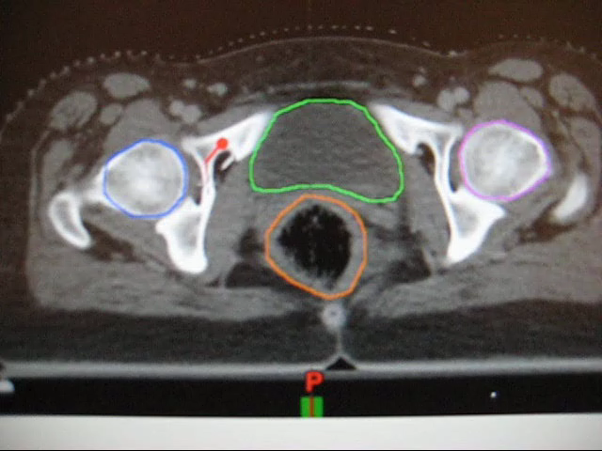
CONTOURING TUMOUR TARGETS

Slide 33
Treatment Planning
Inverse Planning IMRT
CadPlan – Helios
6 MV Photons
7 fields, Coplanar
DMLC technique
Dose constraints to
PTV and other structures
Tight constraints for Rectum e.g., < 40% dose to
70% rectal volume
Notes:
The next step is Treatment Planning which is done using inverse planning Method. In Cadplan the inverse planning software the helios is used for generating IMRT plans
6 Mv photons with 7 coplanar fields are used for treating the Prostate with DMLC technique.
Dose constrains are defined for PTV and other structures. Rectum has given tight dose constrains of less than 40 % of dose to 70 % rectal volume

Slide 34
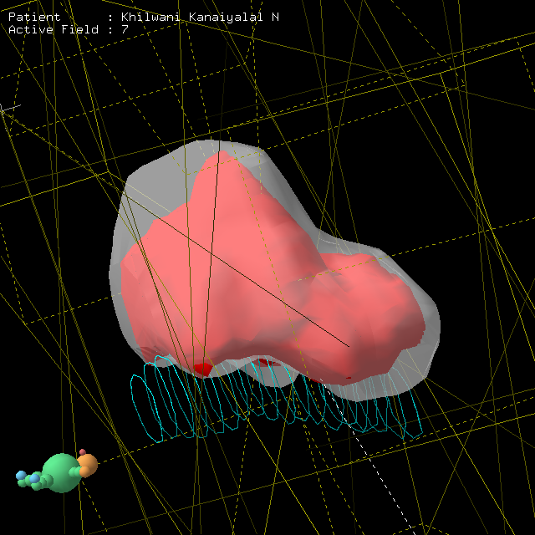
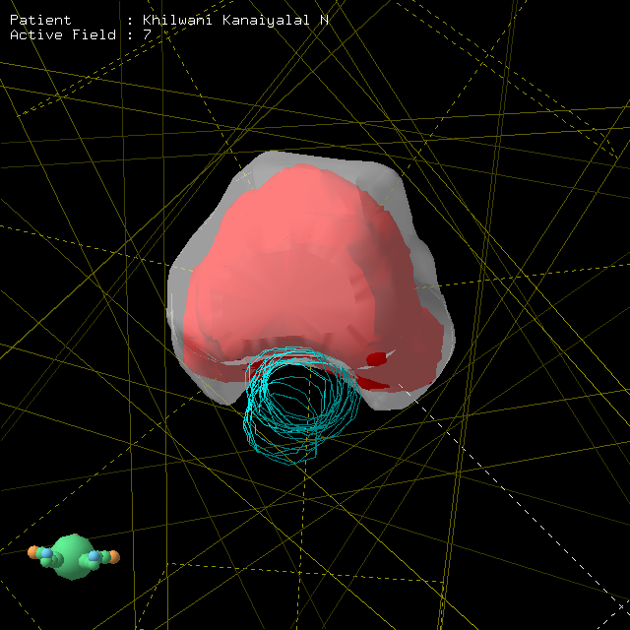
3D VIEW

Slide 35
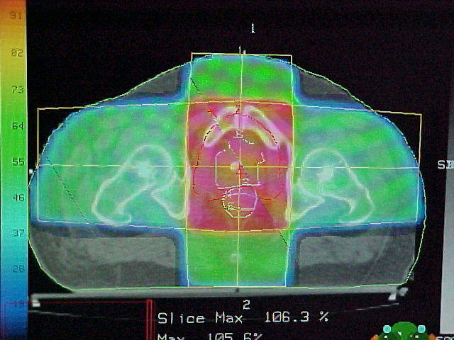
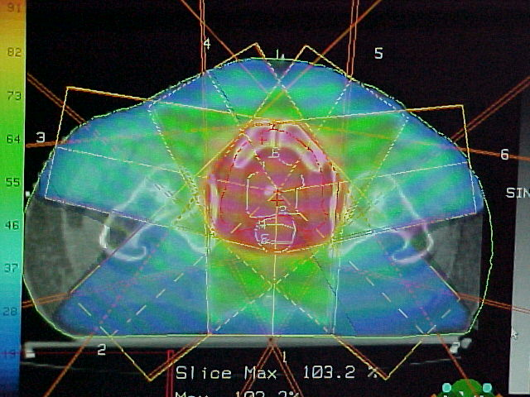
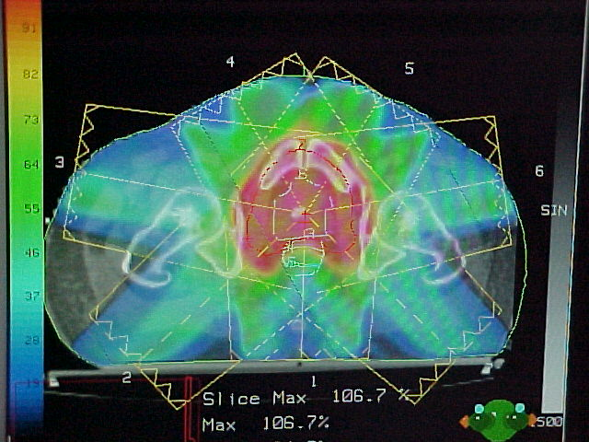
Intensity Modulated Radiation Therapy (IMRT)
2D
3DCRT
IMRT

Slide 36
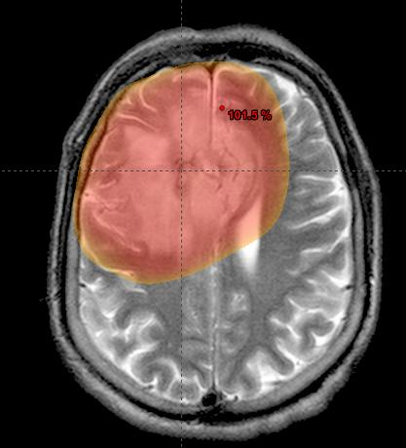





Modern Radiotherapy
Targeted radiotherapy

Slide 37
IMRT Success Depends on
Proper case selection
Taking adequate care during Immobilization
Proper Target Volume Delineation
Good physics backup for planning and QA
Perfect reproducibility of setup

Slide 38

Where is the Precision?

Slide 39

IS THE PLANNED TREATMENT ACTUALLY DELIVERED ?

Slide 40
Have we won the Race ?
Reduced Margins
Setup Errors
Geometric Miss
Locoregional Failures

Slide 41
What setup errors can do ?

Slide 42



local failures

Slide 43



Unwanted complications
Planned
distribution
Treated
distribution
Increased rectal dose

Slide 44
Geometric miss - a problem
Variations in daily positioning of patient
Tumor shape and motion
Reduced margins around tumor volume
Leads to geometric misses
Hence requires daily localization.

Slide 45
IGRT
For better precision ideally tumor needs to be localized on daily basis before every fraction of radiation.
The technology and process that allows for this daily tumor localization is known as Image guided radiotherapy( IGRT).

Slide 46

The future ……

Slide 47


One stop solution
Image Guided Radiotherapy (IGRT)

Slide 48
On Board Imaging (OBI)
3 imaging modes : Radiographic
Fluoroscopy
Cone Beam CT
Radiographic(2D view) - Fast suited for localizing any radio-opaque
marker (implanted fiducials or bony anatomy)
Fluoroscopic - Respiratory gating verification
Tumor movement in different phases of respiration
CBCT - Volumetric 3D data set to match against the treatment planning
CT scan before every treatment.

Slide 49
Imaging just prior to every treatment
On Daily Basis
Fuse with Planning CT Scan image
Correct setup errors if any
Deliver the treatment

Slide 50
Carcinoma Prostate

Slide 51




Rotational errors

Slide 52



Marker implantation – Ca. Prostate
Gold marker size 1.2 x 3 mm
Team work –Radiation oncologist
Urologist and Radiologist
Transrectal sonography
Asses tumor size and location

Slide 53


Immobilization

Slide 54


Treatment
Patient’s set-up using lasers & external markings

Slide 55




AP and Lateral KV images using OBI-2D Match
AP KV imaging
Lat KV imaging

Slide 56

AP and Lateral images were compared with the OBI software via direct overlay with DRR.
Manual matching was performed by Radiation Oncologist on implanted markers or on bony landmarks

Slide 57


Slide 58

Cone beam CT

Slide 59



Altered marker orientation
The markers are at a different orientation compared with the reference DRR.
This patient cannot be aligned by X-Y-Z shifts alone
DRR
OBI

Slide 60


81 Gy in 45 fractions
24 months follow-up status
Disease – NED
No rectal & bladder complications
PSA level Normal

Slide 61

Moving target – A Problem

Slide 62


Slide 63

Techniques to treat mobile tumors

Slide 64

Techniques to treat mobile tumors

Slide 65

Techniques to treat mobile tumors

Slide 66



CBCT showing gross contour change After 10 fractions
Ref CT
CBCT after 25 fractions

Slide 67


Overlay of contours on CBCT images

Slide 68

IS Replanning Required following shrinkage of normal tissues in postoperative head and neck patients on IMRT ?
V Bansal, K Jani ,A Kumar, D Bhavsar, V Subramaniam,R Patel
Page s 259, Vol.88 , supp 2, Sep 2008,

Slide 69

Impact of IGRT on IMRT Contouring
More closer margin between normal and abnormal structures

Slide 70

Precision vs. accuracy
IMRT (precise) vs. IGRT (accurate)

Slide 71
What is clinical outcome with image guidance
Most difficult issue to address – to many other variables
Immediate results – better outcome of IMRT
less steroid use, lesser admissions
Less grade III/IV toxicities,
Increased use of chemoradiation
Virtually no treatment breaks

Slide 72
What is clinical outcome with image guidance
( since Aug 2006 – Dec 2007 data)
Total patients | Mean follow- up (months) | local recurrence | Systemic mets | No follow up (even on phone )
87 | 24 | 7 | 5 | 1
Radical 33 | 22.5 | 3 | 1 | 1
Postop 54 | 23.7 | 4 | 4 | 0

Slide 73








Salivation
40 – 80 %

Slide 74





Acceptable skin and
subcutaneous tissue

Slide 75





Save TM joints – less trismus

Slide 76



Slide 77


Developing Countries – Changing Perceptions
On the verge of major expansions
Opportunities galore
Increasing challenges

Slide 78






Oncological Challenges

Slide 79

Prevention /Early diagnosis

Slide 80
THANK YOU

