Slide 1
Reirradiation in head and neck cancer

Slide 2
Introduction
Last decade witnessed major progress in management of pts with HNSCC
The addition of concomitant chemotherapy
Significant improvement in radiation techniques (IMRT)
However,
Vast majority of these occur in previously irradiated areas and thus poses a common challenge to H & N oncologists
30-50 % | - Develop a loco-regional recurrence (Pignon et al 2009)
14.2 % - | - Second Primary Tumour ( SPT ) another constant threat for those who survive (Haughey et al 1992)
5 -7 % | - Isolated neck recurrences

Slide 3
Treatment options for Recurrent / SPTs
Resectable / Unresectable
Resectable | Unresectable
Surgery
Re irradiation
Palliative Chemotherapy
Traditionally a std of care for resectable tumour However only 20 % pts are candidates for curative resection Results of salvage surgery are poor
Historically been avoided owing to concerns regarding toxicity Radiation tolerance of the normal tissue is significantly reduced compared with the first treatment However, more recently published data demonstrated the feasibility and effectiveness of reirradiation
Poor response rates Limited palliation and No long term survival Nearly all pts die of disease progression within months

Slide 4
Rationale for Re treatment
Local tumor progression is a source of :
Bleeding
Pain
Disfigurement
Infection
Altered swallowing and speech s
“ Because locoregional tumour progression is the predominant cause of death in patients with H & N cancer, achieving local control in patients with recurrent disease may impact survival “

Slide 5
Patients treated with post operative RT+CT due to high risk features- 30% fail with loco regional relapse.
Cause of death- 50 to 60% due to disease
Salvage surgery usually difficult- max. rate - 33%
CT+RT (platinum based) response – 20 to 30%

Slide 6
Most recurrences are local and in field.
Mostly in high dose regions.
Distant mets incidence increases if both primary and nodal failure occurs.

Slide 7
Survival
Survival depends upon time to recurrence- 6.5 mths if recurred within 1 yr and 15 mths if ≥ 2yrs.
DFS and OS worse in patients previously treated with chemoradiation.
Salvage surgery only- 5 yr survival rate- 36% ; 50% develop II recur.
Median survival for second primary Ca- 20 mths.
Concurrent CT+RT better than RT or CT alone.

Slide 8
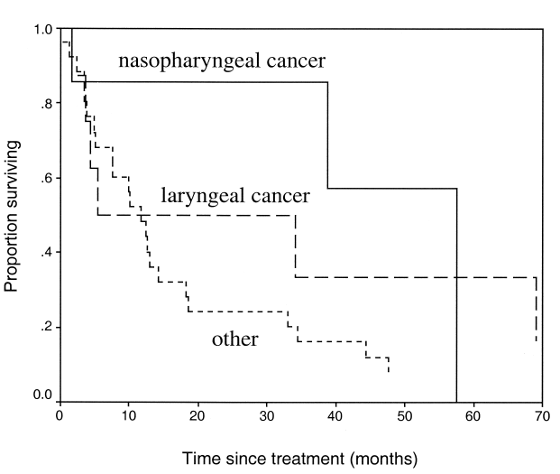
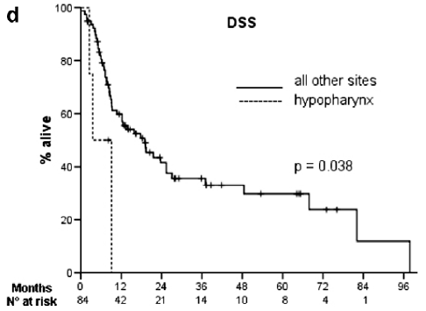
Survival

Slide 9
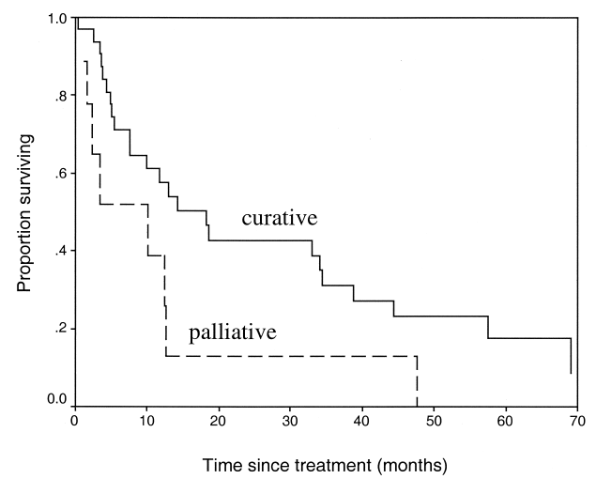
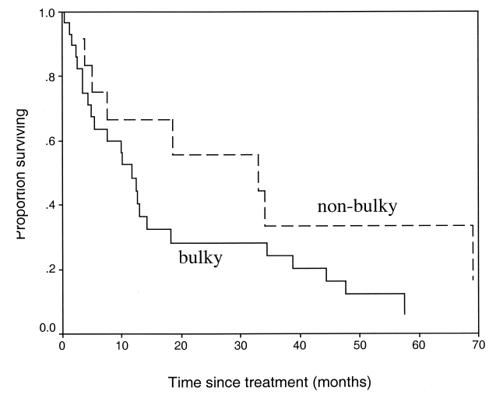

Slide 10
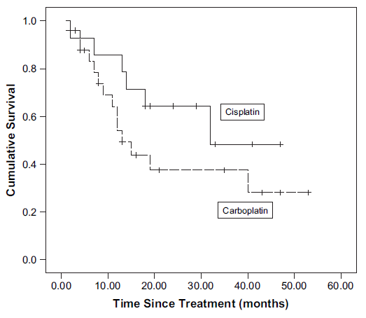
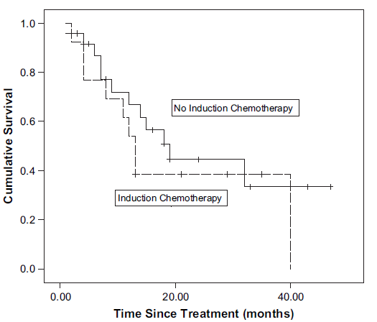

Slide 11
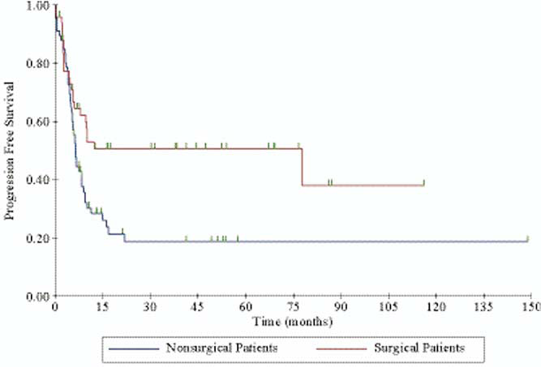
Best Results - Local control - 60–70% of selected patients with 15–30% 5 year survival.
Debulking Sx possible in only 33% of patients and these pts have better prognosis.

Slide 12
Response
Second primary cancers respond better as compared to recurrent cancers to re irradiation and persistent cancers fared even better than recurrent.
Recurrence > 3 yrs- fare better.
Pt’s who recurred > 6mths had better sustenance of response achieved with re irradiation.

Slide 13
After salvage surgery- RT+CT increases LRC &DFS , but with associated toxicities. (no improve- OS).
Haraf et al- stated that 4yr LRC was 71% for debulking Sx followed by RT+CT than 54% for RT+CT alone.
Conformal RT better.
Emami et al, stated that, primary failure fared better (21%) than nodal failure (10%).

Slide 14
Patient selection
Patients should be carefully selected:
Favourable sites such as larynx and nasopharynx;
Small tumour size (< 3cm);
A relatively longer period since previous irradiation (preferably ≥6 months);
No major late complications due to initial RT.

Slide 15
Treatment Considerations
PET CT based planning may be required as it may be difficult to distinguish fibrosis and recurrent tumor on CT/MRI.
RT dose fractionation not > 2 Gy/#.
Incidence of soft tissue necrosis- 0 to 40%
Pt. nutrition- should be excellent
Wang et al in 1993- only for T1/2 recurrent tumors

Slide 16
Treatment Considerations (Target Volumes)
Re irradiation dose should be more than 58 Gy for better LRC, PFS and OS, in many studies (OS- 30% vs 6%)
Cumulative dose to target volume should be more than 100Gy (Either alone or combined with CT).
Cumulative RT dose not more than 130Gy @ 2Gy/#.
Radiation fields should be small.
Highly conformal techniques are usually required- IMRT, SRS, SRT, etc.
CTV should include only GTV and limited margins (1.5 to 2cm) or high risk areas – positive surgical margins or lymph nodes with extra nodal spread.

Slide 17
Treatment Considerations (Organ at Risk)
Cumulative dose – subcutaneous tissue= 110Gy , spinal cord= 50Gy.
More than 90% of the initial dose can be given to subcutaneous tissues after 6 weeks of initial radiation.
60% of the initial dose effect is repaired by the spinal cord if treatment courses are separated by 1–3 years.
Risk of myelitis < 6% if # size – 1.8 to 2.0 Gy.

Slide 18
Better response and OS if overall cumulative field of RT <125 cm².
More reactions expected if cumulative field of irradiation > 70 cm².
2 year loco regional control rate-
52% with IMRT
20% with conventional 2D RT.

Slide 19
Nodal Treatment
Primary Radiation –
Nodes covered if > 20% incidence of mets.
Re irradiation-
Elective Nodal RT is not recommended.
Nodes can be covered if they were initially in low dose area or were previouly geographical missed.

Slide 20
Radiation response enhancement
Mostly are radio resistant. Radio sensitizers are often required.
Hyperthermia and hyper baric oxygen useful in many studies.
If induction chemotherapy is planned- Taxanes (eg TPF) are integral- for resistant SCC. Better than cisplatin and 5FU.
Targeted agents (cetuximab, bortezomib) can be useful.

Slide 21
Isolated Neck Recurrences
Isolated Neck Recurrences
Surgically Resectable
Un resectable
Comprehensive Neck Dissection
- Dose- 60 to 66 Gy
(cumulative RT dose)
- TV- (high risk disease area only, no elective irradiation to uninvolved areas)
Adverse Histological Features
Nodal margin positivity
Multiple LNs
Extra capsular spread
Brachytherapy to be used as boost (to GTV) only.
No Yes
Close Observation
Adjuvant RT (± CT)
- Dose- 55 to 60Gy
(cumulative RT dose)
- TV- (high risk disease area only)
Concurrent chemoradiation is the treatment of choice.
IOERT/Brachy- for borderline resectable

Slide 22
Primary vs Nodal
 | Initial complete response | Eventual tumor control
Nodal | 85% | 10%
Primary | 71% | 21%

Slide 23
Side effects of treatment
Mucositis rates increase by 30%
Severe late reactions- 1 year
Severe late reaction rate- 9 to 41% (mean 25%)
Speech is preserved ,swallowing function is the concern.
Males more tolerant to side effects
Most severe reactions in age > 80 years

Slide 24
Severe late toxicities (0 to 48%) – 6 mths to yrs.
Endocrine dysfunction,
Dysphagia,
Trismus,
Decreased hearing,
Osteonecrosis, and
Chondronecrosis.
Fatal complications (0 to 16%)
Carotid artery rupture,
Brain necrosis,
Aspiration due to cranial nerve paralysis,
Pharyngeal dysmotility, and
Narcotic overdose

Slide 25
Target volume delineation –our initial experience
Strictly involved field radiotherapy
No elective nodal irradiation
No elective Clinical Target volumes

Slide 26
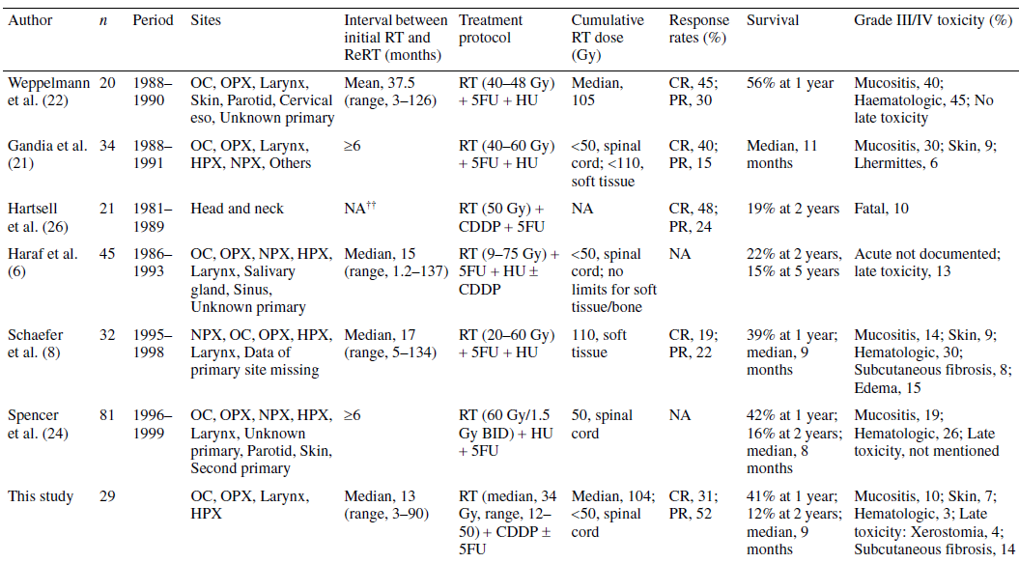

Slide 27
Our experience with Re irradiation
Primary | Recurrence/ Second Primary | Gap | RT | reRT | CCT | Acute Reaction
Larynx | Larynx | 6 yrs | 66Gy, IMRT | 60Gy, IGRT | No | Persistent Hoarseness
Buccal M | Nodal (SM) | 1 yr | Sx- 60Gy, 2D | Sx- 60Gy, 2D | No | Mucositis
Tonsil | GB sulcus | 5 yrs | 71Gy, 2D | 68Gy, IMRT | No | Mucositis
Maxilla | Parapharyngeal region | 1 yr | 60Gy, IMRT | NACT (4), 54Gy, IMRT | No | Mucositis
Parotid | Oropharynx | 4 yrs | Sx-55.8Gy, IMRT | 60Gy, IMRT | Yes | Mucositis
Oropharynx | Oral cavity + Oropharynx | 4 yrs | 70Gy, 2D | NACT (3), 60Gy, IMRT | Yes | Mucositis
BOT | BM + RMT | 3 yrs | NACT (3), 64Gy 2D | 56Gy, 2D | Yes | Mucositis
Tonsil | Tongue | 5 yrs | 70Gy, 2D | Sx- 60Gy, IMRT | Yes | Mucositis

Slide 28
Initial Observations
Recurrence rate – 40 to 50%.
Median survival times- 8 to 10 mths with t/t & ~ 5 mths if left untreated.
RT+CT better than either alone (Conformal).
Sx- RT+CT even better.
Intent of treatment – Curative
Induction CT/ only Adjuvant CT- not recommended.
Best responses in Laryngeal Ca.
RT- targets only GTV or areas of HIGH RISK.
RT doses- cumulative – 120-130Gy (Spinal Cord- 50 Gy)

Slide 29
Unanswered issues:
cumulative dose to the previously irradiated site
effects on neurocognitive functions
damage to endocrine organs
reirradiation tolerance of pediatric patients
role of hyperfractionation
integartion with hyperthermia
use of target therapy

Slide 30
Conclusion
Clinical decision-making is often guided by
Availability of surgical and radiotherapeutic expertise
Prior treatment
Time of recurrence
Performance status
Life expectancy at relapse
Feasibility and acceptability of surgical excision
Histo-pathological characteristics at salvage dissection
Anticipated morbidity

Slide 31
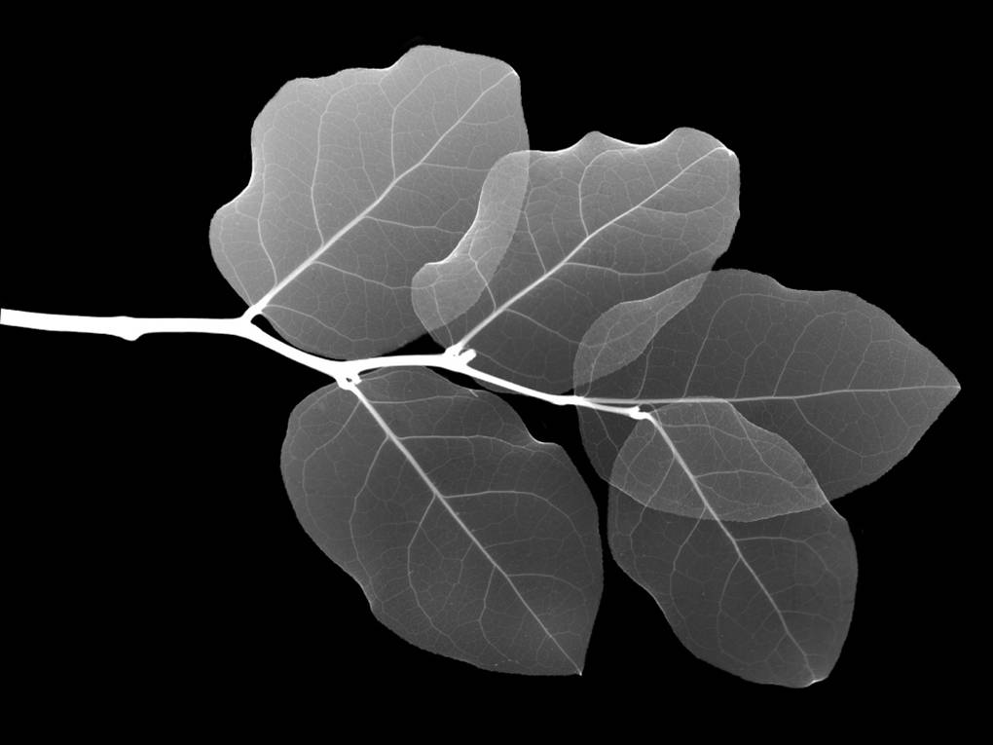
Thank You

