Slide 1
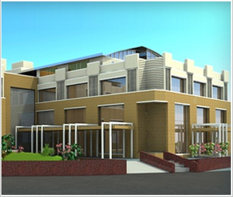

Recent advances in Radiotherapy of CNS Tumours
Dr Vivek Bansal
Director, Dept of Radiation Oncology
HCG Cancer Centre ,Sola
Ahmedabad,Gujarat,India
Email : vbhinduja@yahoo.com

Slide 2
Surgical Considerations in GBM
Optimal primary resection is best predictor of outcome, regardless of tumor histology
  Complete resection rare due to infiltrative nature of GBM
Extent of surgery correlates with overall survival^{[1]}
  Retrospective review (N = 1215) showed median survival following primary and revision resection superior (P < .05) with GTR (13 months) vs NTR (11 months) and NTR vs STR (8 months)
Factors influencing optimal extent of surgery
  Age, PS, proximity to “eloquent” areas of the brain, feasibility of decreasing mass effect, resectability (number, location of lesions), and time since last surgery (in patients with recurrent disease
1. McGirt MJ, et al. J Neurosurg. 2008;[E-pub ahead of print].
Notes:
2
GBM, glioblastoma multiforme; GTR, gross total resection; NTR, near-total resection; PS, performance status; STR, subtotal resection.

Slide 3
Adjuvant RT in GBM
Fractionated external beam RT
an important component in postsurgical standard of care
for GBM
Median survival in phase III studies of adjuvant RT
  118 patients with grade 3/4 supratentorial astrocytoma: 10.8 vs 5.2 months with best supportive care only^{[1]}
  303 patients with anaplastic gliomas: 35 vs 14 weeks with best supportive care only^{[2]}
RT benefits older (> 70 years)
patients with good PS^{[3]}
  Median OS: 29.1 vs 16.9 weeks with best supportive care only
  QOL and cognition not affected by RT
1.00
○
Supportive care alone
RT plus
supportive care
○
○
0.75
○
○
0.50
Probability of Survival
0.25
○
○
○
0.00
0
20
40
60
80
100
No. at Risk
Supportive care
alone
RT plus
supportive care
Weeks
42
39
17
24
3
8
0
3
0
1
1. Kristiansen K, et al. Cancer. 1981;47:649-652.
2. Walker MD, et al. J Neurosurg. 1978;49:333-343.
3. Keime-Guibert F, et al. N Engl J Med. 2007;356:1527-1535.

Slide 4
RT Plus Chemotherapy Improves Survival
Meta-analysis of 12 randomized clinical trials of patients with high-grade gliomas (N = 3004)
Adding chemotherapy to
RT conferred a 15%
reduction in risk of death
  Year 1: 6% improvement
  Year 2: 5% improvement
  Benefit becomes apparent
  around Month 6
  Effect independent of age,
  histology, PS, extent of resection
HR
HR: 0.85 (P < .001)
0
0-5
1-0
1-5
2-0
RT + Chemotherapy Better
RT Alone Better
Glioma Meta-analysis Trialists Group. Lancet. 2002;359:1011-1018.
Notes:
4
PS, performance status; RT, radiotherapy.

Slide 5
Temozolomide: Standard of Care in GBM
First adjuvant systemic chemotherapy to show significant promise in GBM
  Phase III study (N = 573): 2-year OS rate improved from 10.4% with RT alone to 26.5% with temozolomide
100
Median Survival
90
80
RT + temozolomide: 14.6 months
70
RT alone: 12.1 months
60
50
Probability of OS (%)
40
30
20
10
0
0
6
12
18
24
30
36
42
Months
Stupp R, et al. N Engl J Med. 2005;352:987-996.
Notes:
5
GBM, glioblastoma multiforme; OS, overall survival; RT, radiotherapy.

Slide 6
RADIATION ONCOLOGY
Integral Part of Modern Management of Brain tumour patients

Slide 7
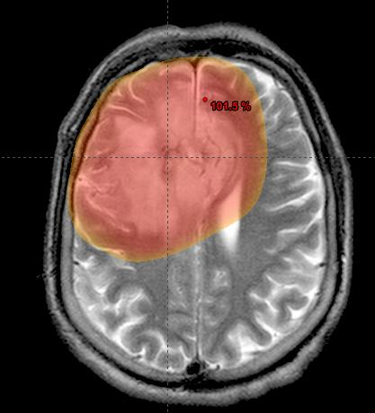
The Goal
Optimal Dose Delivery for better control
…With Minimum Acute And Long Term Toxicity giving better quality of life

Slide 8
A Challenge for The Radiation Oncologist
Tumor
Very Close proximity Of Tumor and Critical structures
Total Dose Delivery Limited by Tolerance of Normal structures
Dosimetric Challenges Due to Varying Contour/Tissue Heterogeneity

Slide 9
Dose volume relationship

Slide 10
IMRT – a high tech art in medicine
PLAY OF POWERFUL HARDWARE AND SOFTWARE IN THE HAND OF CLINICANS AND PHYSICISTS.

Slide 11
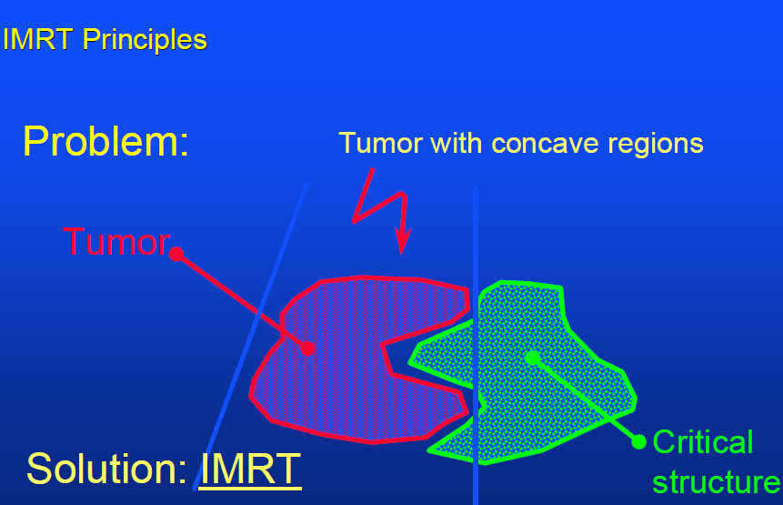

Slide 12
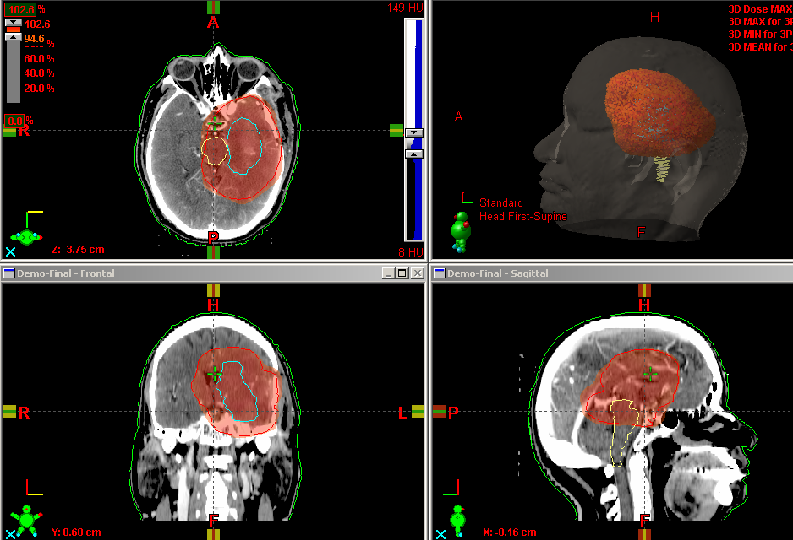
IMRT - BRAIN

Slide 13
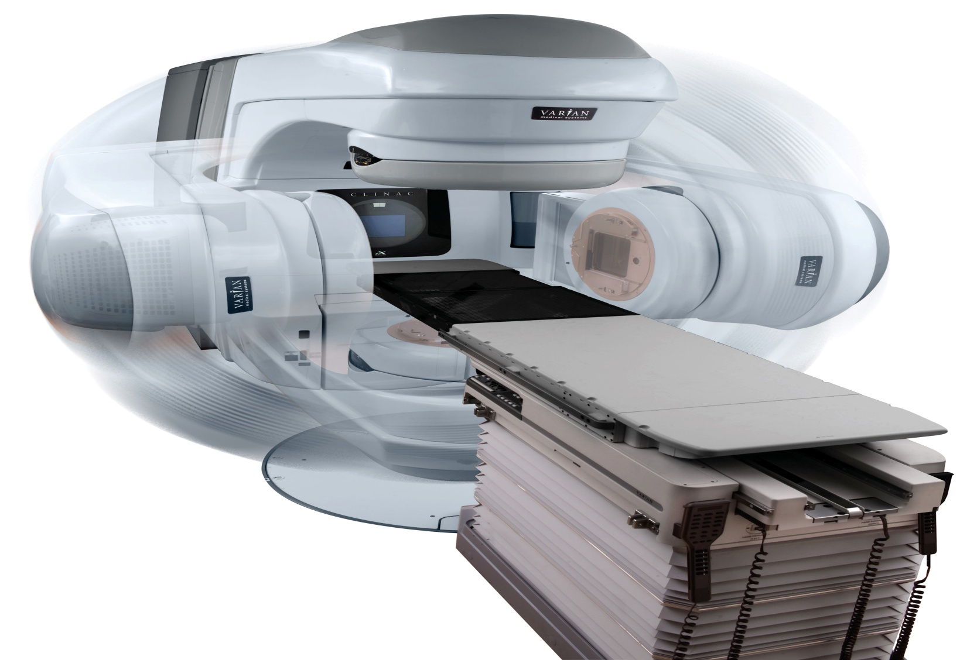
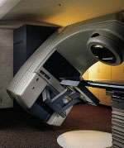
One stop solution
Image Guided Radiotherapy (IGRT)
IGRT solution
On Board Imaging Device
Conventional
LINAC

Slide 14
Paradigm shifts in RT planning
Shaprio et al- No survival advantage and local control with WBRT as compared to localized radiation therapy.
Laperriere et al- No survival benefit for additional high dose (90Gy) irradiation to the region of enhancement.
Chan et al- Pattern of recurrences close to the primary tumour / region of enhancement.
Shaprio et al. J Neurosurg 1989;71:1-9
Laperriere et al. IJROBP 1998;41:1005-11

Slide 15
HIGH GRADE GLIOMAS
PATTERN OF FAILURE
Central ( Site of Previous tumour ) 78%
Inside Radiation Field 13%
Marginal ( Upto 2cm from tumour ) 9%
Chan et al. JCO.20(6) : 2002

Slide 16
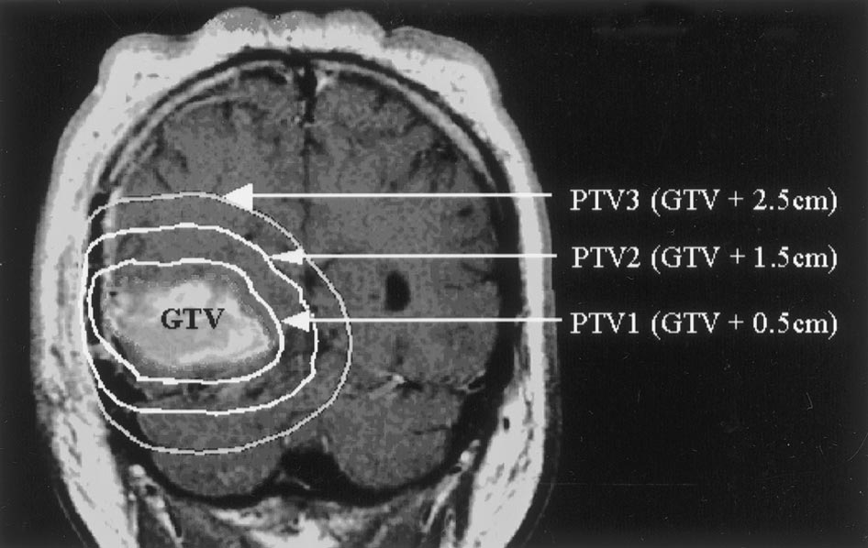
Chan et al Journal of Clinic. Oncol. 20(6) : 2002
70 Gy
80 Gy
90 Gy

Slide 17
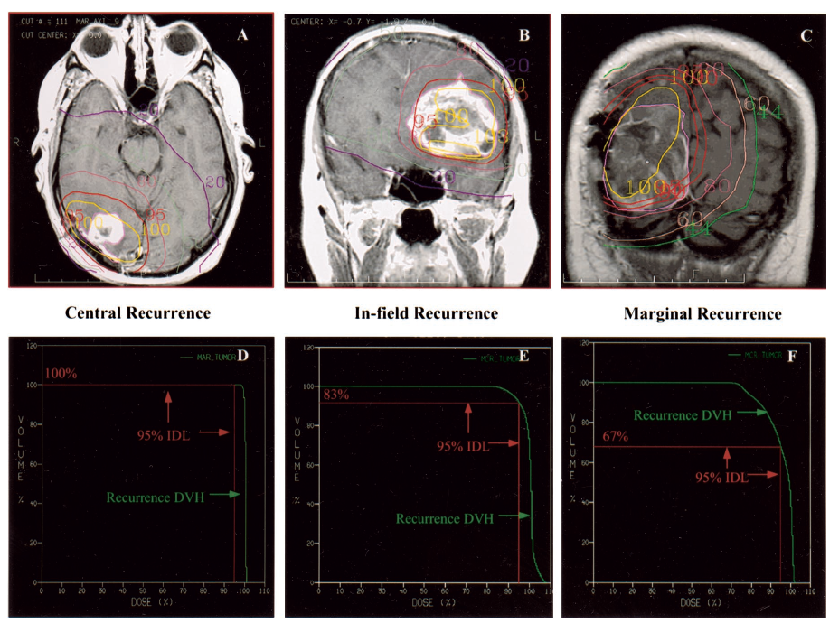

Slide 18
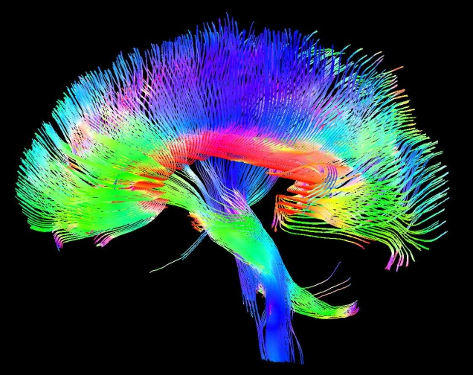
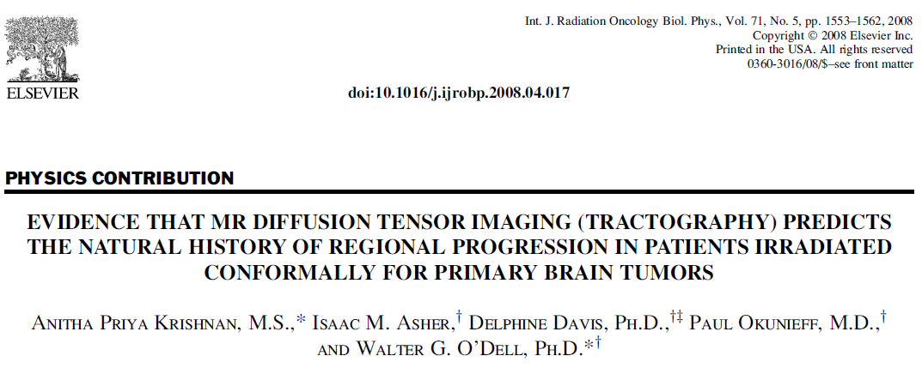
Role of Tractography

Slide 19
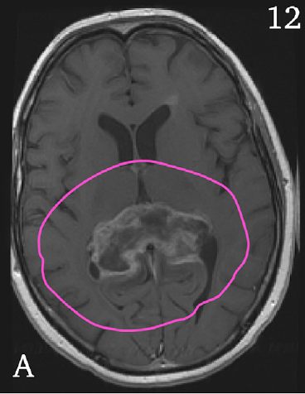
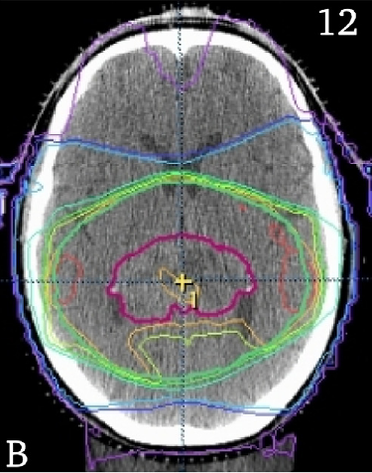
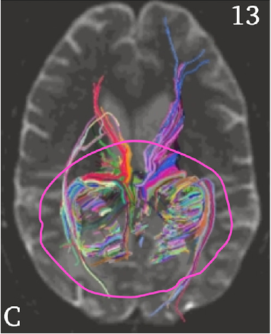
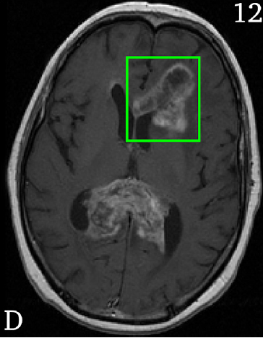
Diffusion Tensor Imaging

Slide 20
Can Tractography
alter our Contouring?

Slide 21
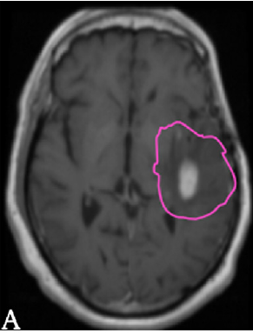
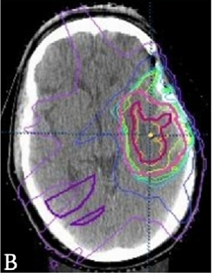
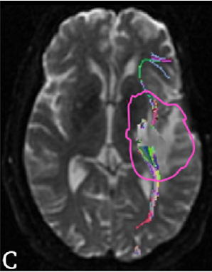
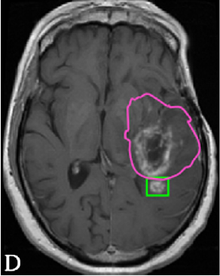
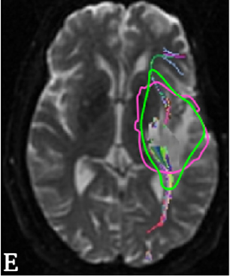
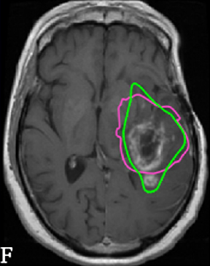

Slide 22
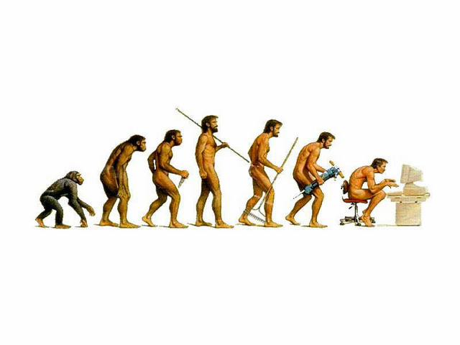
EVOLUTION OF RADIOTHERAPY
Dose escalation feasible
Organ Preservation
QOL improved
TELE-COBALT
THERAPY
LINAC
IMRT
IGRT
TOMO-TH
SRS
SRT
ART
DART
DGRT
TELETHERAPY

Slide 23
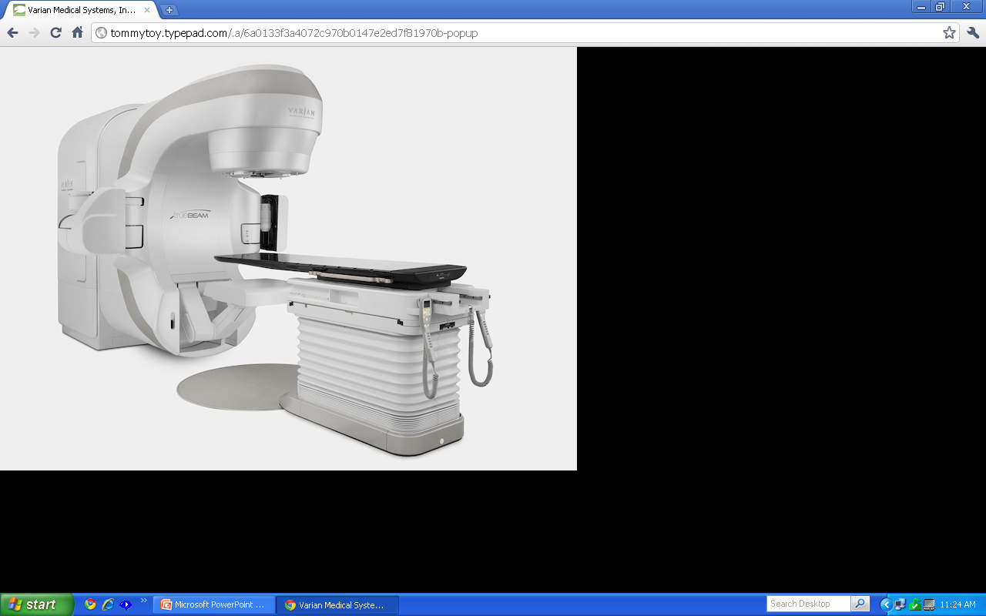
One stop solution for
IMRT,IGRT,VMAT,SBRT & FFF
TRUEBEAM- A MASTERPIECE

Slide 24
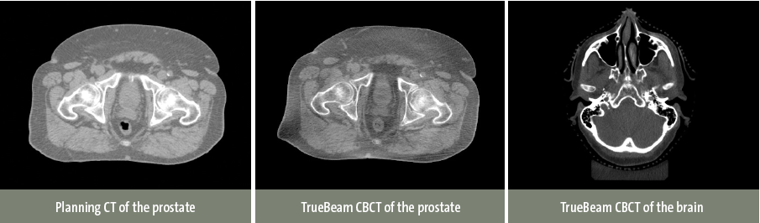
Image Quality

Slide 25

RAPID ARC BASED IGRT
Most important feature to get a fast treatment with only one rotation.
Unlike conventional treatments, dose delivery via RapidArc is gantry speed limited. Or, higher dose per fraction does not translate to longer treatment time.
RapidArc treatment is the capability of delivering conformal dose to target in a very short period.

Slide 26
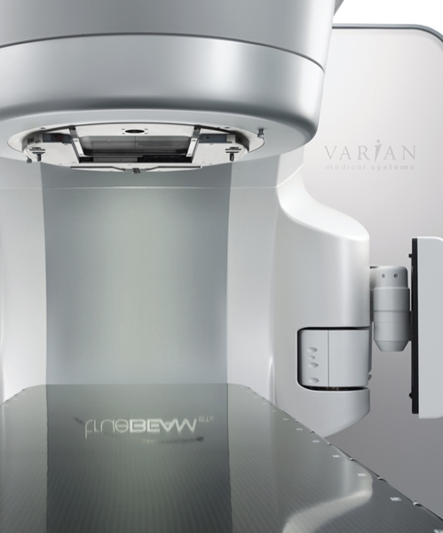
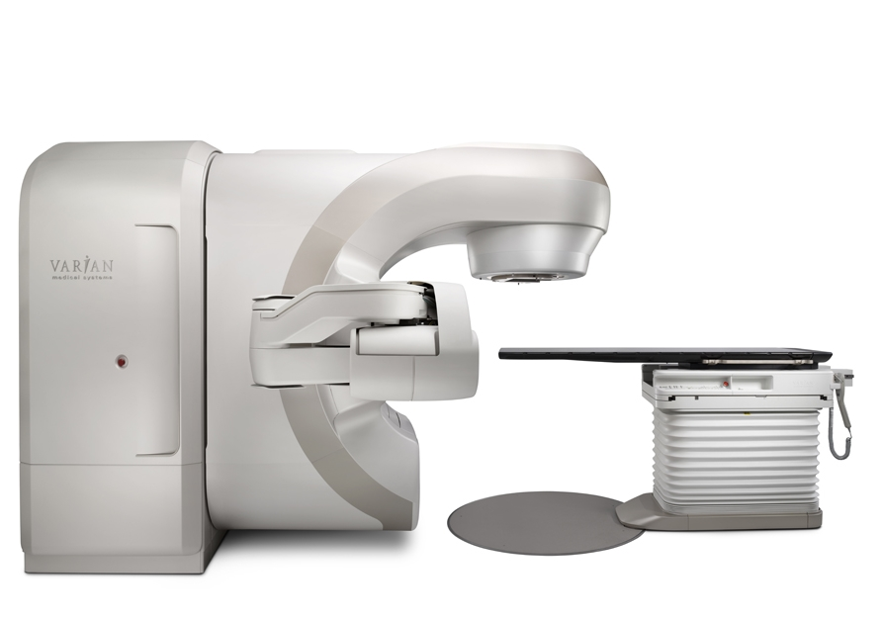
TRUEBEAM-New Beam generation system
FLATTENIG FILTER FREE(FFF) BEAM MODE

Slide 27
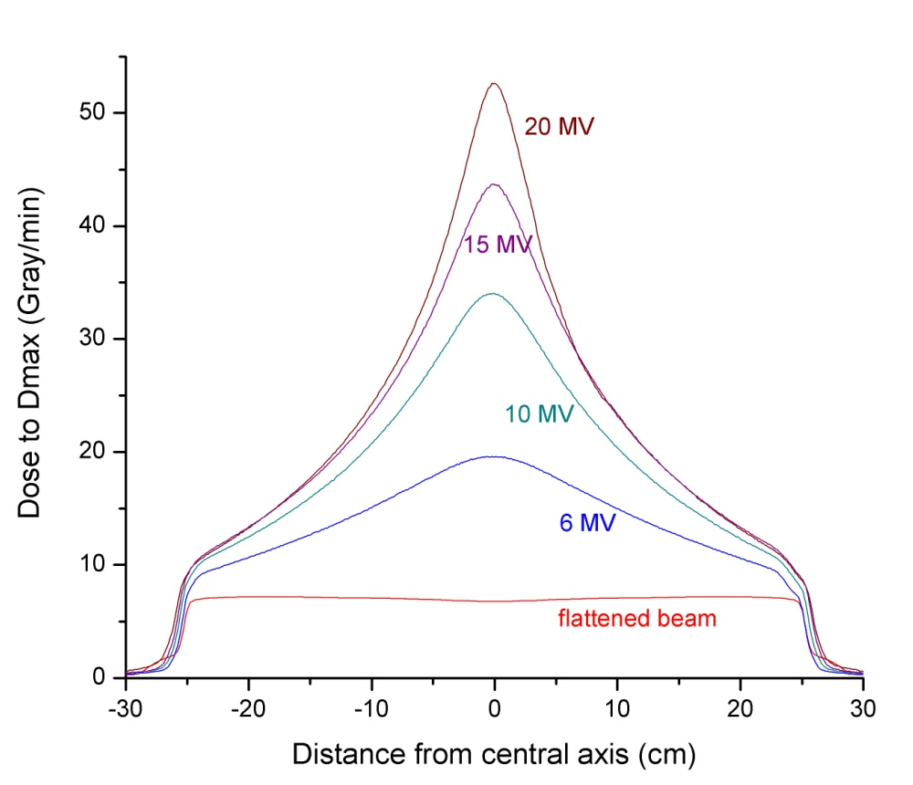
High Intensity Mode - Flattening Filter Free (FFF) Beams
The primary purpose of the FFF X-rays is to provide much higher dose rates available for treatments
Available in clinical mode for
6 MV → 1400 MU/min
10 MV → 2400 MU/min
40-140% High Dose Rate
Enables fast hypofractionation
Gains for IMRT, RapidArc
or small field SRS

Slide 28
Why FFF
In SRS or SBRT treatments, large MUs are often required and FFF X-ray beams can deliver these large MUs in much shorter “beam-on” time.
With shorten treatment time, these FFF X-rays improve patient comfort and dose delivery accuracy

Slide 29
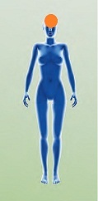
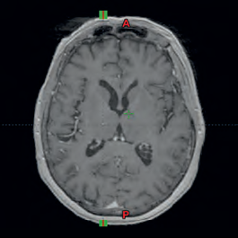
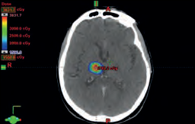
SRT Brain(Thalamus)
Brain mets from NSCLC TNM Stage IV
5x7Gy / 5x6Gy, 1782 MU, 6x FFF, 1400 MU/min
Beam on time 210 sec, 4 Non-coplanar arcs
Before
After
Results in shorter delivery time and therefore increased patient comfort
Reduce the chance of intrafraction motion
SRS/SRT with FFF beams can be accomplished in a standard 15-minute time slot.

Slide 30
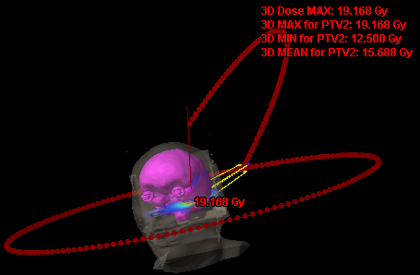
TrueBeam™ Overview
TrueBeam in Clinical Use—Zurich
Vestibular Schwannoma
RapidArc: single arc
12.5 Gy per fraction
10X High Intensity Mode
<2 minutes
treatment time
Mode Monitor Units Beam-On Time
X6FFF 4527 MU (+5.3%) 3.24 min
X6 4299 MU 7.61 min
X10FFF 3858 MU (-10.2%) 1.67 min
X10 4016 MU (-6.6%) 6.70 min
Images courtesy of University of Zurich Hospital
    SRS/SRT with FFF beams can be accomplished in a standard 15-minute time slot

Slide 31
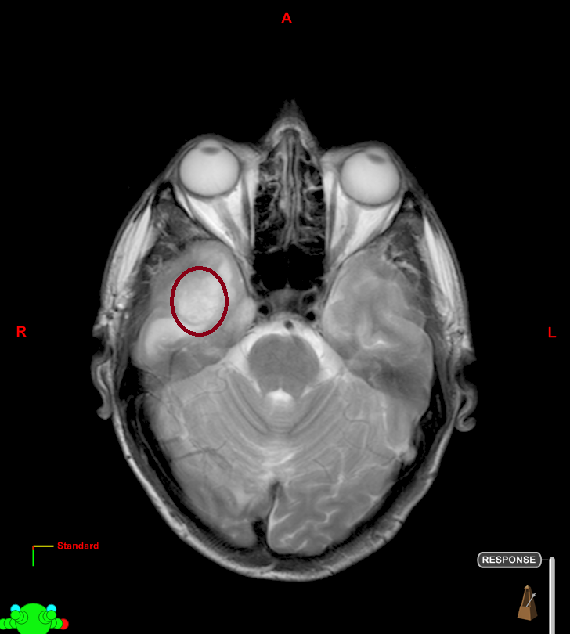
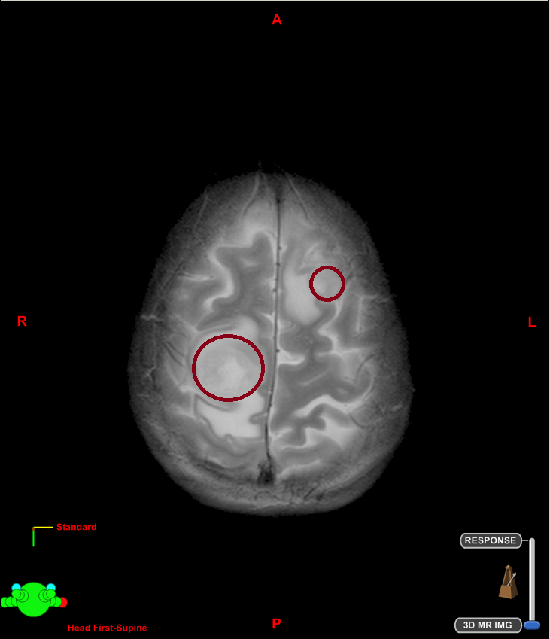
Our Experience
42yrs male with multiple brain mets, was given 30Gy in 10 fractions to whole brain followed by boost

Slide 32
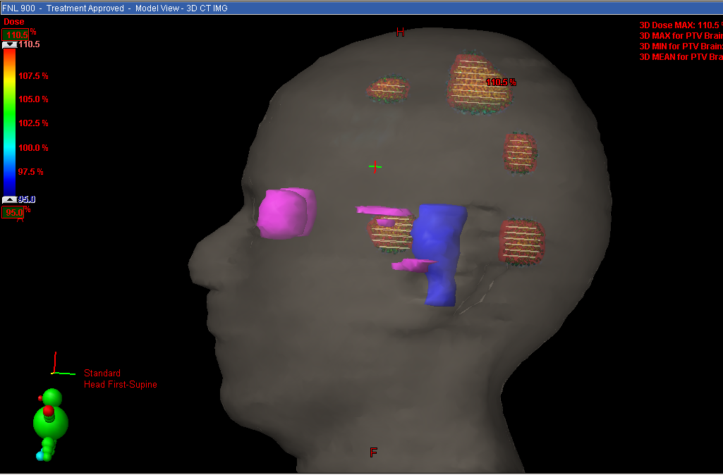
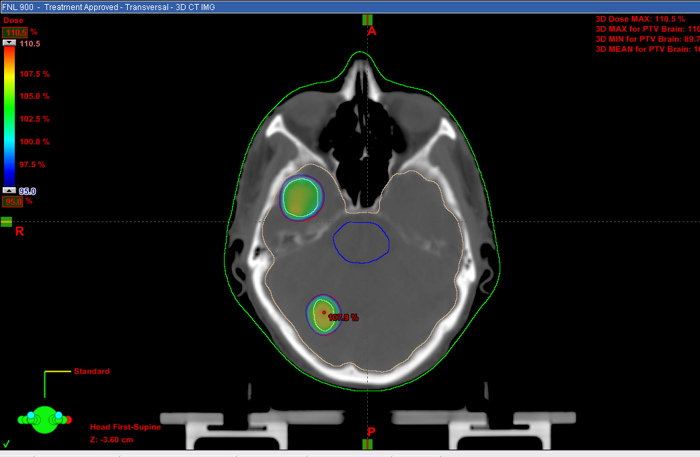
Brain Metastasis – 5 lesions
Given 9 Gy in single fraction using 10X-FFF, in one arc (2.5minutes).

Slide 33
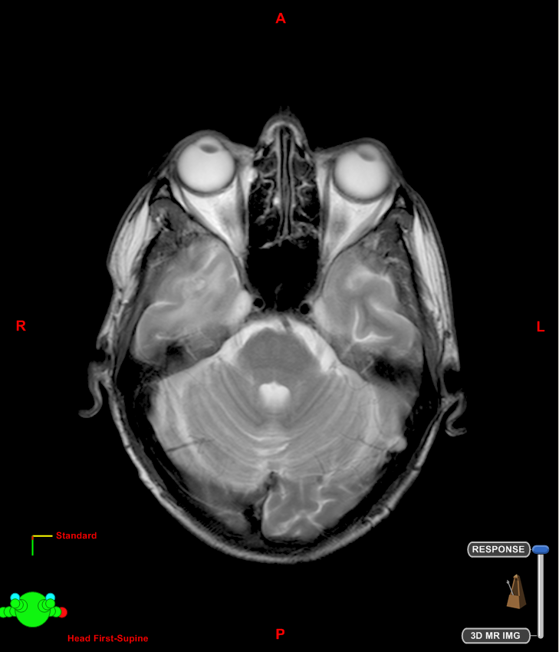
Frameless SRS
Initial
3 months post SRS

Slide 34
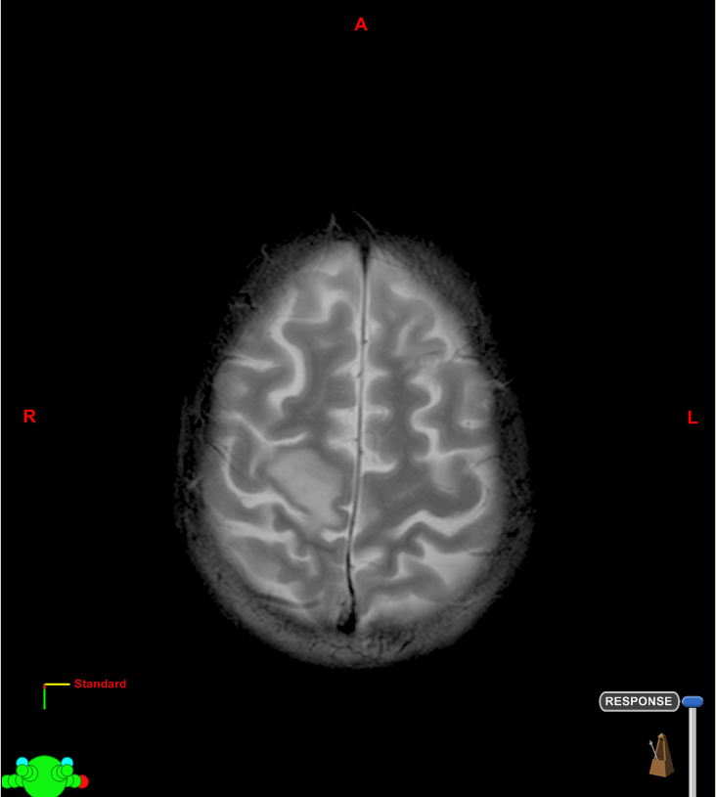
Frameless SRS
Initial
3 months post SRS

Slide 35
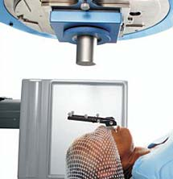
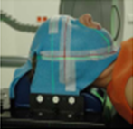

Work-flow of Frame-less
Stereotactic RT
Thermoplastic Mask
Patient Positioning based on drawings on mask
Cone beam CT Imaging
Definition of region of interest for image registration
Registration planning CT vs verification CBCT
Correction of errors in 6 DOF
Treatment

Slide 36
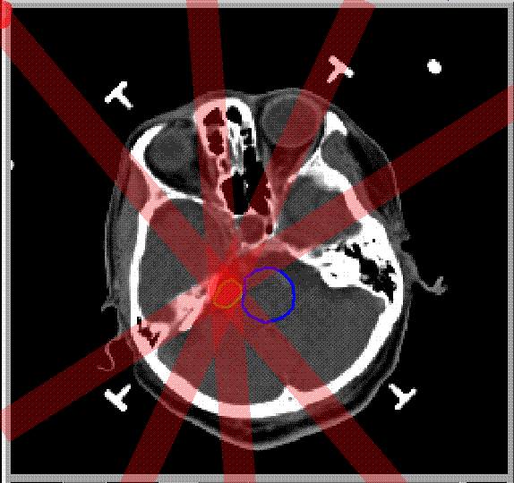
Comparison of accuracy
 | Frame based FSRT | Frame based SRS | Frameless IGRT
Positioning Error (3D) | 3 – 3.5 mm | 0.5 – 1.5 mm | < 1 mm
Intrafractional Error (3D) | 1 – 1.5 mm | < 1 mm | 1 – 1.5mm
Baumert 2006
Boda-Heggemann 2006
Guckenberger 2007
Maclunas 1994
Lamba 2009
Murphy 2003
Boda-Heggemann 2006
Guckenberger 2007
Lamba 2009

Slide 37
IMRT vs SRS vs IMRS
Only Spherical dose distribution possible with SRS while concave dose distribution possible with IMRT/IMRS.
Concomitant Boost capabilities- different dose to different areas of tumor and critical structures.

Slide 38


Changing Technology Impacts Every Sphere of Life

Slide 39
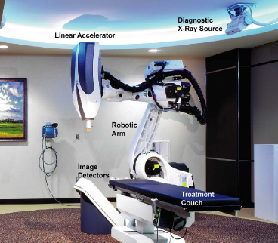

Slide 40
CYBERKNIFE INDICATIONS
BRAIN METASTASIS
MENINGEOMAS
A-V MALFORMATIONS (AVM)
ACCOUSTIC NEUROMAS
BRAINSTEM GLIOMAS
RECURRENT GLIOMAS

Slide 41
CYBERKNIFE
SPINE
    Benign tumors
    (chondromas, neurofibromas, etc.,)
    Primary, Metastatic or Recurrent Cancer of the spinal cord
    Benign tumours of the bony spine

Slide 42
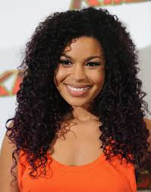
Hair fall is most common and distressing side effect of radiation therapy to brain in females and Children.
It is unavoidable but with the use of IMRT we can reduce the scalp dose leading to early recovery of hair follicles.

Slide 43
Radiation Induced alopecia
Reduction in scalp dose as high as 30-50% have been seen in dosimetric comparison with advanced planning techniques (Forward-Planned 3D conformal, IMRT and VMAT) when compared to traditional opposed lateral fields.

Slide 44
Radiotherapy Details
Scalp Sparring IGRT can be planned and delivered using 6MV photons on a linear accelerator equipped with Kv CBCT and On Board Imaging facility (Truebeam™; Varian ®) for the required on-line set up verification.
The therapy was initiated on 18/12/2012 and completed on 31/01/2013 .
She also received Cap. Temozolamide (75mg/m²) with radiation.

Slide 45
      Dose Delivered
PTV 45Gy in 25 fractions, followed by
Boost to PTV 14.4Gy in 8 fractions
Total Dose - PTV→59.40 Gy in 33 fractions

Slide 46
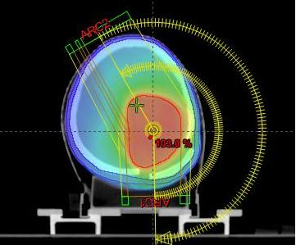
Planning Details
Scalp was contoured from canthi to the vertex.
OAR were contoured
Treatment was delivered by 2 ARC with 6 MV photon
Mean dose to scalp was limited to 10 Gy

Slide 47
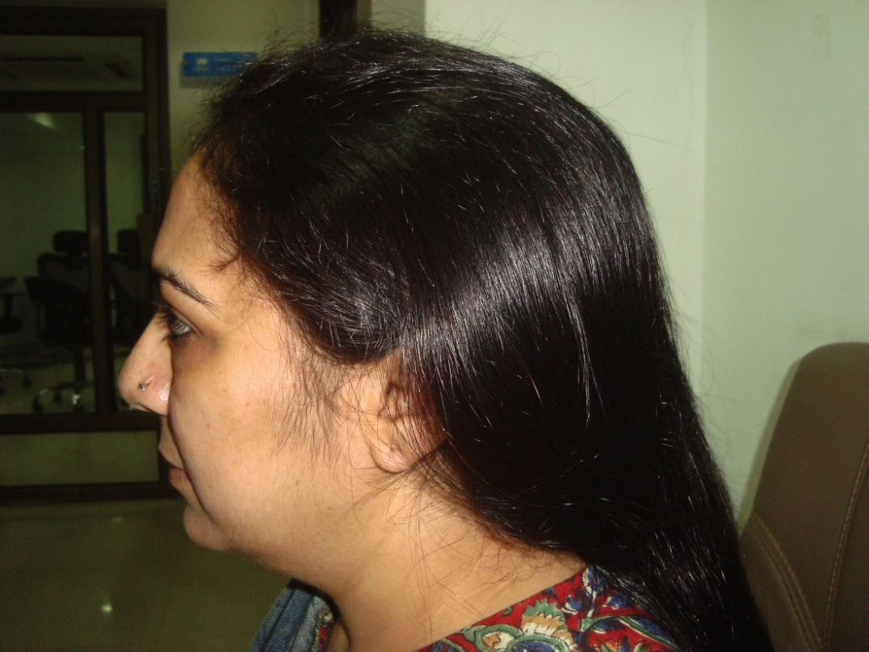
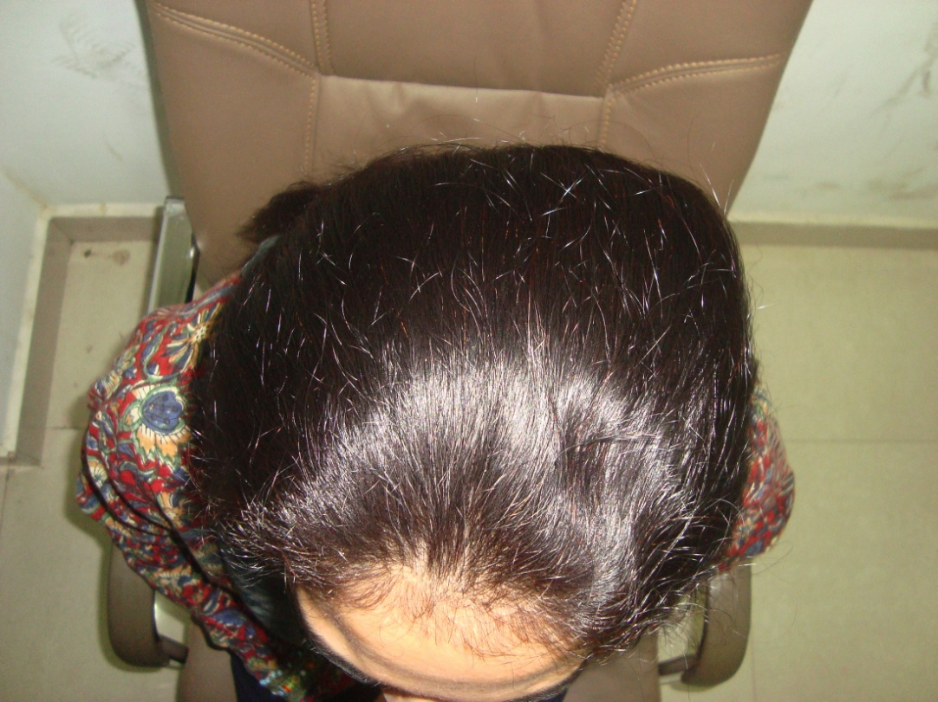
Clinical Assessment
Before starting the treatment (17/12/2012). Three Month Post-Op

Slide 48
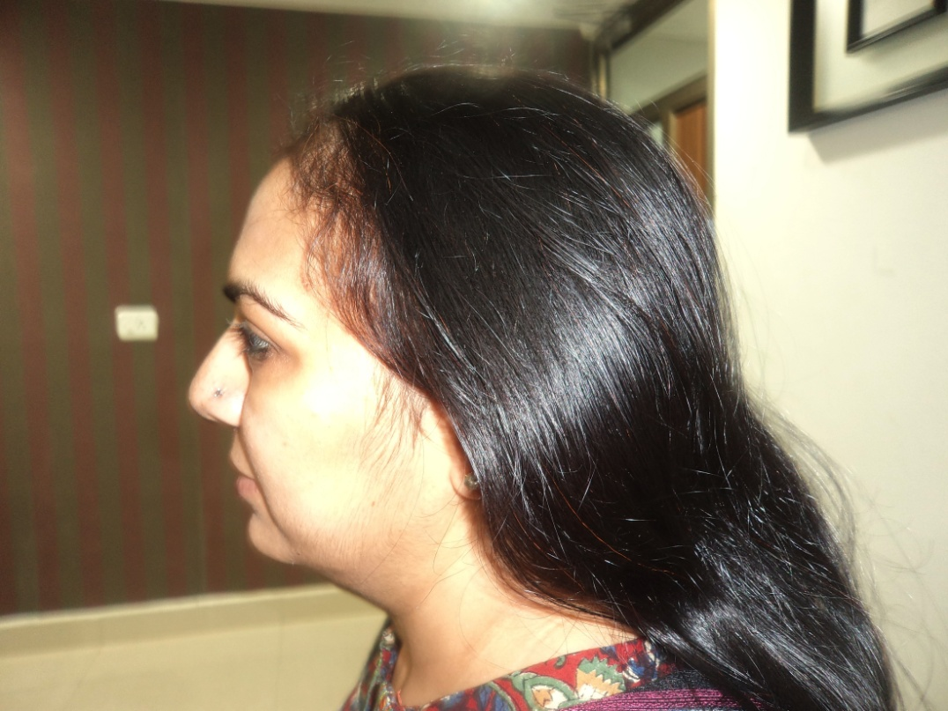
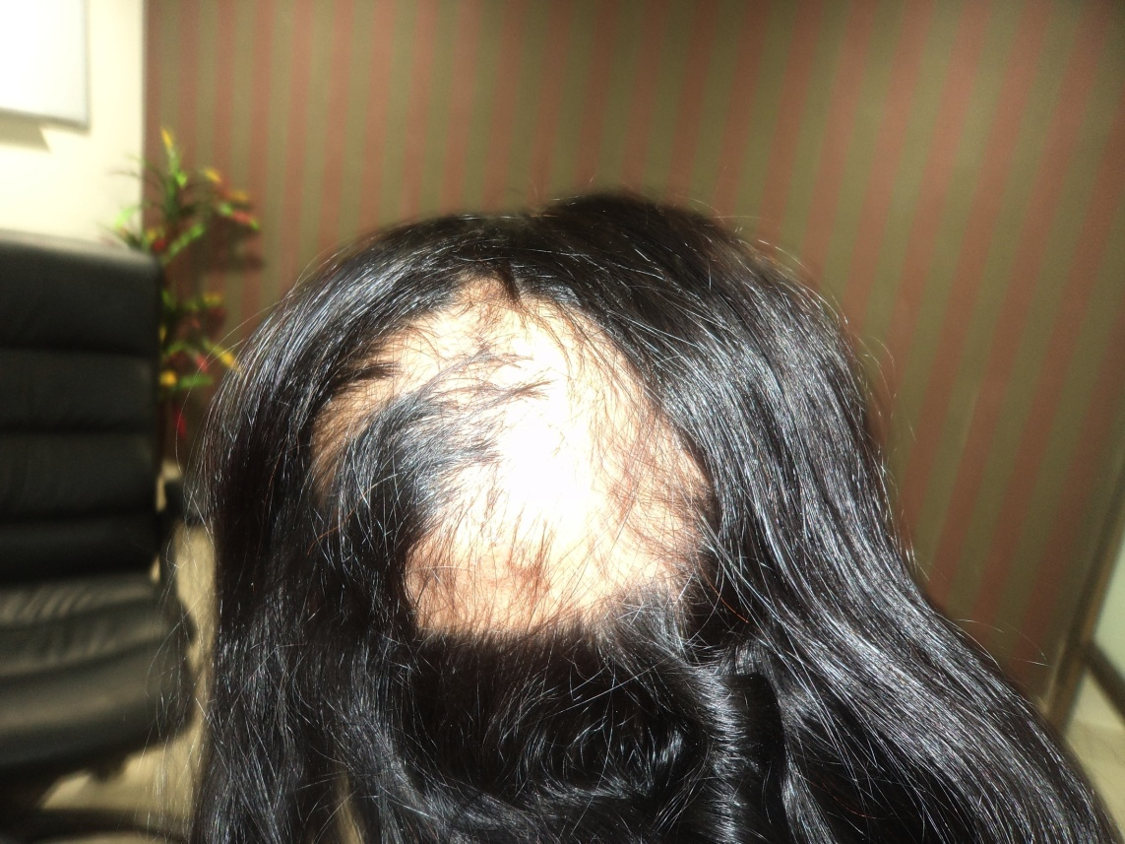
Clinical Assessment
After 3 week she started complaining of mild hair fall
After 22 fractions (16/01/2013)

Slide 49
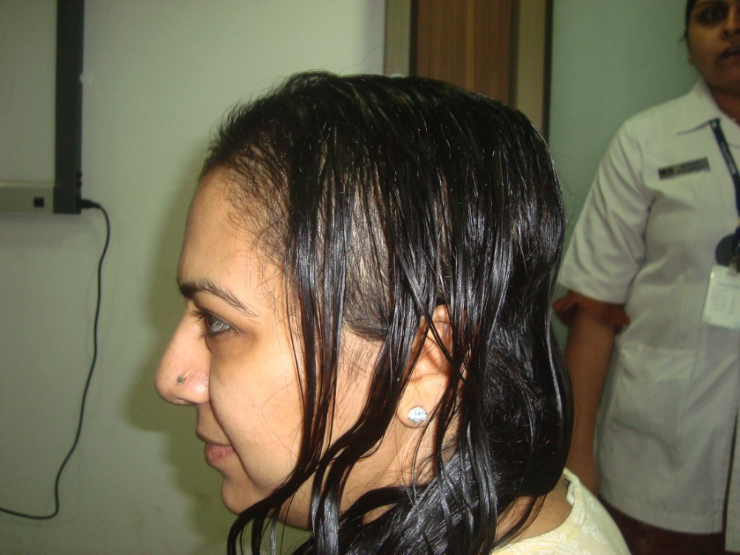
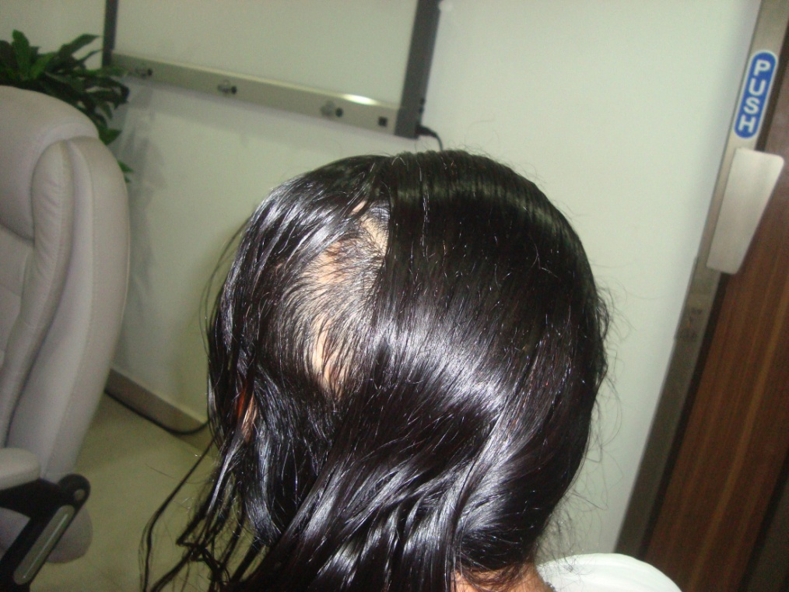
Clinical Assessment
After 4 month of completion (14/05/2013)

Slide 50
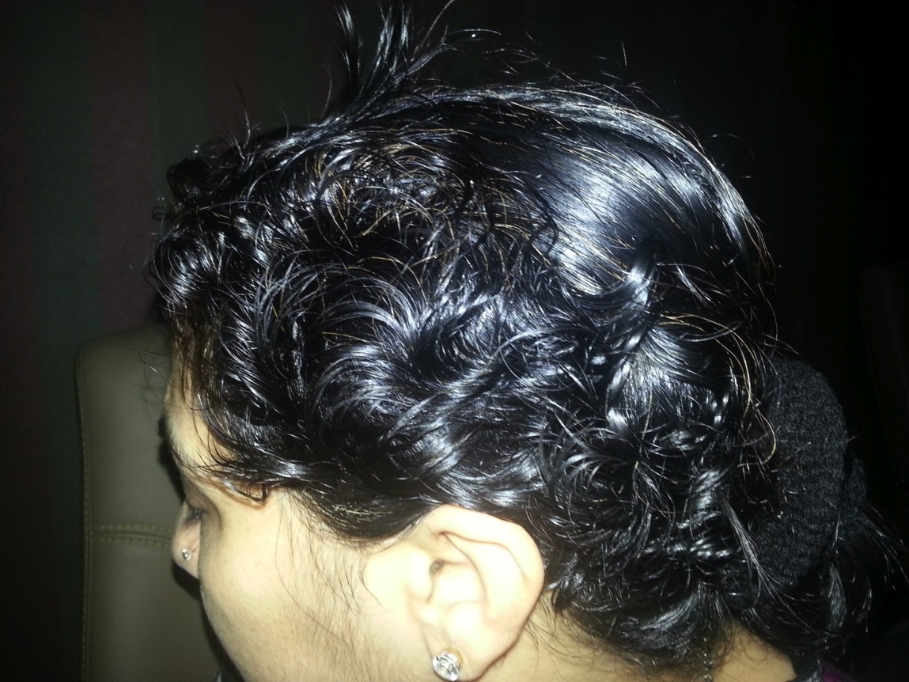
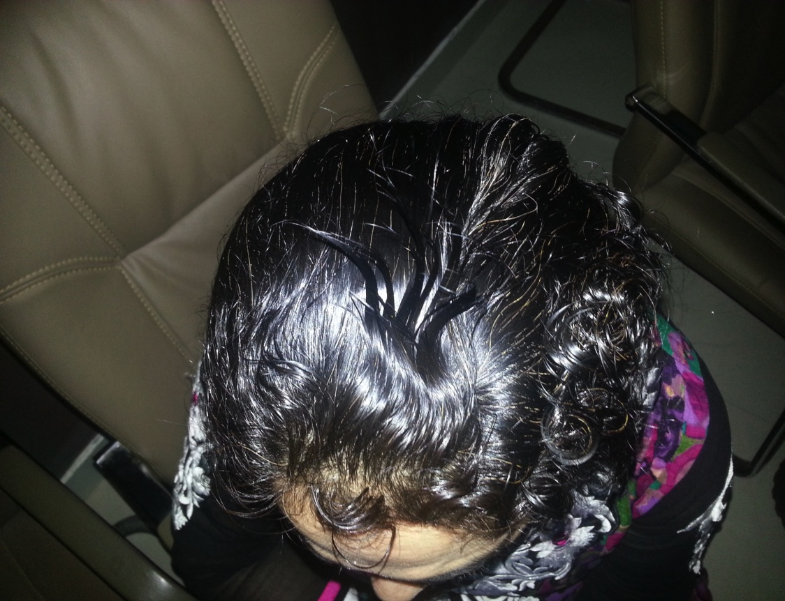
Clinical Assessment
After 6 month of completion (19/10/2013)

Slide 51


Hippocampus sparing

Slide 52



Memory loss preservation with IMRT
Cognitive functions are thought to reside in temporal lobes especially in the hippocampus.

Slide 53

Imaging
CT-MR Fusion-
  Low grade tumors
  Benign meningiomas,
  Skull base tumors

Slide 54

















IMAGING

Slide 55

Anatomy and areas of contrast enhancement
Edema

Slide 56


Slide 57



Normal post-op changes
  Enhancement
  Gliosis
  Oedema
  Tumour bed enhancement due to high protein content
  Pseudoprogression
Oedema / Infiltration - difficult to interpret the response to therapy specially after steroids .

Slide 58
Vaccine that Boosts Survival in Glioblastoma

Slide 59
Vaccine Yields Promising Progression-Free Survival in GBM. Medscape. May 03, 2013.
46 treated (Post-op, Post RT +TMZ) Patients
Vaccination taken HSPCC-96 (Prophage G-100, Aegnus Inv.)
Started from 14 weeks, weekly for 4 week then monthly till stock last
146 % increase in Progression Free Survival
60 % increase in Overall Survival

Slide 60

Thank You

