Slide 1
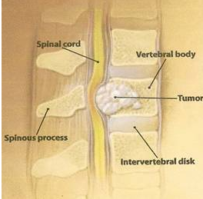
Role of Radiation in vertebral metastasis- spinal surgeon’s perspective
DR. Vivek Bansal
Director, Radiation Oncology

Slide 2
Introduction
Bone pain secondary to metastasis is the most common pain
syndrome requiring treatment in cancer patients .
2 Patients with predominant bone metastases have longer duration of survival than patients with predominantly visceral metastases .
3 Patients with bone metastases have more severe symptoms and become symptomatic earlier in the clinical course than do patients with liver and lung metastases .
4 Complications of bone metastases are common (occurring in up to one-third of patients who develop first metastases in bones) and produce high morbidity .
5 There is an increasing incidence of bone metastases because of longer patient survival as a result of more effective treatment of primary tumors and other metastases.
6 The care of this group of patients is poorly integrated.

Slide 3
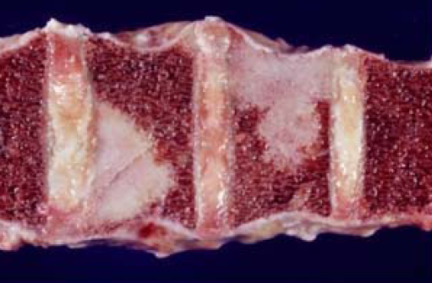
Vertebral metastasis
Spine is the most common site of metastatic bone disease
Most common forms of carcinoma to metastasize to the spine are - lung
breast
prostate.

Slide 4
Vertebral metastasis
It is the initial manifestation of cancer in 8-20% of cases.
peak between 40-60 years of age.
2-5% of cancer patients have at least one episode of spinal cord compression during the last 2 years of life.

Slide 5
Signs & symptoms
Pain is the presenting symptom in 85% of patients
The pain may be difficult to distinguish from benign spinal disease (Pain from metastatic disease is often unrelenting and not improved with recumbence. )
Causes of pain may be -biologic factors
mechanical instability
pathologic fracture
epidural compression
nerve root impingement

Slide 6
Types of radiological lesions

Slide 7
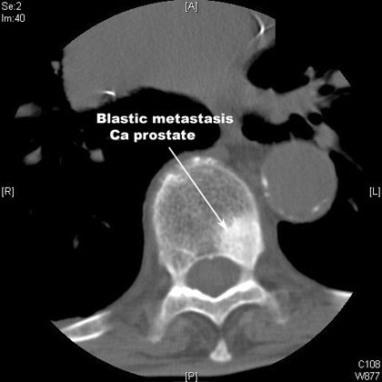
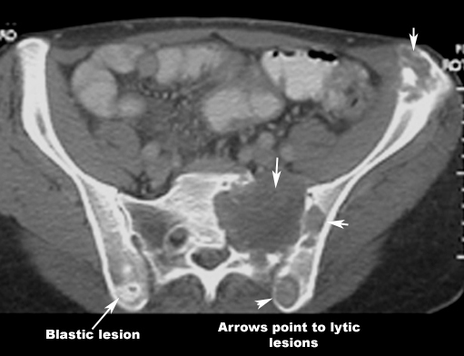
Osteoblastic lesions:
Tumor producing cytokines-activate osteoblasts
Best detected on bone scan
Most commonly arises from prostate cancer, breast, lung and carcinoid
Osteolytic lesions:
Tumor produces PTHrP, Vit D-like steroids that elicit bone resorption
Best detected by plain radiology (may not be apparent until > 1cm)
Most commonly arises from :
breast, lung, thyroid, renal, melanoma, and gastrointestinal malignancies

Slide 8
Imaging
Plain Films
Bone scan
CT
MRI
PET

Slide 9
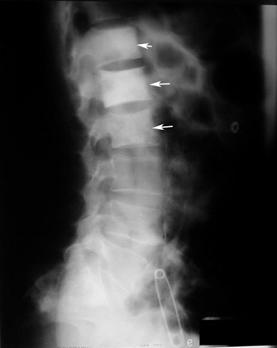
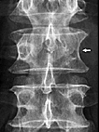
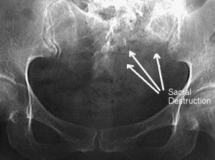
Plain film
Indicates the net result of bone resorption and repair showing Osteoblastic, Osteolytic and mixed lesions
An estimated 25% of patients with SCC have no bone
destruction, making x-rays and bone scans unhelpful.
Vertebral metastases are only visible when 50% of bone is
destroyed.

Slide 10
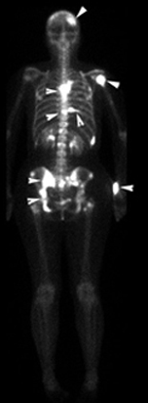
Radioisotope Bone Scan
Excellent screening modality.
Preferred method for evaluating
the entire skeleton
Reflects the metabolic reaction
of bone preferential uptake of
the tracer at sites of active bone
formation.
More sensitive than plain films
for detecting metastasis.

Slide 11
CT Scan
Excellent soft tissue image, soft tissue and bony metastases are clearly demonstrated.
CT most appropriate for diagnosing spinal metastases in locations difficult to assess with bone scan or radiographs
Also, it is reserved for patients with positive bone scans and negative radiographs in order to clarify pathology.

Slide 12
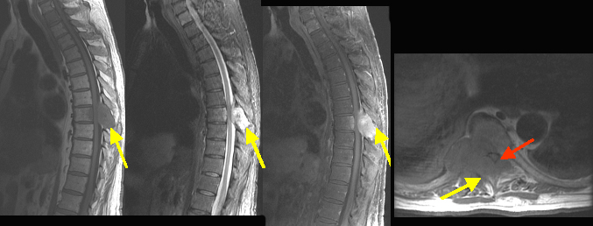
MRI
More sensitive than CT, especially for lesions involving the
spine, because it can provide mutiplanar images and identify
the nerve and spinal roots
Investigation of choice for detecting involvement of bone
marrow, inter trabecular mets ,soft tissue and osseous tumor
extension

Slide 13
Prognosis
Prognosis for spinal metastasis depends on –
general condition
ambulatory status
pretreatment neurologic function
primary tumor type
sites of other metastasis
(brain and viscera)
70% to 90% of patients who are ambulatory at presentation remain ambulatory
whereas 33% to 70% of those who have paraparesis and 11% of those who have paraplegia on presentation regain an ambulatory status.*
King G, Kostuik J, McBroom R, et al. Spine 1991;16:265

Slide 14
Treatment
Multidisciplinary approach that addresses systemic and focal disease.
The complex nature of metastatic disease requires the combined efforts of a team of medical, surgical, radiation, and orthopedic oncologists.
Systemic disease necessitates a combination of chemotherapy, hormonal therapy, immunotherapy, and bisphosphonate therapy.
Focal complications are best addressed with surgery or radiotherapy, or both.
Prevention of skeletal complications requires early detection and aggressive management.
All members of the team must keep a vigilant eye for the early signs of disease progression and skeletal manifestations.

Slide 15
Surgery - indications
An operative procedure must be considered for cord compression
Fracture dislocation
Acute-onset paraplegia
Radioresistant lesions
Absence of steroid response
No histologic proof of cancer.
Patients with - Spinal instability
Retropulsed bone fragments
Complete collapse of the vertebral body with myelopathy
do not benefit from irradiation alone

Slide 16
Objectives of surgery
Surgical goal is to manage :
Pathologic and impending pathologic fractures
Improve function
Relieve pain
Facilitate nursing care and
Promote overall psychological well being .

Slide 17
Surgical management
Surgical intervention in patients with spinal metastases is limited to patients with progressive neurologic deficits and vertebral collapse associated with spinal instability.
Good results are achieved in patients who undergo anterior decompression and stabilization
For patients with painful metastases and compression fractures of the vertebral bodies without segmental instability and neurologic compromise, a new technique of percutaneously injecting polymethylmethacrylate through the pedicle into the body has shown much promise.

Slide 18
Chemotherapy
Chemotherapy for cord compression can result
in giving complete remission from
lymphomas
germinal tumors
leukemias
neuroblastomas

Slide 19
Radiotherapy
Provides good control of pain and restoration of function.
Premedication with analgesics, use of support and repositioning devices may be needed for patient comfort and for daily setup accuracy.
Patients are maintained on steroids, and dose tapering occurs 2 weeks after the completion of irradiation

Slide 20
Considerations before Radiation
General condition and performance scale
Any prior treatment with chemotherapy, radiotherapy.
Which vertebral level is affected?
Any associated soft tissue extension with vertebral metastasis.
Basic haematological profile with necessary intervention if any before RT.
Analgesics requirement with steroids and any other medications.
Proper radiation planning with dosage etc.

Slide 21
Dosage schedule
Many dose fractionation regime:
30 Gy in 10 fractions over 2 weeks
20 Gy in five fractions over 1 week
8 Gy in single fraction
A more fractionated course of irradiation with a higher total dose, such as - 40 Gy in 20 fractions
50 Gy in 25 fractions
should be considered in a patient –
with a long, "stable" metastatic history
a long disease-free interval

Slide 22
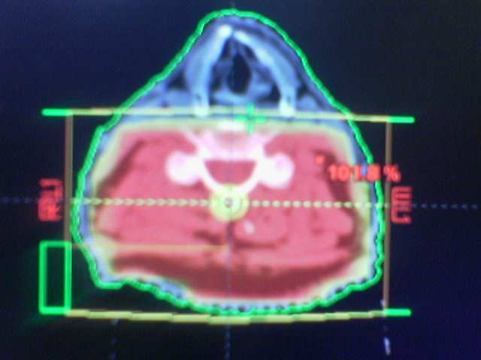
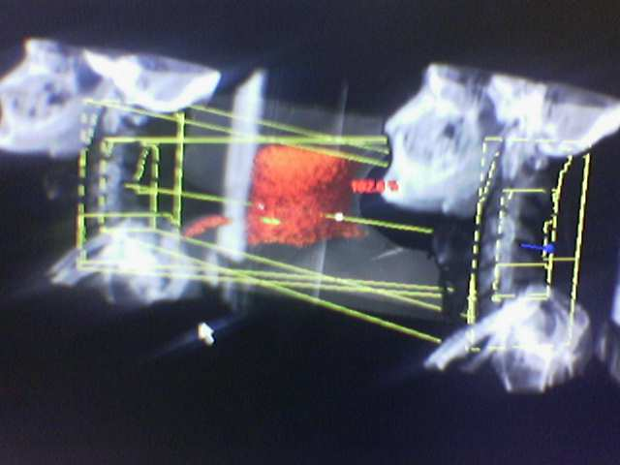
Cervical spine irradiation
Lateral fields have been advocated for the cervical
spine to spare the pharynx and larynx

Slide 23
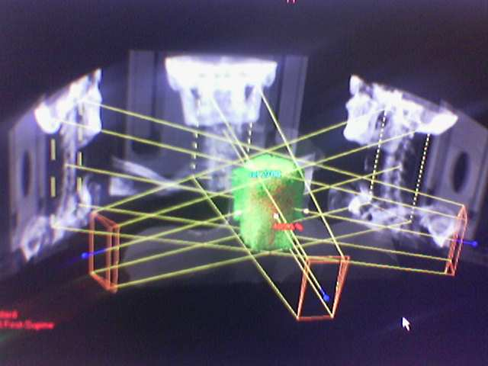
Alternatively oblique fields can be used

Slide 24
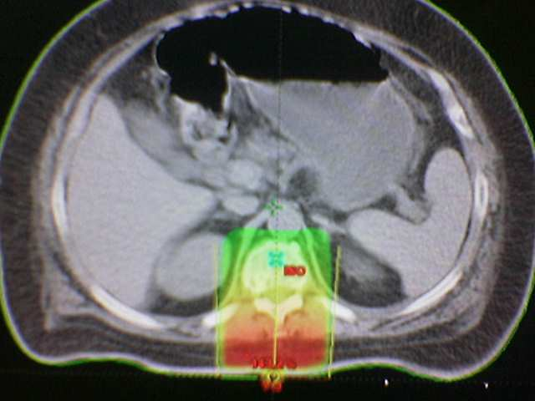
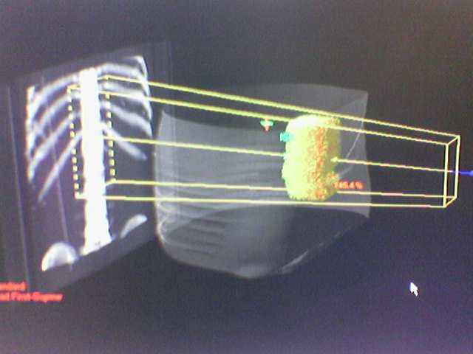
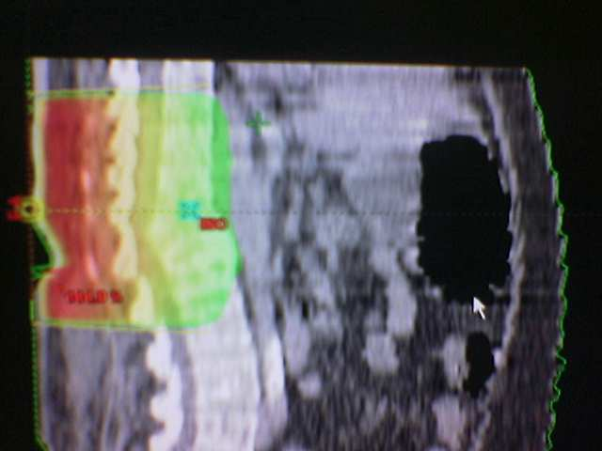
Radiation Therapy –Thoracic vertebra
The most common technique is to apply a posterior field.

Slide 25
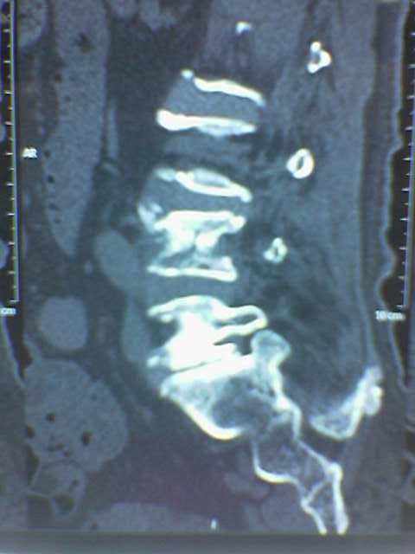
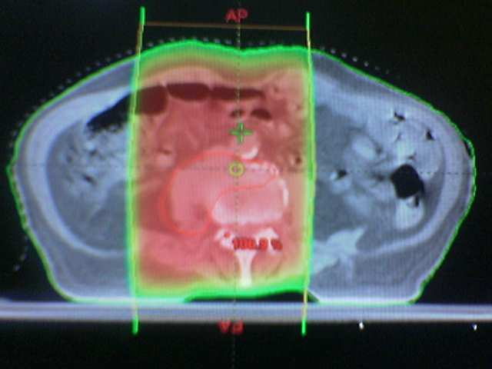
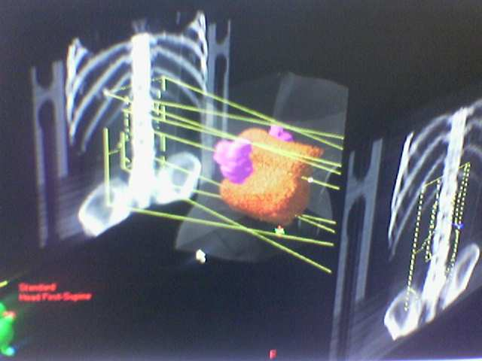
Lumber vertebra
opposed fields may be preferred as the
treatment volume approaches the midline

Slide 26
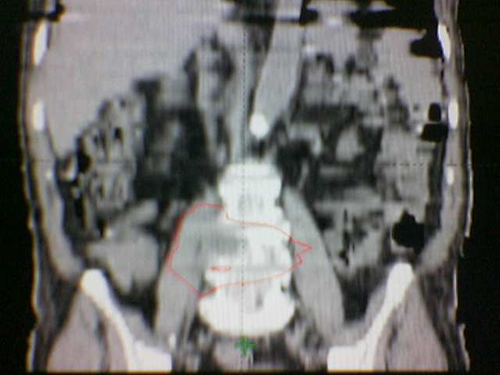
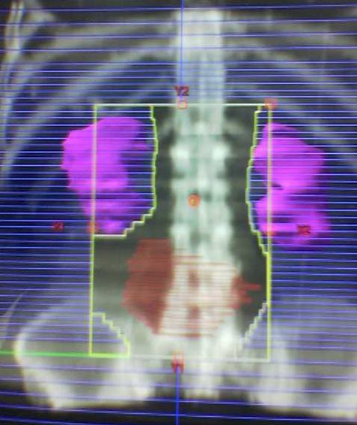
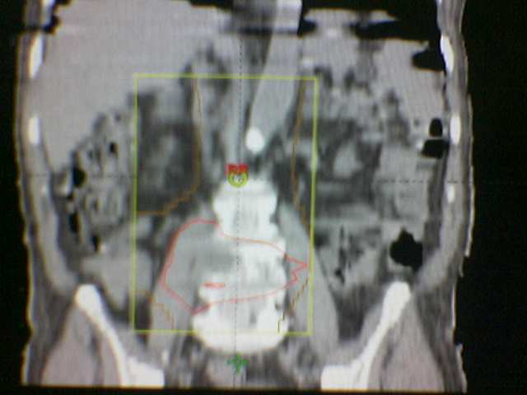
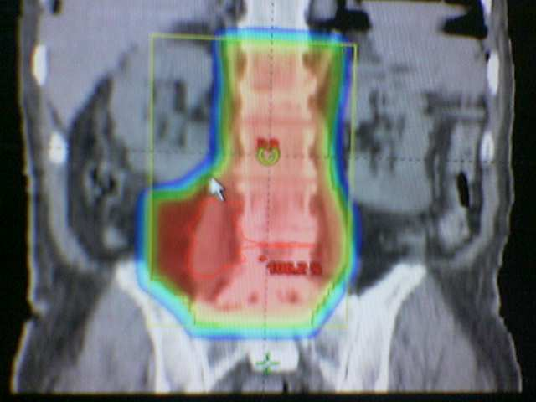
Conformal treatment

Slide 27
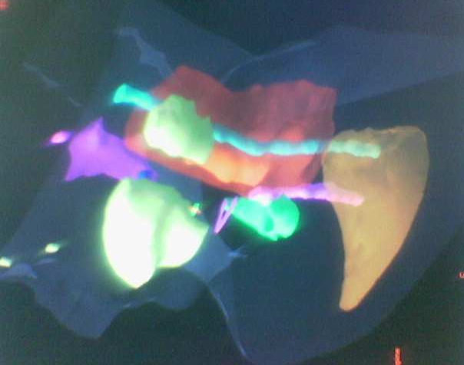
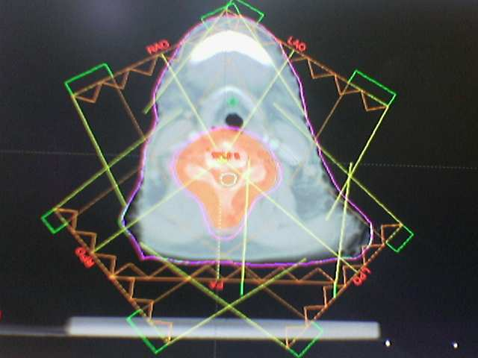
IMRT-saving parotids

Slide 28
C_{B}CC
USA
Destroying the tumor is length of life issue
But
Reducing toxicity is a quality of life issue

Slide 29
C_{B}CC
USA
IMRT Advantages
Normal Tissue Conformal avoidance
Improved target coverage
Dose Escalation

Slide 30
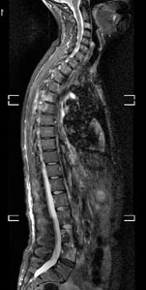
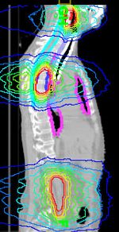
Multiple
Metastases

Slide 31
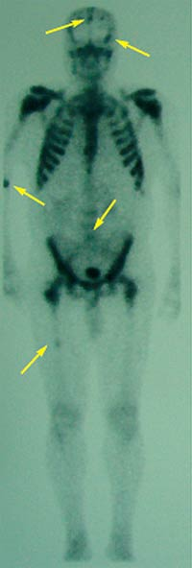
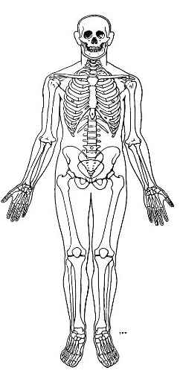
Disseminated metastasis
Hemi body irradiation
UHBI
LHBI

Slide 32
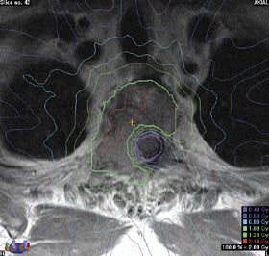
Re-irradiation
IMRT/IGRT
SRS/SRT
careful documentation with
simulator films
skin tattoos
photographs
portal diagrams
is needed to allow for later adjacent overlapping portals
Re-irradiation to spinal metastases while limiting spinal cord doses to tolerable levels

Slide 33
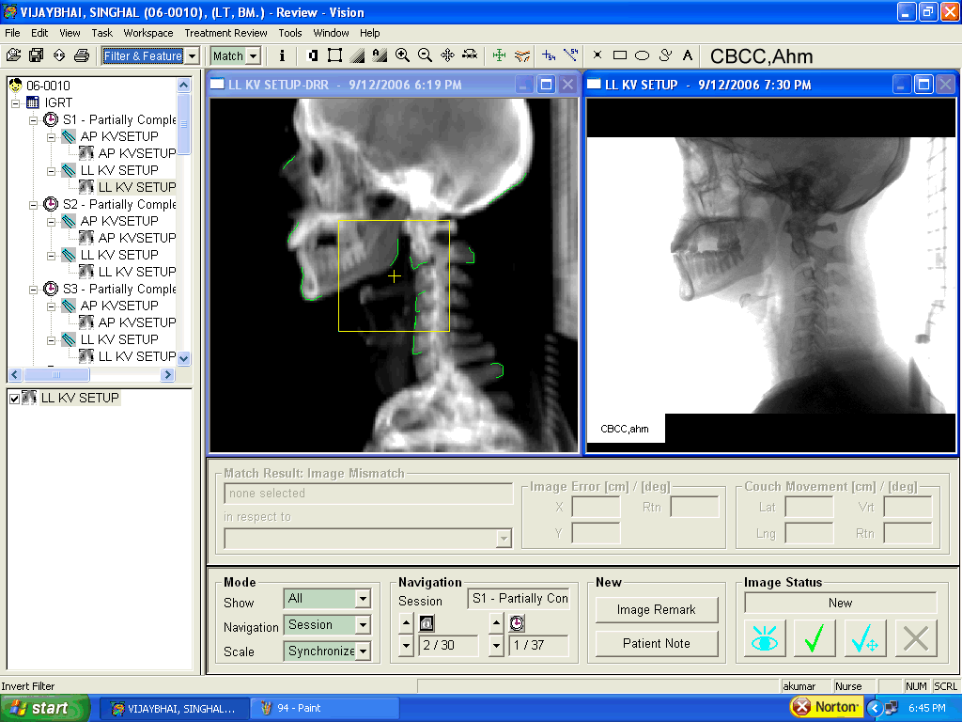
IG-IMRT
Re-irradiation possible

Slide 34
C_{B}CC
USA
What we need at this hour ?
Understand the residual uncertainties in planning and delivery since its impact is increasingly becoming important in outcomes.

Slide 35
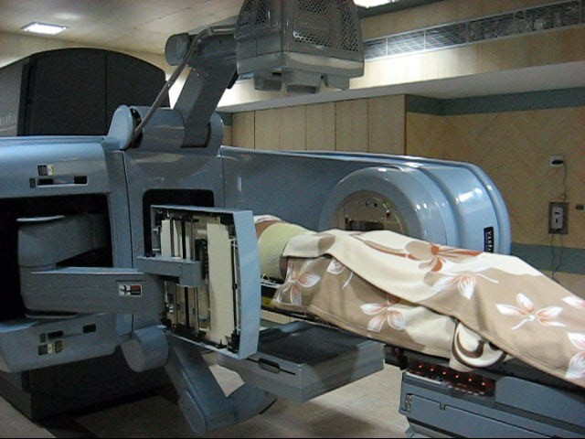
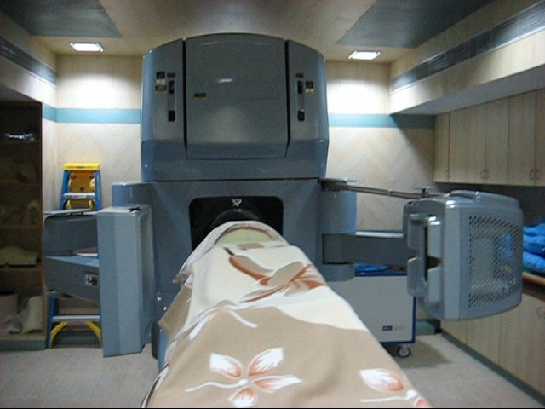
Treatment delivery
AP and Lateral KV images using OBI-2D Match
AP KV imaging
Lat KV imaging

Slide 36
Cost effectiveness-hospice
XRT : 30 Gy/10 # or 20 Gy/5#
Cost
XRT- $1200 to 2500
Analgesics - $9000 to $36000
Macklis,et.al.
ASTRO 2005
Costs for palliative XRT less than systemic therapy
Response rates: equal or better
Less toxicity

Slide 37
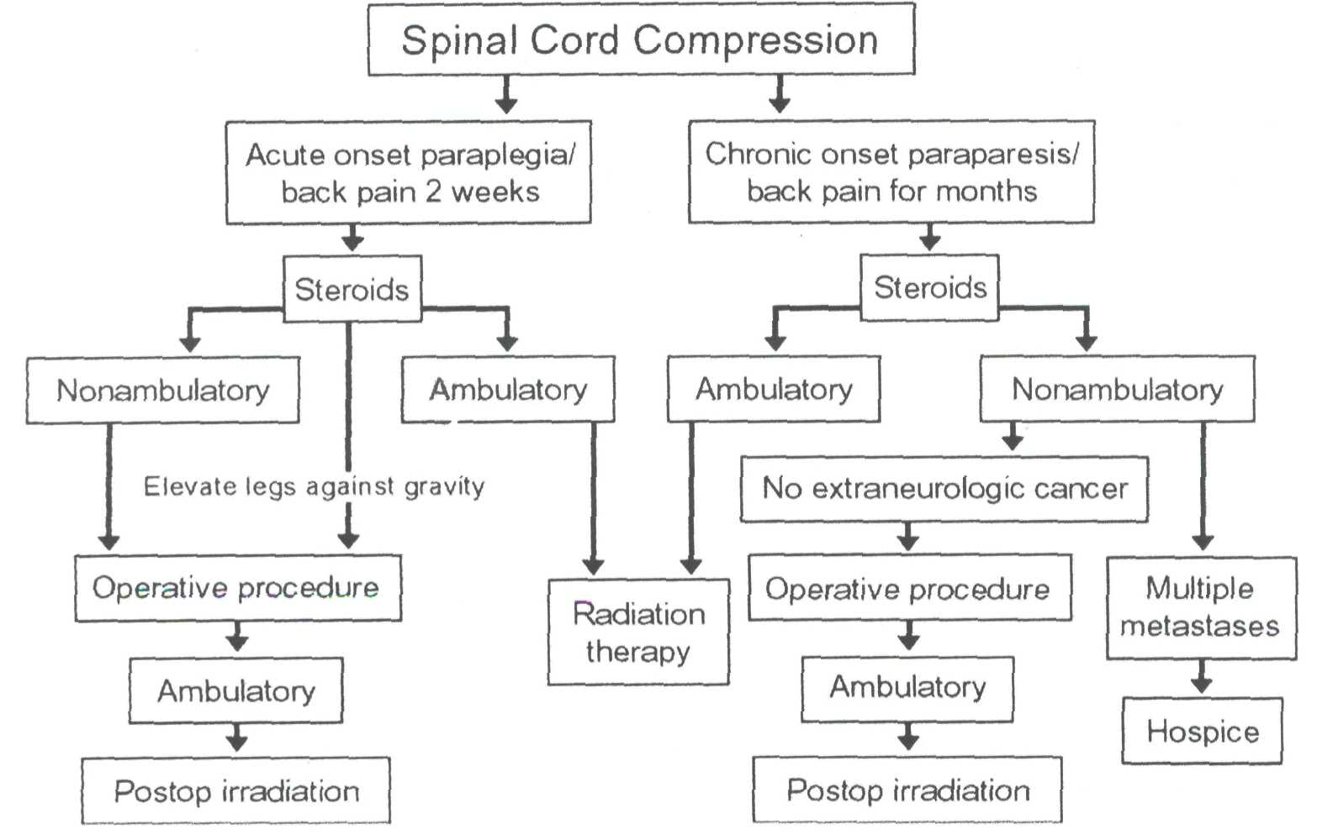
Spinal cord compression-management
The standard of practice in past years - emergency posterior operative procedure and then deliver postoperative irradiation (for cord compression)
Radiation therapy without surgery is as successful as surgery in ambulatory patients and in paretic patients who respond to steroids.

Slide 38
Result of treatment
Maranzano and Latini- Int J Radiat Oncol Biol Phys 1995;32:959
prospective study
275 patients with spinal cord compression
1. Continued effectiveness of radiotherapy and steroids as a
means of treatment when no surgical indications were
present.
2. Ambulation was maintained or improved in 76%
3. Sphincter control in 44%.

Slide 39
Conclusion
Symptoms and deficits due to vertebral metastasis are much different from those associated with metastasis to other visceral sites.
Symptom control with good quality of life are major concerns since these patients have relatively longer survival.
Radiation therapy with or without surgery remains the mainstay of treatment.
Good imaging with individualized treatment , expert clinical judgment, timely intervention with handling of psycho-social issues and other support systems holds key for successful management of vertebral metastasis.
There is an urgent need to establish the staging classification for bony metastasis to insure comparability and interpretation of results to guide treatment decisions and research.

Slide 40
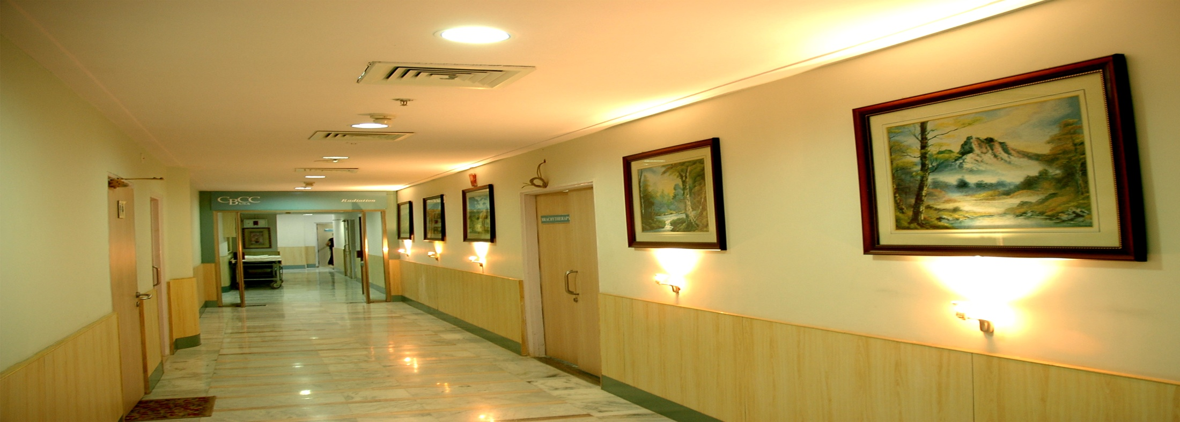
Thank You
Department of Radiation Oncology

