Slide 1
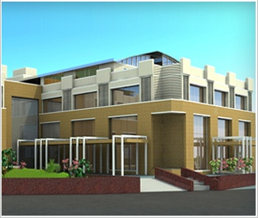

Stereotactic Body Radiation Therapy(SBRT) WITH FFF
FROM LIMITS TO OPTIONS
Dr Vivek Bansal
Director
Dept of Radiation Oncology
HCG Cancer Centre ,Sola
Ahmedabad

Slide 2
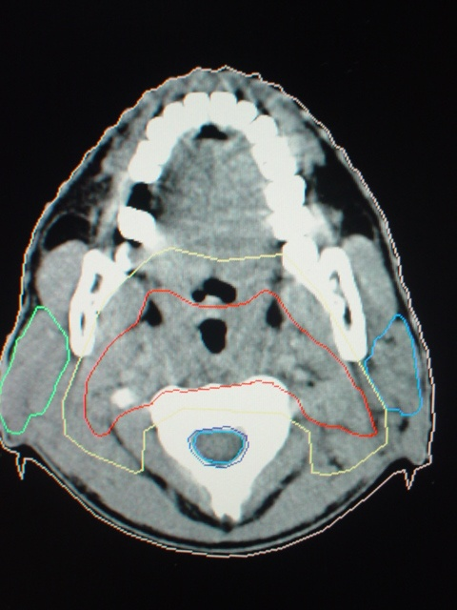
The Goal
Optimal Dose Delivery
…With Minimum Acute And Long Term Toxicity

Slide 3
1965 - 2007
CLINICAL PROGRESS
Improved assessment
Treatment Selection
Control of reactions

Slide 4
This has been possible
This has been possible
Tremendous progress in Imaging/other technologies
Extraordinary advances in Radiotherapy delivery systems and associated technologies
Advances in chemotherapy and targeted agents
Progress in surgical oncology

Slide 5
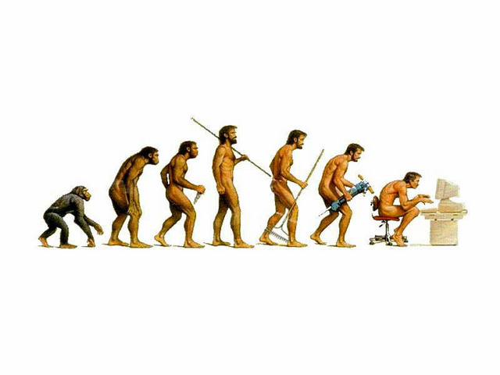
EVOLUTION OF RADIOTHERAPY
TELE-COBALT
THERAPY
LINAC
IMRT
IGRT
TOMO-TH
SRS
SRT
ART
DART
TELETHERAPY

Slide 6
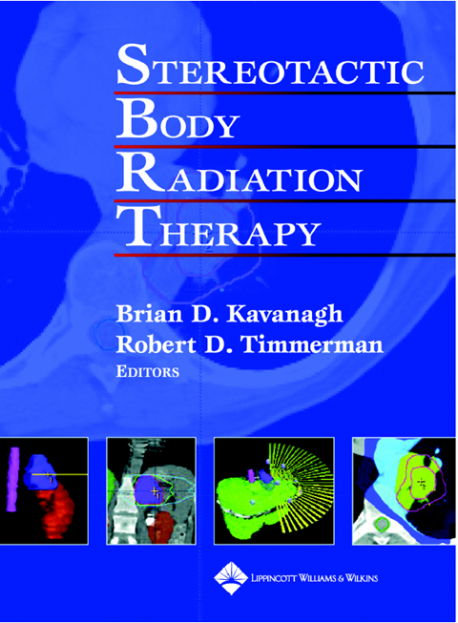
SBRT: What is it?
SBRT: What is it?
Stereotactically localized, ultra-high-dose radiotherapy delivered to discrete tumor nodules in the lung, liver, and other extracranial locations in a hypofractionated regimen (typically 1-5 treatments)

Slide 7
Rationale of SBRT
Rationale of SBRT
Higher radiation doses given over a shorter period allows for less tumor cell repair and repopulation leading to more cell kill.

Slide 8
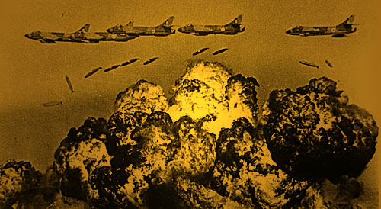
Non-digital conventional radiotherapy analogous to carpet bombing

Slide 9
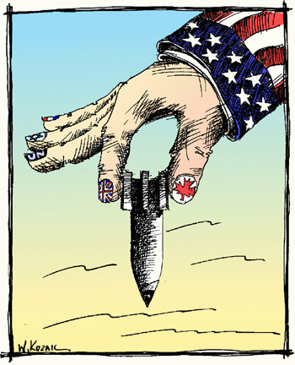
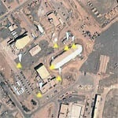
SBRT ANALOGOUS TO DIGITAL SMART BOMBING
ACCEPTABLE COLLATERAL DAMAGE

Slide 10

BBALANCE TO BE KEPT
BALANCE TO BE KEPT
Tumoricidal dose
Normal tissue tolerance

Slide 11
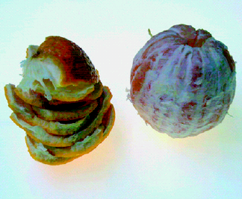
VOLUME
volume = 4/3 ¶ r ³
a small reduction in margin (5mm)
yields a reduction by half in volume
Verellen D, Nature Reviews cancer 2007;7:949-61

Slide 12
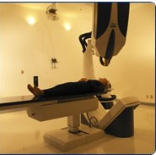
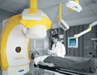
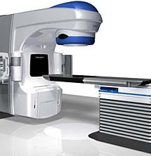
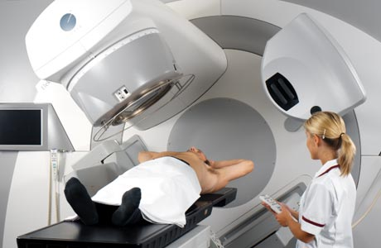
Specialized Devices for SBRT
Specialized Devices for SBRT
Novalis
Cyberknife
Accelerator-based IGRT
(Trilogy, Synergy)

Slide 13
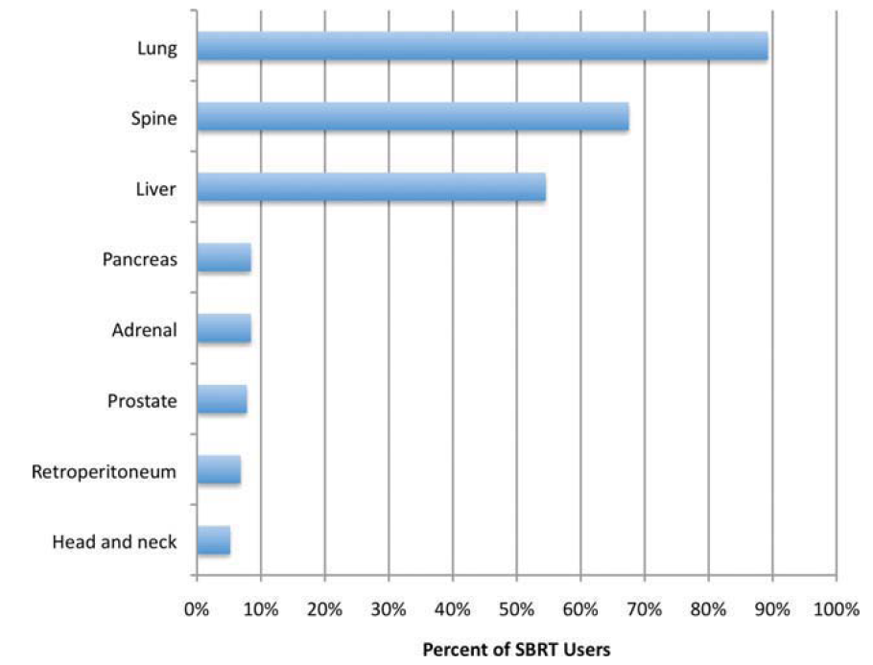
SBRT Sites
SBRT Sites
Pan H et al, A Survey of Stereotactic Body Radiotherapy Use in the United States. Cancer. 2011 Oct 1;117(19):4566-72
13

Slide 14
Indications of SBRT
Indications of SBRT
Lung
  Stage I (T1–2 N0 M0) NSCLC
  Lung mets
Liver
  HCC
  Liver mets
Spine
  Spinal mets (primary/re-irradiation)
  Benign spinal tumors
Promising early results
  Prostate ca
  Renal cell ca
  Pancreatic ca

Slide 15
Lung SBRT/SABR
Selection Criteria,
Techniques,Outcomes

Slide 16
Patient Selection
SBRT is a suitable approach for patients who present with peripheral early stage tumors
NSCLC that measures 6 cm or less
- Int J Radiat Oncol Biol Phys 70:685-692, 2008
Meta-analysis : Evidence Supports
- Radiotherapy Oncol 95:32-40, 2010
SBRT does not show to impair pulmonary function, although patients with severe
chronic obstructive pulmonary disease constituted more than one third of treated
Individuals
-J Thorac Oncol 4:838-844, 2009
SBRT has also been applied safely in patients who have undergone a prior
peumonectomy
-Cancer 115:587-594, 2009

Slide 17
Clinical Essentials
Clinical forum for patient evaluation and discussion
Robust quality assurance program
Protocols for treatment planning and delivery
Integrated clinical team with designated roles
Consideration of whether to develop the SBRT program within the context of a research ethics board-approved multicenter, or institutional protocol, and if not, to then put in place adequate independent mechanisms for patient follow up that is required to ascertain tumor control and toxicity and validate speciﬁc techniques
Notes:
Essentials

Slide 18
SBRT team
Radiation therapist
Medical physicist
Radiation oncologist
Diagnostic radiologist
Medical professionals, such as surgeons

Slide 19
SBRT process :Overview
Pre SBRT workup
Simulation 4DCT and PET
( motion management)
Contouring of target and OAR’s
SBRT selected as proffered modality in multidisciplinary meetings
SBRT team meeting : plan review , selection , toxicity and failure analysis
Treatment delivery: review of volumetric CBCT, patients review during treatment
Patients follow up
Challenge at each level

Slide 20
Pre -SBRT Work-up
Workup
Simulation
Treatment delivery
Contouring
Quality assurance
CECT thorax , abdomen and MRI of brain
Isotope bone scan
OR
Fluorodeoxy-glucose (FDG) PET/CT scan ( Preferred)
Every patient has pulmonary function testing, although we do not specify lower limits that would preclude SBRT
In practice, treatment ﬁelds are often small, minimizing the amount of lung damage from RT and so even patients with extremely limited lung function, including those on home oxygen, may be candidates for SBRT, particularly if they have a peripheral lung lesion.
Notes:
Cect detail

Slide 21
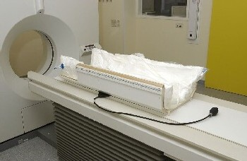
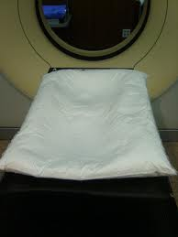
Treatment Simulation
Workup
Simulation
Treatment delivery
Contouring
Quality assurance
Patient immobilization
Reproducible and stable patient positioning is essential to facilitate
accurate treatment and to permit the small margins typical of SBRT
Treatment planning.
Stereotactic frame
evacuated bags
Careful positioning in the immobilization device, supporting the hands
and shoulders, and in some patients, premedication with analgesia
(e.g., to prevent shoulder pain) or an anxiolytic may need to be
considered
Notes:
Cushions / knee rest

Slide 22
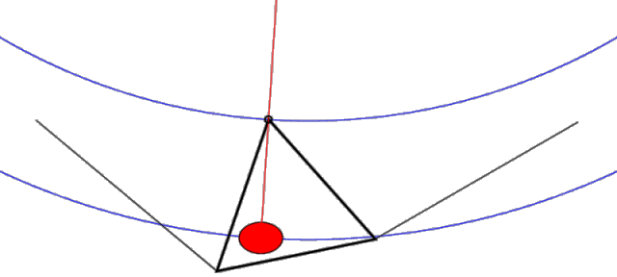
Treatment Simulation
Workup
Simulation
Treatment delivery
Contouring
Quality assurance
Respiratory motion
Causes artifacts during imaging acquisitions
Radiation delivery limitations
Limiting treatment planning
Treatment planning difficulty

Slide 23
Treatment Simulation
Workup
Simulation
Treatment delivery
Contouring
Quality assurance
Methods to Account for Motion
1.Motion-encompassing methods
2.Respiratory gating methods
3.Breath-hold methods
4.Forced shallow breathing with abdominal compression
5.Real-time tumor-tracking methods

Slide 24
Tumour & OAR Delineation
Workup
Simulation
Treatment delivery
Contouring
Quality assurance
Gross Tumor Volume (GTV)
4DCT imaging [exhale / inhale dataset ]
If 4DCT unavailable or unsuitable free-breathing helical images can be used for treatment planning
In selected patients intravenous CT contrast may help to identify the GTV
When PET imaging is available (either in the diagnostic or preferably, the treatment position) it is fused to the exhale CT and may be used to inform the contouring process, especially in instances where there is a neighbouring region of atelectasis.

Slide 25
Tumor and OAR Delineation
Workup
Simulation
Treatment delivery
Contouring
Quality assurance
Clinical Target Volume (CTV)/ Internal target volume (ITV)
Planning Target Volume (PTV)
For the remaining uncertainty a setup margin is required
A uniform expansion of 5 mm is typically applied to the 4DCT
based ITV to generate the PTV
In certain circumstances, for example OAR proximity, this may
be individualized
OAR Delineation
(Do not forget :B plexus, Chest wall , Proximal Br tree,oesophagus)

Slide 26
Radiation Treatment Planning
Workup
Simulation
Treatment delivery
Contouring
Quality assurance
Dose Prescription
Isodose which is chosen to ensure adequate PTV coverage
The prescription isodose should be between 60 and 90%, where
the center of mass of the PTV is normalized to 100%.
Doses greater than 105% of the prescribed dose should be
located inside the PTV where substantial heterogeneity is
allowed
In some situations, such as when the tumor is near the chest
wall, it is desirable to try and avoid ‘hot spots’ over certain
normal tissues, in this case the rib and intercostal tissues, which
may be located inside the PTV.
Notes:
highlight

Slide 27
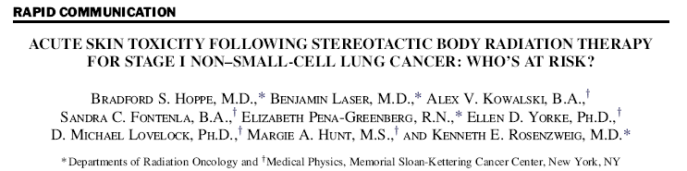
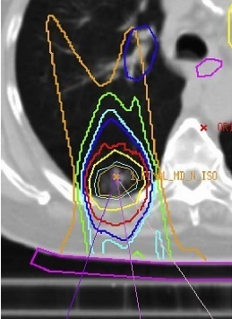
EXTRAORDINARY Care Needed
EXTRAORDINARY Care Needed
Int. J. Radiation Oncology Biol. Phys. 2008; 72: 1283–1286
27

Slide 28
Radiation Treatment Planning
Workup
Simulation
Treatment delivery
Contouring
Quality assurance
SBRT - Dose consideration
• Comparison of different radiation delivery schedules and estimates of their biologic equivalent dose (BED)
• Standard RT (2 Gy x 30-33) 72-79 Gy
• Radiosurgery
– 24 Gy x 1 81 Gy
– 30 Gy x 1 120 Gy
• Hypo fx (SBRT)
– 12 Gy x 4 106 Gy
– 12 Gy x 5 144 Gy
– 20 Gy x 3 180 Gy
Notes:
Bed

Slide 29
Radiation Treatment Planning
Workup
Simulation
Treatment delivery
Contouring
Quality assurance
SBRT – Dose Schedule
While not clearly defined, typically 1 to 5 fractions
• 5 to 10 fx may also be considered SBRT
Dose delivery
• 2 fractions/week
• 3 fractions /week
• 5 fractions/week
SBRT – Dose
Early German and Japanese single dose trials
(Japan 15 to 25 Gy, Germany 19 to 26 Gy)
IU dose escalation trial – 24 to 66 Gy
RTOG trial dose – 3x20 Gy
Alternate protocols [OHSU/U Wisconsin] – 5x12 Gy

Slide 30
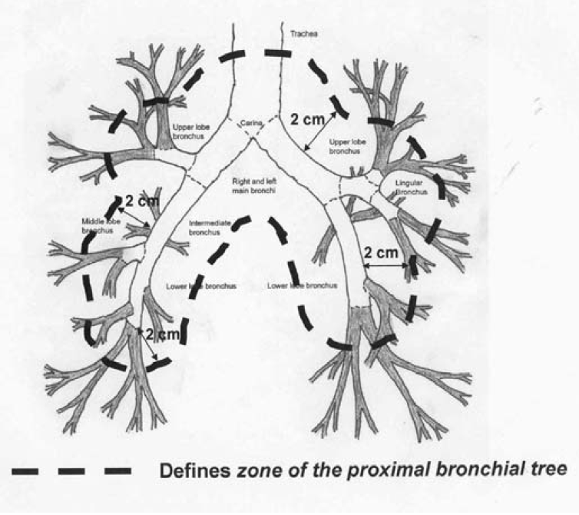
SBRT-LUNG IN CENTRAL LESIONS-DOSE REDUCTION
Dose/toxicity concerns for
Bronchus/trachea
Esophagus
Great vessels
Restricted
Fly Zone

Slide 31
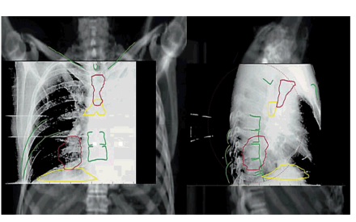
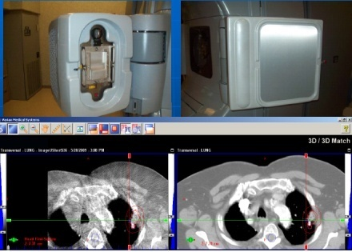
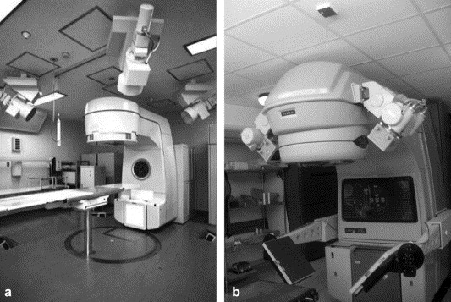
Challenges in SBRT
Planning issues
Image guidance
Orthogonal pair planar imaging
In-room CT (CT-on-rails or CBCT).
Real-time imaging
Aims
Align the body into the correct position
Confirm that the target itself is correctly positioned
Verify that the motion management is correct for that day.

Slide 32
Challenges in SBRT
Treatment delivery issues
Patients selection and bias
Diagnostic issues
Treatment delivery
Treatment planning
Quality assurance
Matching - When ?
At each treatment
Before each treatment field
4DCBCT Verification

Slide 33
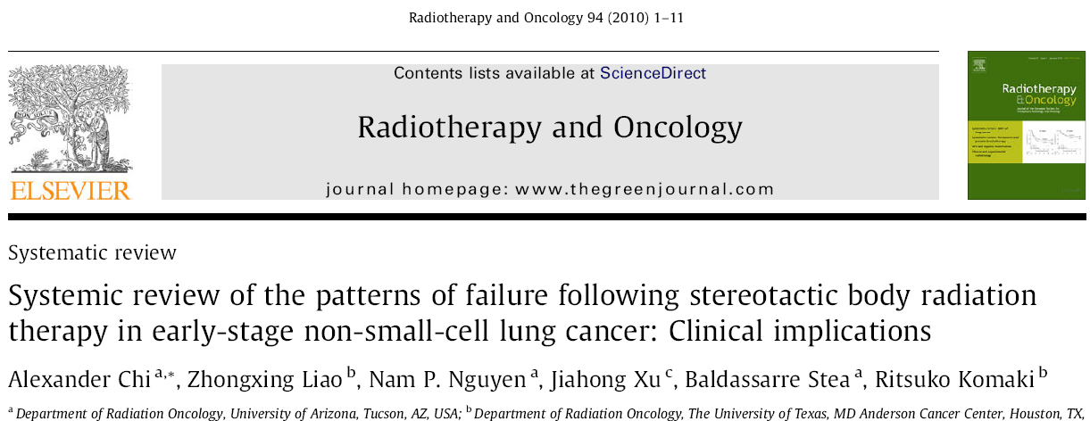
Local control ranged from 80% - 100% with adequate isocentric / peripheral BED.
Recurrence associated with increased tumor size.
Higher dose required for larger lesions.
Main pattern of failure after SBRT : distant metastasis.
Adjuvant chemotherapy may further decrease all recurrences.
Gr 3–5 toxicity—centrally located tumors.

Slide 34
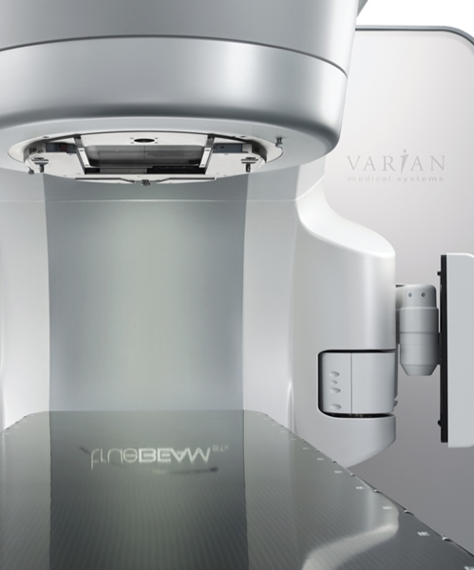
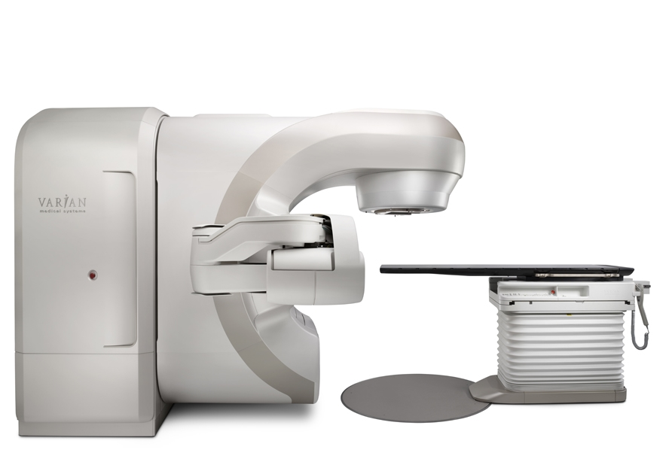
TRUEBEAM-New Beam generation system
FLATTENIG FILTER FREE(FFF) BEAM MODE

Slide 35
Why FFF
In SRS or SBRT treatments, large MUs are often required and FFF X-ray beams can deliver these large MUs in much shorter “beam-on” time.
With shorten treatment time, these FFF X-rays improve patient comfort and dose delivery accuracy

Slide 36
Other advantage of higher dose rates of FFF X-rays & reduced treatment time is in organ motion management
larger dose fractions can be delivered in a single breath-hold or gated portion of a breathing cycle

Slide 37
TrueBeam MV – Beam Generation System
2400 MU/min
10 HI
Dose Rate
1400 MU/min
6 HI
4 MV
6 MV
8 MV
10 MV
15 MV
18 MV
20 MV
600 MU/min
Energy
Notes:
Today in Clinics
Multi-Energy: 13 Carousel Positions available
5 Flattened Photon Energies: 4, 6, 8, 10 & 15 MV available in summer 2011
From low dose rates through 600 MU/min
2 High Intensity Mode Energies:
6X FFF, 10X FFF (Flattening Filter Free)
8 electron energies: many foils, 22e (max)
End of 2011
18, 20 MV, and 4 MeV (BJR 11)

Slide 38
Physical Benefits of FFF
Reduced scatter
Reduced leaf transmission
Reduced radiation head leakage
“ reduction of out-of-field dose is expected “

Slide 39
Evidence
VMAT plans using unflattened beams demonstrate
better conformity to target,
sharper dose fall-off in normal tissues and
lower dose to normal lung than the 3D plans for lung SBRT.
Zhang et al. (Radiat Oncol. 2011 Nov 9;6:152)

Slide 40
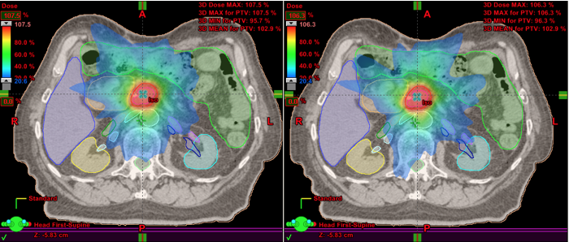
Pancreatic Cancer
6 MV
PTV: 19 cc
24 Gy
MU: 6826
Dose rate 600 MU/min
Beam on time: 11.4 min
10 MV FFF
PTV:19 cc
24 Gy
MU: 7930
Dose rate 2400 MU/min
Beam on time: 3.4 min

Slide 41
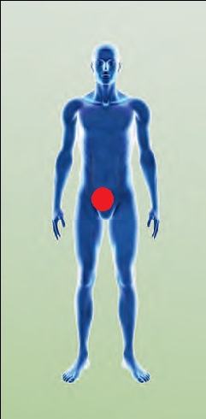
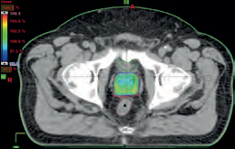
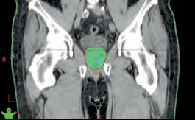
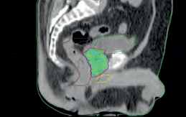
SBRT Prostate
Prostate T2NoMx, Gleason score 6 = 3+3
5x7Gy, 2170 MU, 10x FFF, 2400 MU/min
Beam on time 120 sec, 2 arcs
Extreme hypofractionation for prostate with the alpha/beta ratio for the prostate(1.5) which is lower than its surrounding normal tissues ie rectum (3) represents biologically the best differential to exploit about.
Treatment time is crucial for patient set-up, organ motion and prostate displacements.
2 minutes beam-on time per fraction. This is in strong contrast to robotic techniques that typically require a minimum of 30 – 45 minutes for the same dose delivery

Slide 42

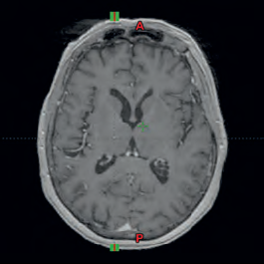
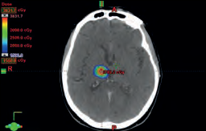
SRT Brain(Thalamus)
Brain mets from NSCLC TNM Stage IV
5x7Gy / 5x6Gy, 1782 MU, 6x FFF, 1400 MU/min
Beam on time 210 sec, 4 Non-coplanar arcs
Before
After
Results in shorter delivery time and therefore increased patient comfort
Reduce the chance of intrafraction motion
SRS/SRT with FFF beams can be accomplished in a standard 15-minute time slot.

Slide 43
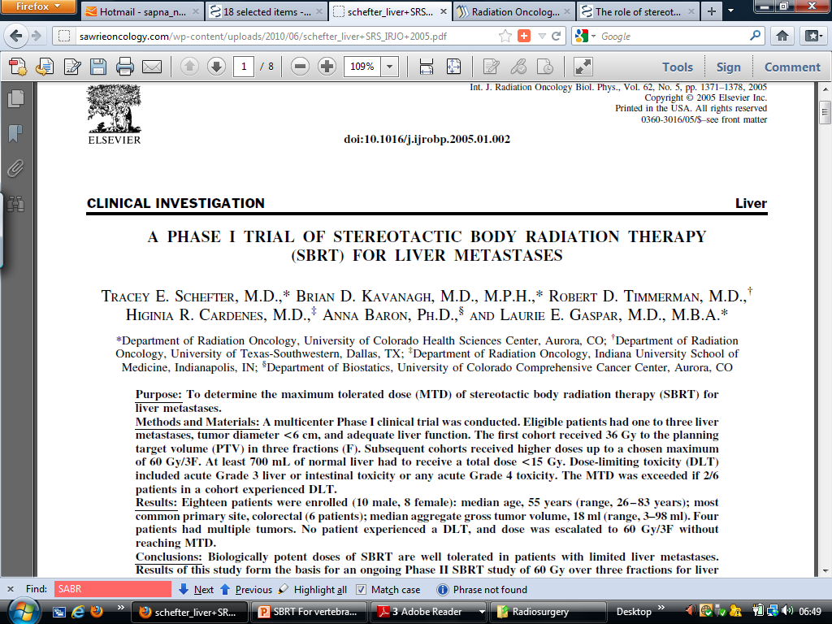
Treatment of Extracranial Oligometastases
  1-3 liver mets of any histology except germ cell / lymphoma
  Max tumour dia < 6cm
  KPS > 60%
  Adequate liver & kidney function
  No chemotherapy within 2 weeks
  No liver infection
  No evidence of disease outside the liver
Correct choice of patients
NCCN Guidelines
  Lung cancer solitary adrenal metastases
  Limited lung , liver mets in selected patients with colon cancer.
General guidelines
  Good performance status
  Responsive disease
  Effective systemic treatment available
  Long gap between primary treatment and failure, or effective strategies available
CAUTION; Unsupported by evidence. To be used very judiciously

Slide 44
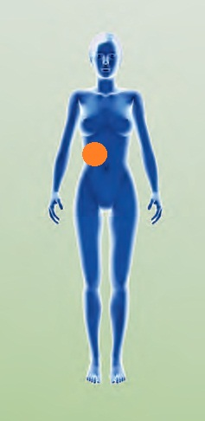
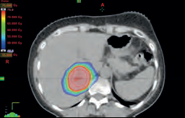
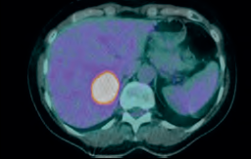
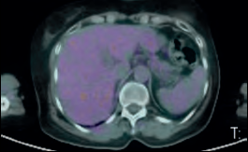
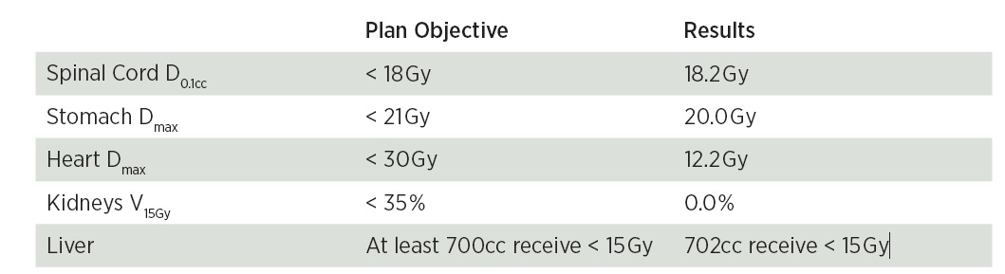
SBRT Liver mets
Hepatic metastases from breast Ca TNM Stage IV
3x25Gy, 5424 MU, 10x FFF, 2400 MU/min
Beam on time 135 sec, 2 arcs
Axial CT with Liver Lesion
PET-CT Before RT
PETCT After 9 months

Slide 45
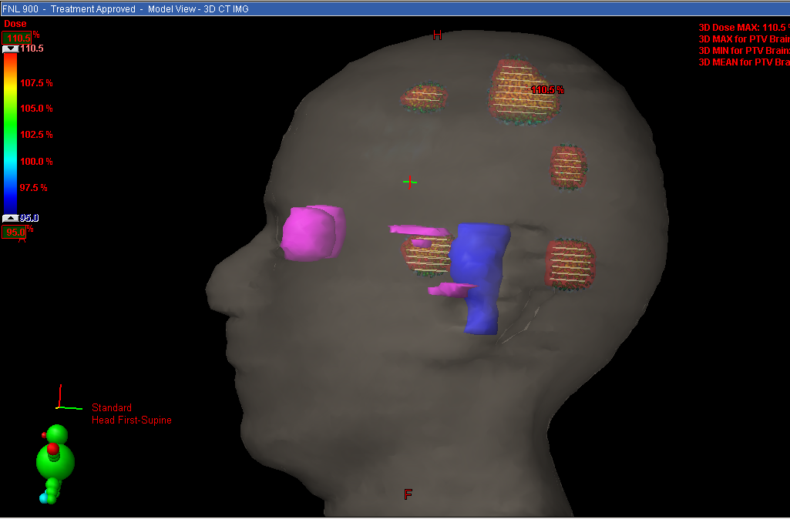
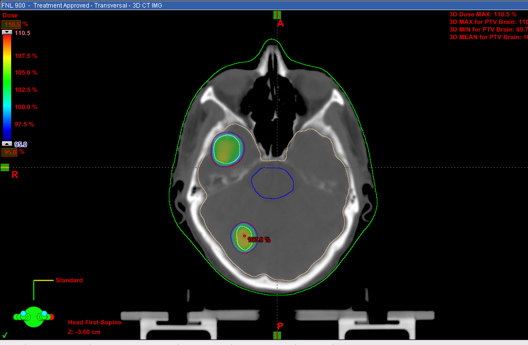
Given 9 Gy in single fraction using 10X-FFF, in one arc (2.5minutes), FF would have taken 4 arcs, 4.5-5min

Slide 46
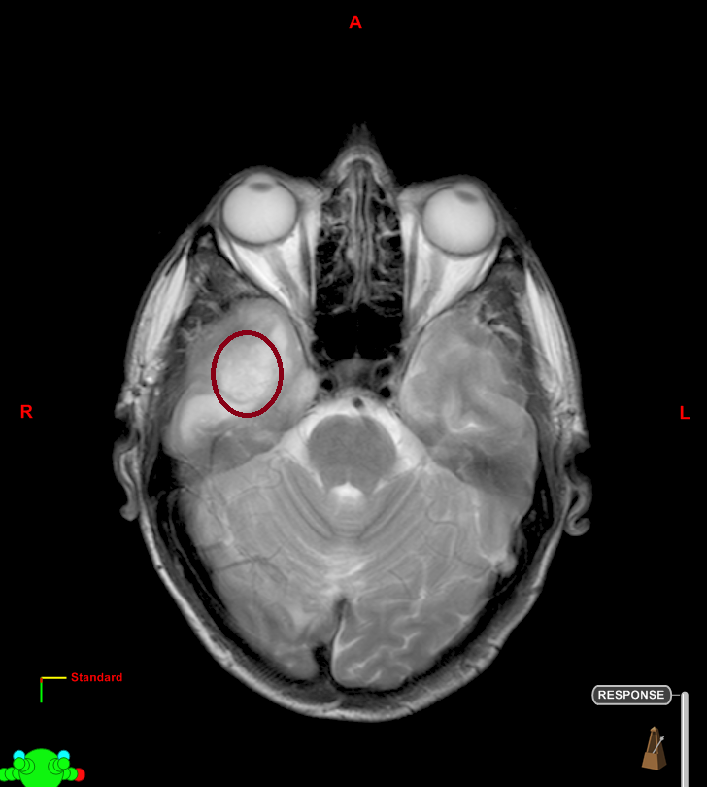
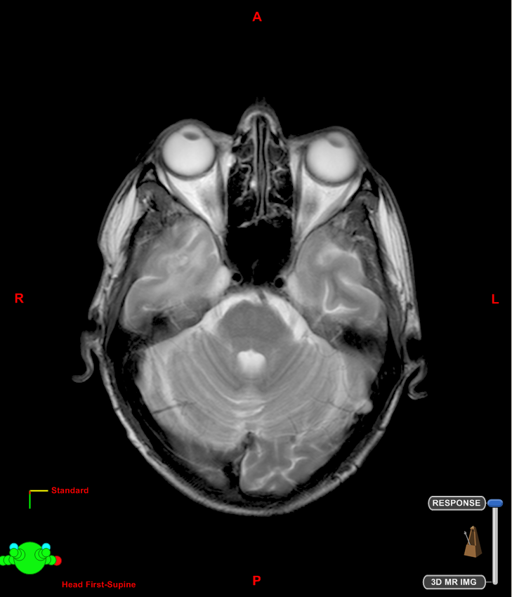
Initial
3 months post SRS

Slide 47
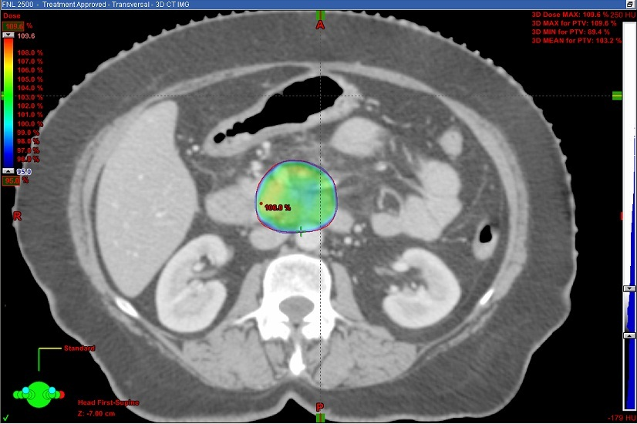
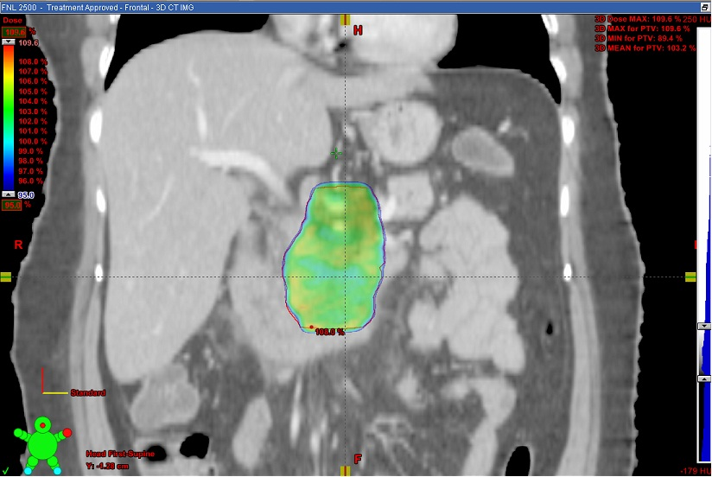
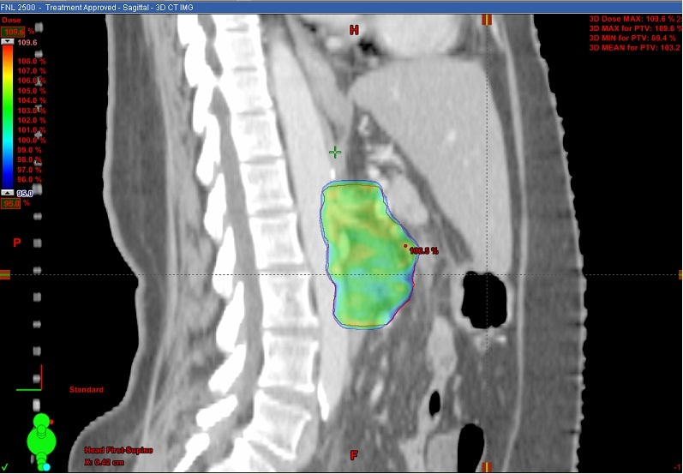
SBRT in Pancreas using FFF
25 Gy given in 5 fractions, using 10X-FFF Single arc each time, treatment time 75 sec. (FF would have taken 4 arcs, total time 300 seconds)

Slide 48

Challenges in SBRT
Patients selection and bias
Diagnostic issues
Treatment delivery
Treatment planning
Quality assurance

Slide 49
IS IT THE END OF PROTRACTED RT SCHEDULES?
CERTAINLY NOT!

Slide 50
NO EVIDENCE PRESENTLY OF SBRT EFFICACY IN
          H&N
          CERVIX
          LARGE FIELDS
          BREAST, etc.

Slide 51
Challenges in SBRT
Disease Profile in India
Challenges in India
Hysteresis
MULTI - DIMENSIONAL ISSUES
Notes:
Sir James Ewing , a engg from scotland coined this term , lag period due to output dependence on multifactorial issues

Slide 52
The Global Burden of Cancer
Million
* WHO Projection

Slide 53
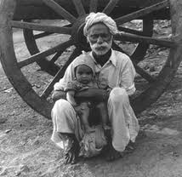
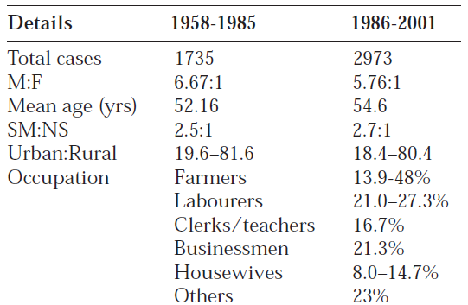
Problems of Resource Limited Settings:
Patient Related
Poverty
Malnutrition
Illiteracy
Funding
Infrastructure
Manpower
Standardization
Poverty,illiteracy & malnutrition is a Carcinogen
Lung cancer: Indian demographics
Indian J Chest Dis Allied Sci. 2004 Oct;46(4):269-81.

Slide 54
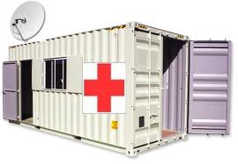
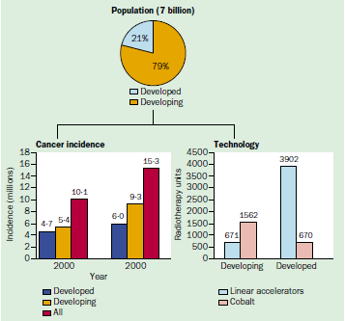
Problems of Resource Limited Settings:
Provider Related
Poverty
Malnutrition
Illiteracy
Funding
Infrastructure
Manpower
Standardization
2000
2010
Radiotherapy units per million population:
India/Pakistan 0.3
Bangladesh 0.1
USA 8.3
Dismal for Simulators / TPS
Lancet Oncology(5)2004;695-8

Slide 55
Problems of Resource Limited Settings:
Provider Related
Poverty
Malnutrition
Illiteracy
Funding
Infrastructure
Manpower
Standardization
Radiation Oncologists 750
Medical Physicists 550
Dosimetrist: 0
Radiotherapy Technologist 900
Medical staff (3 CDRT) 400
Medical staff (Advanced RT) 75-110
HUGE SHORT FALL

Slide 56
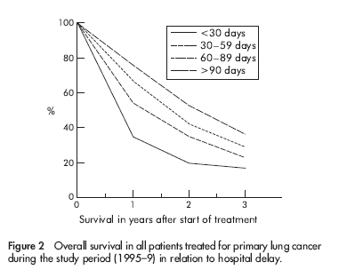
Problems of Resource Limited Settings:
Provider Related
Poverty
Malnutrition
Illiteracy
Funding
Infrastructure
Manpower
Standardization
Treatment Starting Delays are common
2-6 weeks in most state funded departments
May result in upstaging and poorer outcomes
Effect of delays on prognosis in patients with NSCLC
Thorax 2004;59:45–49

Slide 57
What we are witnessing is the
Fast Pased
Technological
Convergence/coalescence

Slide 58

The Unique Paradox:
Problems of Resource Limited Settings
Lost between
Basic deficiencies &
Technical advancements

Slide 59
Optimization of Treatment
Good Nutritional Support.
Avoidance of Treatment Breaks
Integration of Chemotherapy as and when indicated
Altered fractionation & abbreviated schedules
Integration of high-precision techniques wherever needed

Slide 60
Concept of Local Control
Concept of Local Control
You may not achieve a cure after local control
BUT
One can not have a cure without local control
Concept of Local Control

Slide 61

Together We Can
Change The World
THANK YOU

